Slide 1
Contraception & Sexual Health ( CaSH )
Dionysis Vaidakis
Obstetrician &Gynecologist
Clinical Assistant Professor
vaidakis.d@unic.ac.cy

Slide 2
Learning Objectives
Why should you learn about Contraception
Why Contraception for your patients
Attitude/Values/Judgments/Ethical considerations
Regular methods of contraception
Principles of action
Efficacy
Benefits
Risks
Contraindications
Drug interactions
Emergency contraception

Slide 3
Sexual health
Sexual health is fundamental to the overall health and well-being of individuals, couples and families, and to the social and economic development of communities and countries.
access to comprehensive, good-quality information about sex and sexuality;
knowledge about the risks they may face and their vulnerability to adverse consequences of unprotected sexual activity;
ability to access sexual health care;
living in an environment that affirms and promotes sexual health.

Slide 4
Sexual health
Sexual health-related issues are wide-ranging, and encompass sexual orientation and gender identity, sexual expression, relationships, and pleasure. They also include negative consequences or conditions such as:
Infections
unintended pregnancy and abortion;
sexual dysfunction;
sexual violence; and
harmful practices (such as female genital mutilation, FGM).

Slide 5
FamiLy planning
https://youtu.be/nXLxcVYB-LA
Family planning
the ability of individuals and couples to anticipate and attain their desired number of children and the spacing and timing of their births
influenced by
marital situation
career considerations
financial position
any disabilities or medical conditions
Family planning has been of practice since the 16th century
Physicians advised women to space their children, having them every three years
Today
sex education
prevention and management of sexually transmitted infections,
pre-conception counselling
infertility

Slide 8
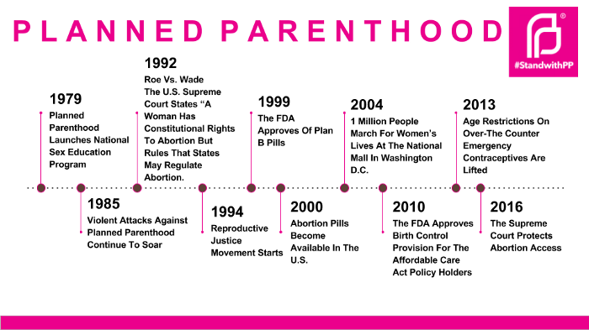

Slide 9
Why should Ι Learn ?
Prescribe contraception confidently
Provide good patient care
avoid pregnancy
avoid STI
Practice medicine with NO medico-legal issues
avoid drug interaction
under 16s
Why should Ι learn I will specialized on oncology ?

Slide 10
Main goaLs of family planning
Number of children
Time
Place
BUT also :
Decrease Abortions rates
AND especially unsafe abortion

Slide 11
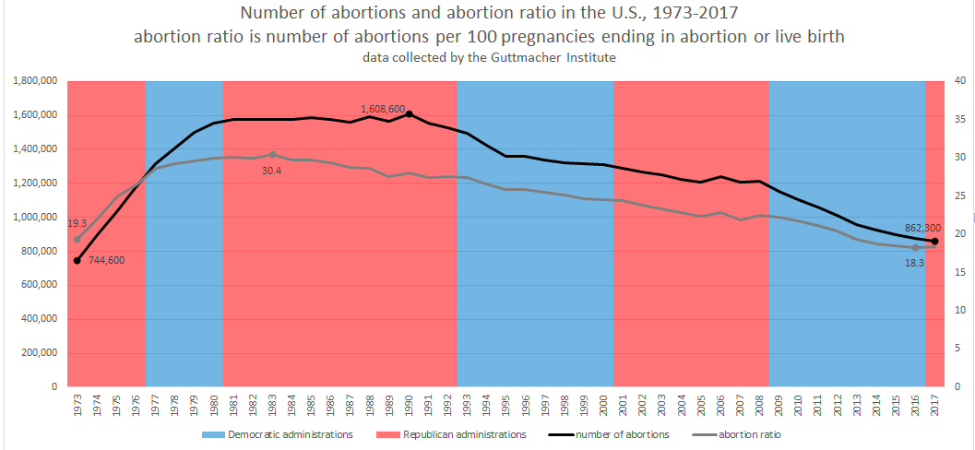
abortions
For 2017, the Guttmacher Institute IN USA :
Abortions: 862,320 (historic low)
abortion rate 13.5 abortions per 1,000 aged 15 to 44 years
abortion rate 18.4 abortions per 100 pregnancies ending in abortion or live birth.

Slide 12
W.H.O. and unsafe abortions
According to WHO statistics, the risk rate for unsafe abortion is 1/270
unsafe abortion is responsible for at least 8% of maternal deaths.
Worldwide, 48% of all induced abortions are unsafe (25 million women)
2-7 million women each year survive unsafe abortion but sustain long-term damage or disease
The British Medical Bulletin reported in 2003 that 70,000 women a year die from unsafe abortion.

Slide 13
sexual health and pregnancy
SEXUAL HEALTH
WHO definition
SEXUALITY AND SOCIETY
Sex for reproduction?
ADOLESCENT SEXUAL BEHAVIOR
Approximately 38 percent of high school youth report having had sexual intercourse, and 27 percent report being currently sexually active
males age 15 to 24 years reported having their first sexual intercourse before age 13 years
8.5 % of those with sexual initiation before age 13 years described their first episode of sexual intercourse as unwanted

Slide 14
Health ISSUES AND OUTCOMES RELATED TO SEXUALITY
Unwonted Pregnancy
STIs and HIV
Approximately 19 million STIs occur each year in the United States, of which a disproportionate number (9 million) occur in adolescents
Victimization
Teen dating violence
Sexual minoritized youth

Slide 15
ISSUES FOR THE HEaLTH CARE PROVIDER
Provision of education
Overcoming barriers
Principles of care
Confidentiality
Normalization
‘’It is normal to have sex at your age’’
Respect
Avoid assumptions

Slide 16
Ethical considerations
What does it mean to be professional?
Abortion Yes or No
Age of first sexual intercourse
Develop your own ethical red lines

Slide 17
Why Contraception AND NOT abstinence

Slide 18
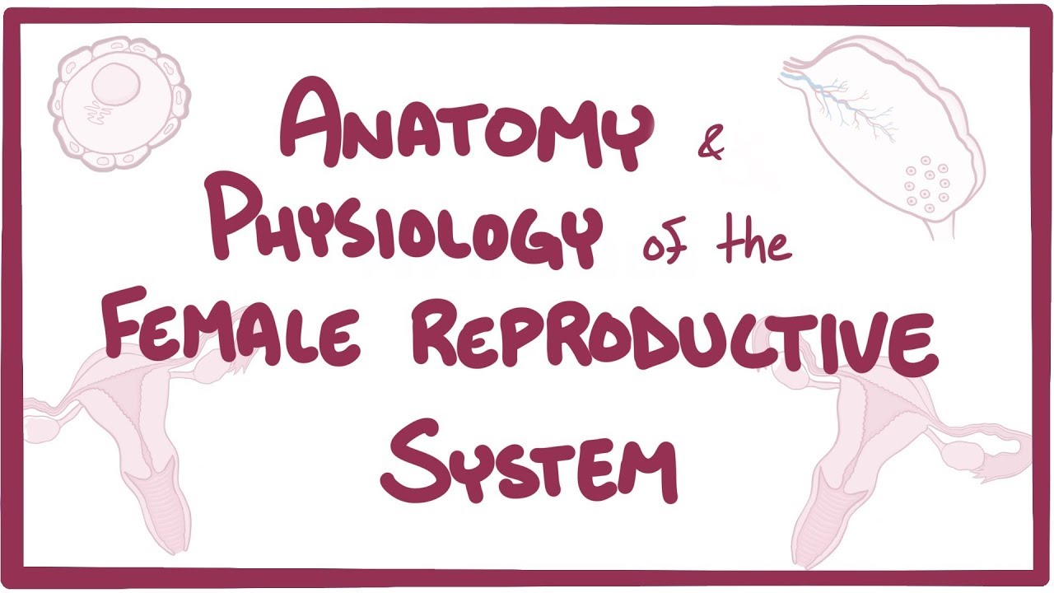
Physiology
A quick revision

Slide 19
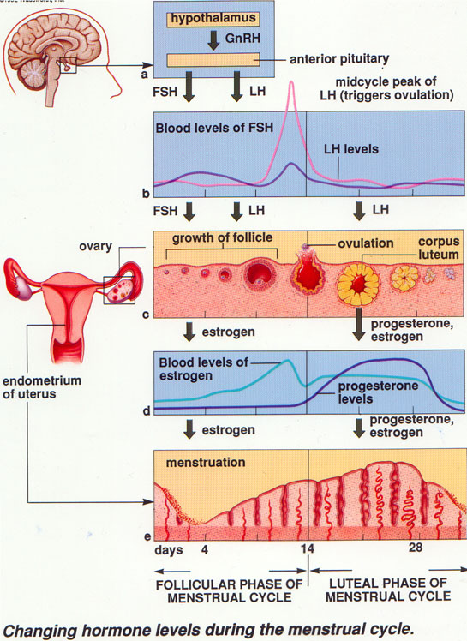
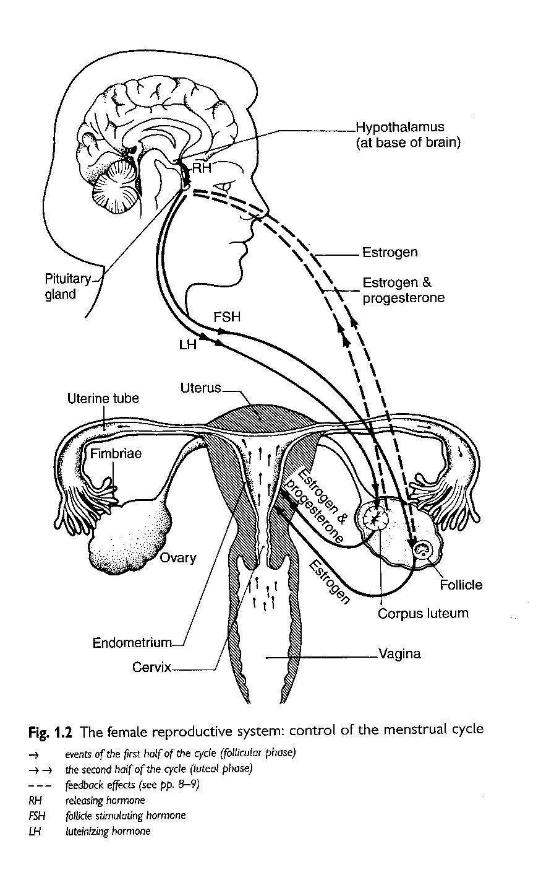
Understanding Hormonal regulation
A quick revision

Slide 20
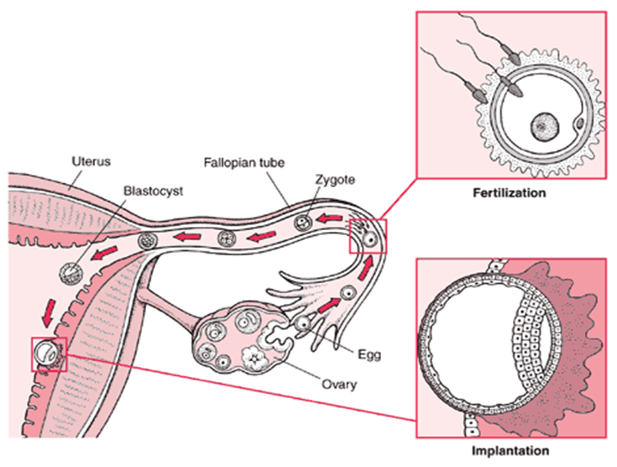
Fertilization
How long does a sperm could survive in the genital tract?
How long does it take for the fertilised egg to implant ?

Slide 21
Types of Contraception
Contraception
Reversible
Methods
LARC
Used Everyday
Permanent
Methods
Female Sterilisation
Used at the time of Sex
Depo Provera Injections
Implants
IUD &IUS
COCP & POP
Vaginal Rings
Patches
Male condoms
Female condoms
Diaphragms
Male Sterilisation

Slide 22
Criteria for choosing a method- UK Mec

Slide 23
Barrier methods

Slide 24
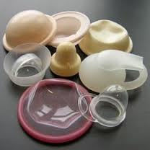
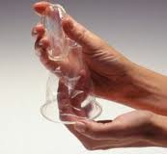
Barrier methods

Slide 25
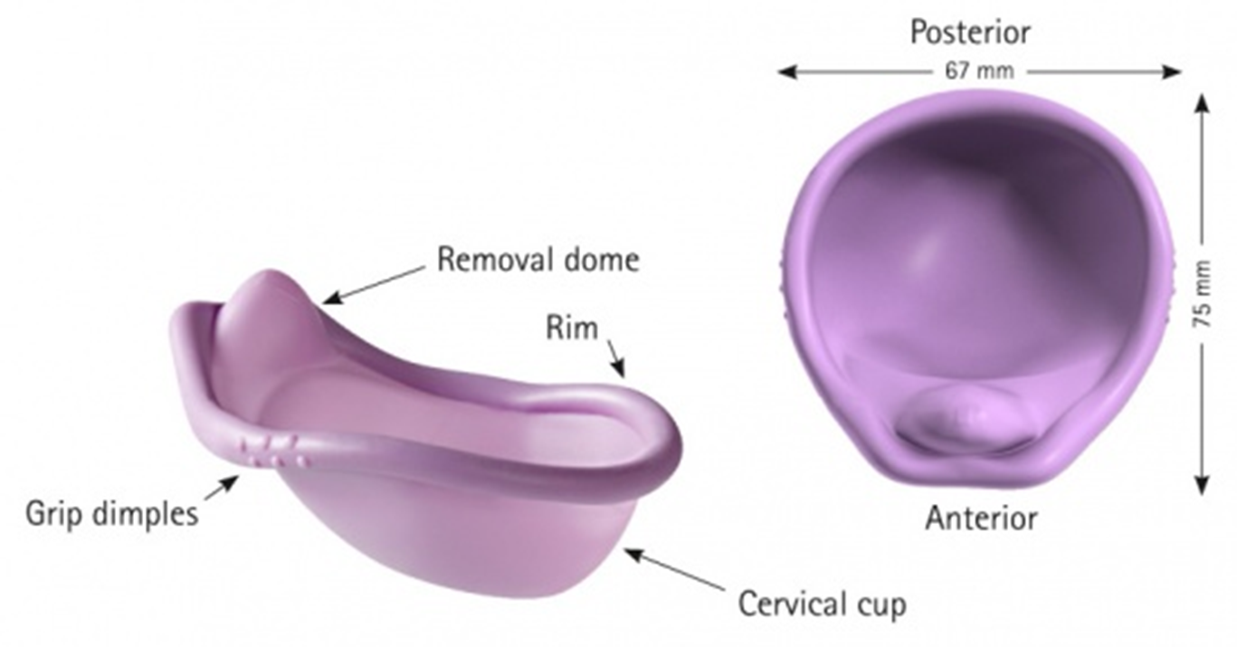
Diaphragm

Slide 27
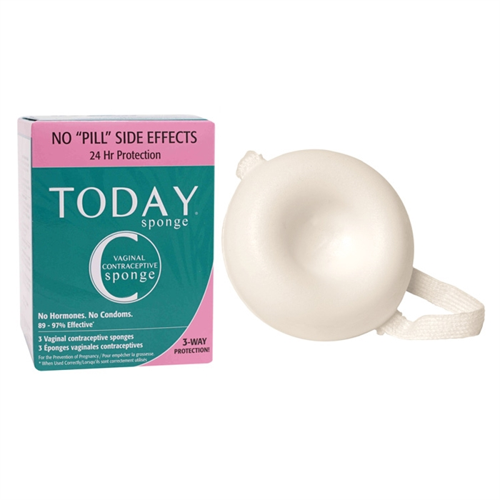
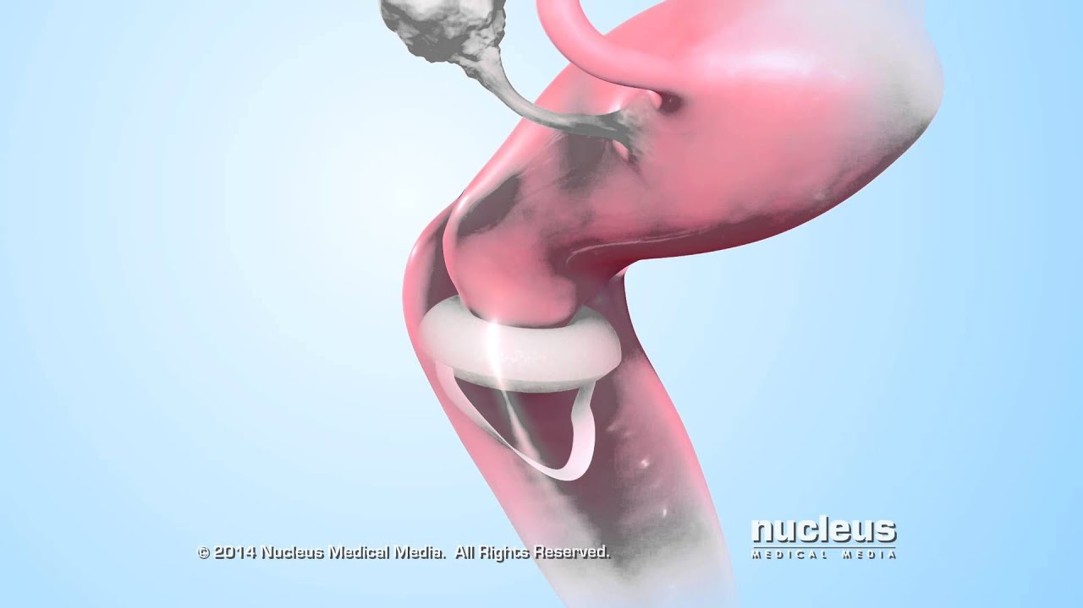
Sponge

Slide 28
HORMONAL methods

Slide 29
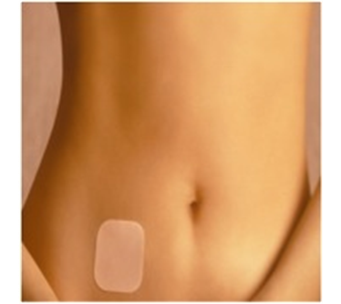
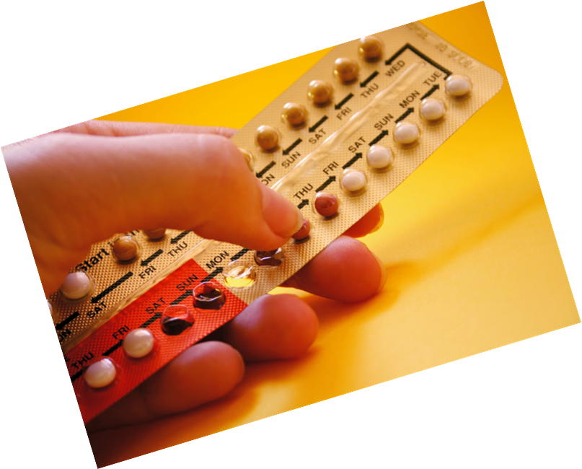
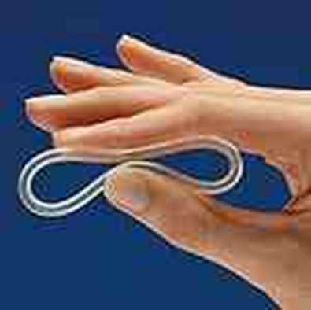
HORMONAL methods
Combined Hormonal Contraception(CHC)
Estrogen only
Progesterone only

Slide 30
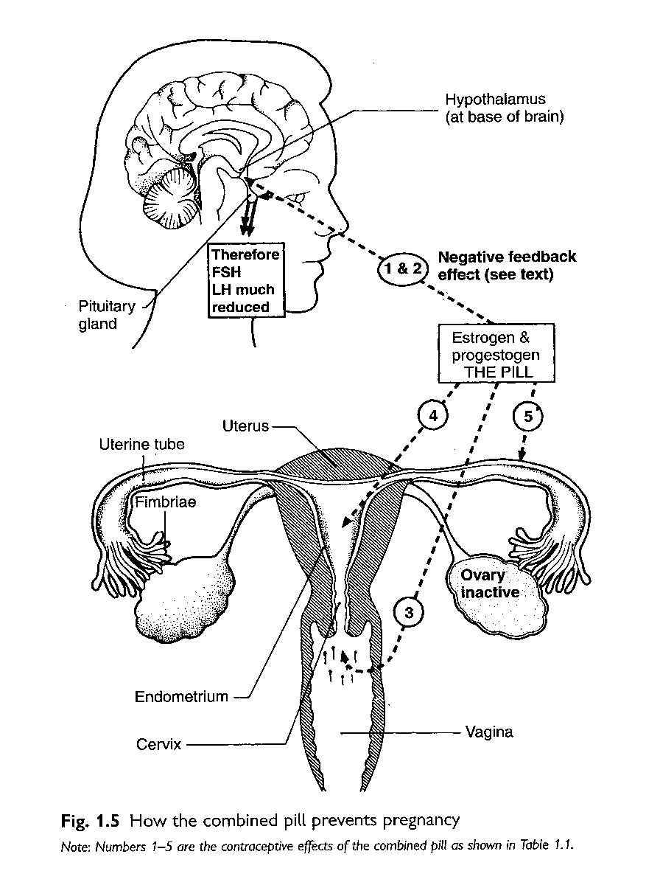
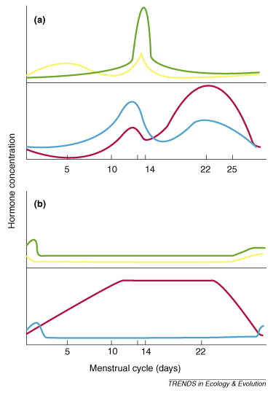
Mode of action of Combined methods

Slide 31
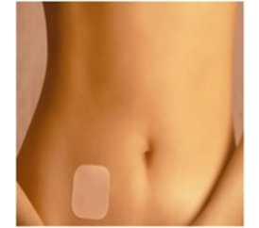
Combined Patches and Rings
Patches
One patch / week
Patches for 3 weeks
One patch free week
Rings (Nuvaring)
One ring for 3 weeks
One ring free week

Slide 32
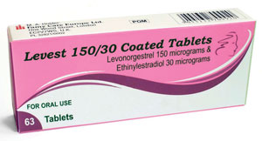
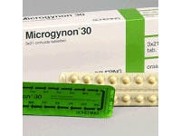
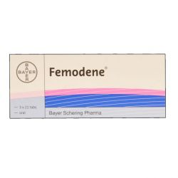
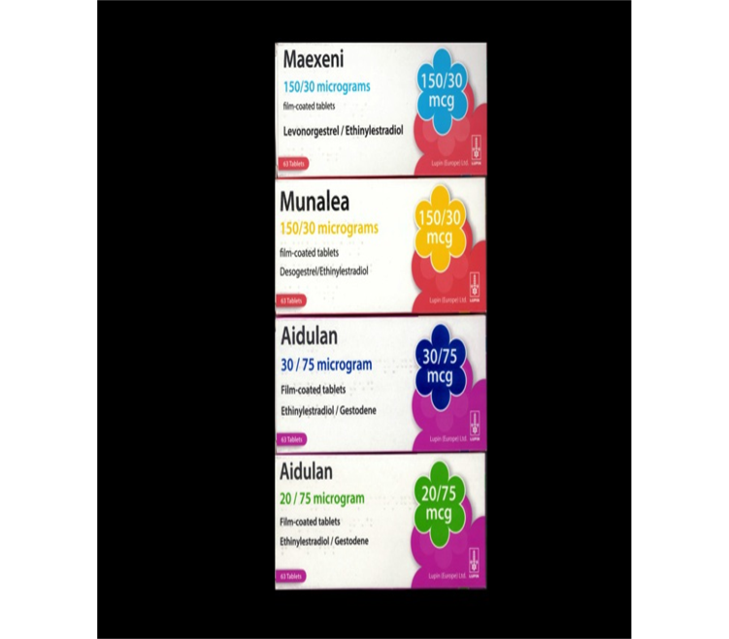
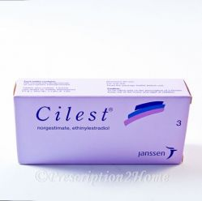
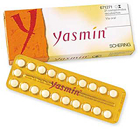
Combined oral contraceptive pill

Slide 33
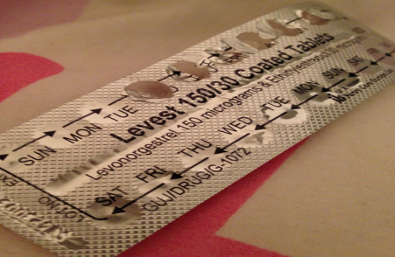
Combined oral contraceptive pill
Majority in UK- Monophasic pills (Fixed dose)
20, 30 or 35 micrograms of Ethinylestradiol
1st, 2nd, 3rd generation pills- Different progestogens
Taken for:
Standard Regimen: 21 day pack with 7 days pill free period- Licenced to use in UK
Tailored Regimen: used continuously or with pill free period less than 7 days- Only Qlaira is licenced to use in UK
Efficacy:
Typical use failure rate 9%
Perfect use failure rate 0.3%

Slide 34
Combined oral contraceptive pill
What are the benefits of using COCP?
What are the risk factors to be considered?
What are the contraindications for using COCP?
What are the side effects ?

Slide 35
Benefits of the COCP
↓ Dysmenorrhoea and Menorrhagia
To regulate the cycle
Symptomatic relief / treatment of Endometriosis
↓ Endometrial cancer x 50% (use over 15 years)
↓ Ovarian cancer x 40% (use over 15 years), 20% (use for 5 years)
↓Fibroids x 30% (use over 1 years)
↓ Benign breast disease x 50 - 75%
↓ Rheumatoid arthritis x 50%
↓ Colorectal cancer x 20%
? ↓ Duodenal ulcer
May improve some Menopausal symptoms, Acne

Slide 36
Evidence about VTE risks
Rates: 34-38 per 100,000 women per year
BMI over 30 - Doubles VTE risk
BMI over 35 - Quadruples VTE risk
Smoking - Doubles VTE risk
Increased risk with Age, Pregnancy & immediate post partum

Slide 37
Risk of Venous Thromboembolism
Venous thromboembolism(VTE) includes deep vein thrombosis (DVT),
pulmonary embolism(PE) and cerebral venous sinus thrombosis
Compared to non-users, the risk of VTE with use of CHC is approximately doubled but that the absolute risk remains very low
Although the relative risk of VTE does increase with CHC use, the absolute risk in women of reproductive age is very low
The risk of VTE is highest in the four months following initiation of CHC or when restarting after a break of at least one month
The risk then reduces over the next year and remains stable thereafter

Slide 38
Risk of VTE and CHC
LNG-containing pills may be the ‘safest’ pill choice - for starting or switching contraception

Slide 39
Risk of Breast Cancer and CHC
Meta-analysis of case-control studies from 25 countries:
Increased risk of breast cancer whilst using COC
Excess risk - increases quickly after starting
Does not increase with duration of use
Disappears within 10 years of stopping COC use
Breast cancer and family history:
A family history of breast cancer does not restrict use of CHC (UKMEC 1)
Risk of breast cancer associated with CHC use is likely to be small, and will reduce with time after stopping

Slide 41
Contraindications and CHC use
UK MEC Category 4
Smoking >35 years > 15/day
BP > 160/95mmHg
Personal H/O VTE
VTE on anticoagulant
Current Migraine with aura- any age
Current Breast cancer
UK MEC Category 3/4
Acute Hepatitis: starting CHC
UK MEC Category 3
Smoking >35 years < 15/day
BP > 140-159/90-94mmHg
Obesity, BMI>35
F/H VTE 1st degree relative <45 years
Immobility
Current migraine at any age, no aura
Migraine with aura >5 years ago
Breast Cancer with Mutation/No evidence with current disease
UK MEC Category 2/3
Known Hyperlipidaemia

Slide 42
Contraindications and CHC use
UK MEC Category 2
Acute Hepatitis: Continuing CHC
Diabetes type 1 or 2 with no vascular disease
Current migraine at any age with NO aura initiating
Uncomplicated valvular & congenital heart disease
UK MEC Category 1
Chronic hepatitis
Compensated cirrhosis
Family H/O Breast cancer

Slide 43
Drug interaction
NOT broad spectrum antibiotics
Enzyme Inducers:
Anticonvulsants
Rifampicin
Rifabutin
Lamotrigine (except in combination with sodium valproate):
The risk of reduced seizure control whilst on CHC, and the potential for toxicity in the CHC-free week, the risks of using CHC may outweigh the benefits (UKMEC Category 3

Slide 44
Management of Drug interaction
On short-term treatment with an enzyme-inducing drug (and for 28 days after stopping treatment):
continue using a combined oral contraceptive (COC) containing at least 30 μg ethinylestradiol (EE), the patch or ring along with additional contraception
An extended or Tricycling regimen should be used
The hormone-free interval shortened to 4 days
Additional contraception should be continued for 28 days after stopping the enzyme-inducing drug
Long use of enzyme-inducing drug, exception of the very potent enzyme inducers rifampicin and rifabutin:
Additional precaution
OR
The dose of COC to at least 50 μg EE (maximum 70 μg EE)
Use an extended or Tricycling regimen with a pill-free interval of 4 days

Slide 45
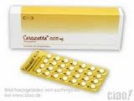
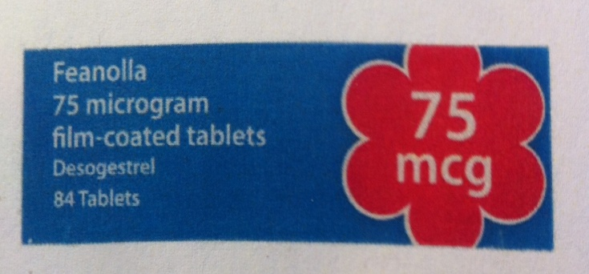
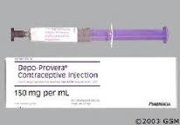
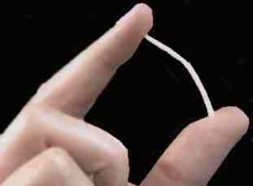
Progestogens only methods

Slide 46
Progestogen Only Pill (POP)
Micronor
Traditional POP
Norethisterone
Thins endometrium and thickens cervical mucus
3 hour window- missing pills
Cerazette/Zellata/Feanolla
Desogestrel
Thins endometrium
Inhibits ovulation up to 97% of women
12 hour window- missing pills
FSRH – March 2015

Slide 47
Progestogen Only Pill (POP)
Efficacy:
99% if taken correctly
Assumption - Desogestrel is more effective, not by data
Ectopic pregnancy – 1:10 among the failed contraception (Traditional POP)
Side effects:
Progestogenic
Bleeding (20% amenorrhea, 40% regular, 40% irregular)
Weight

Slide 48
Contraindications for POP
Absolute contraindication
Current breast cancer
Relative contraindications
History of breast cancer (no recurrence in 5 years)
Liver tumors
Enzyme inducing medication

Slide 49
Drug interaction & POP
Not affected by non enzyme inducing antibiotics
Enzyme inducers :
Reduced effect 4 weeks after stopping them
Management with Enzyme-inducing drugs:
Long term
Switch to the progestogen-only injectable or intrauterine contraception
Short term (<2 months)
Continue the POP with use additional precautions during treatment and for 28 days afterwards
FSRH – March 2015

Slide 50
What to do if you miss a pill
the type of pill you're taking
how long ago you missed the pill
how many pills you've forgotten to take
whether you've had sex without using another type of contraception in the previous 7 days

Slide 51
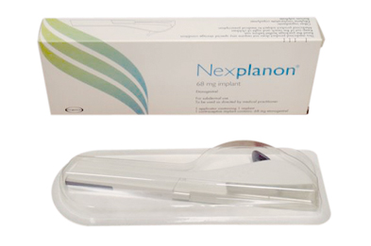
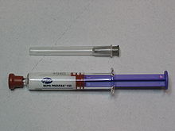
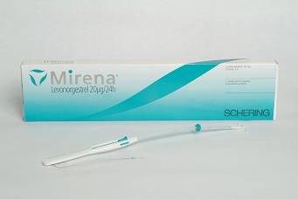
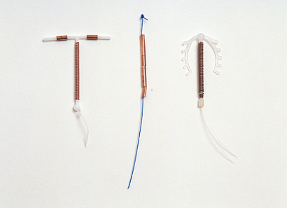
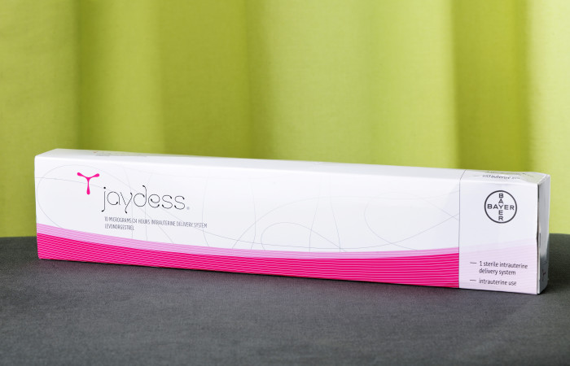
Long Acting Reversible Contraception

Slide 52
Injection- Depo Provera
150mg Medroxyprogesterone acetate
Lasts 3 months(12 weeks) for IM and 13 weeks for SC
Inhibits ovulation
Start day 1-5 or use extra precautions
Advised to switch to another method at age 50 years , if no risk consider longer if she wish to continue. After 45 years old - UKMec 2
Consider alternative for teenagers/perimenopausal
Delay in return of fertility by up to a year
Effect on Bone Mineral Density (BMD)
Side effects: bleeding/weight
Failure rate:
With in 1st year of use 0.2%
Typical user 6%

Slide 53
Depo Provera
Weight gain
< 18 years of age with a body mass index (BMI) ≥30 kg/m2
Gain > 5% weight in first 6 months and continue after
Cervical cancer
Use for 5 years or longer & reduce after stopping
Advise using condom, smoking cessation, regular cervical screening and vaccination for HPV
Breast cancer
current use of DMPA and is likely to be small and reduce with time after stopping
Unscheduled bleeding- COCP for 3 months
Efficacy NOT reduced with concurrent use of enzyme inducing drugs
UPA may reduce efficacy
There is no evidence of harm in pregnancy
May benefit:
Menstrual problems
Pain associated with endometriosis
Sickle cell crisis pain
Endometrial and ovarian cancer
FSRH – Dec 2014 & Updated March 2015

Slide 54
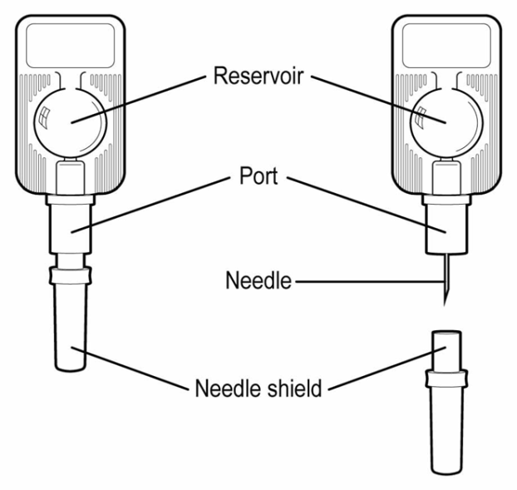
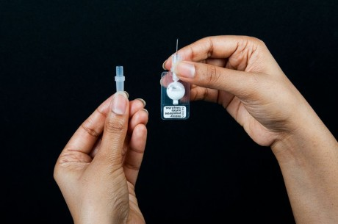
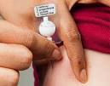
Sayana Press
Medroxyprogesterone acetate
104 mg/0.65 ml suspension
Sub-cutaneous injection
Single-dose container
Prefilled Injector- shake vigorously before use
Injection in abdomen or thigh
Injected every 13 weeks interval-(+/- 7 days)
Inhibit gonadotrophins secretion --> Prevents follicular maturation & ovulation
Currently not licensed for self administration
FSRH – June 2013

Slide 55
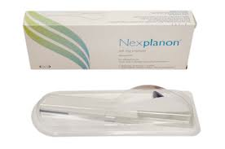
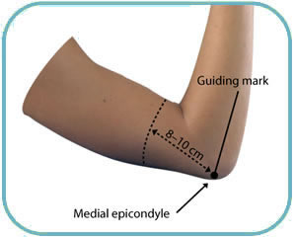
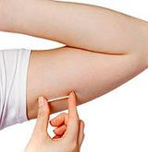
Implant- Nexplanon
68mg Etonorgestrel
Inhibition of ovulation
Lasts for 3 years
Start on day 1-5 of cycle or extra protection for 7 days
Inserted in upper inner aspect of the arm

Slide 56
Nexplanon
Drug interaction:
Enzyme inducers
Can now be used with some HIV drugs
Side effects:
Bleeding
Headache
Acne
Bloating
(mood)
(weight)
(hair loss)

Slide 57
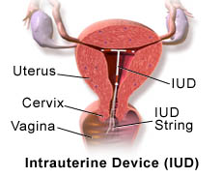
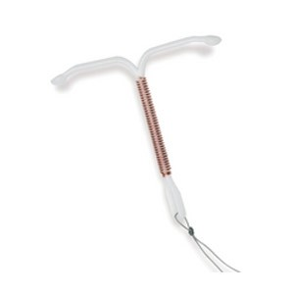
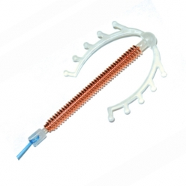
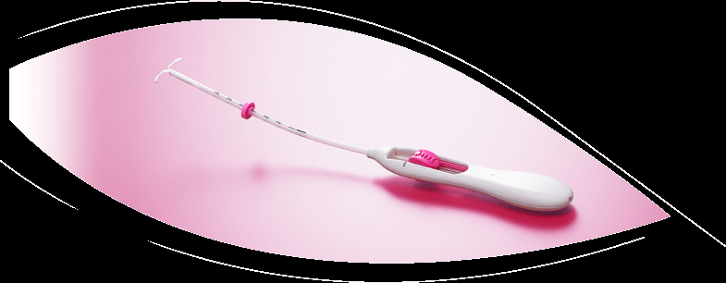
Intra Uterine Device & Intra Uterine System
IUDs
IUS – Mirena

Slide 58
IUD & IUS
IUD
Prevents implantation
Can be used as Emergency contraception- up to 120 hours of UPSI
Prevent sperm entry
IUS - Levonorgestrel
Prevents implantation
Thickens Cervical mucus- prevents sperm entry
Mirena- 5 years
Jaydess
3 years
Contains Silver ring- identified in USG/X-Ray
Contraindicated for women with hypersensitive to Silver

Slide 59
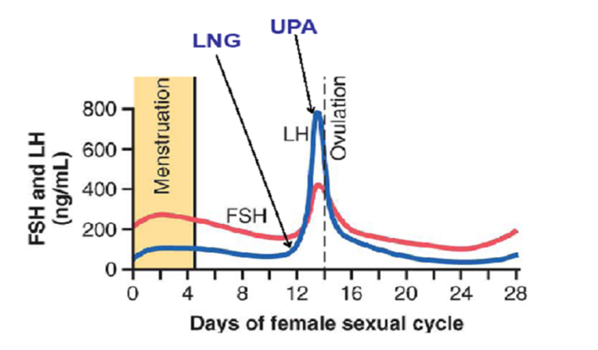
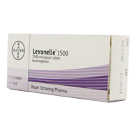
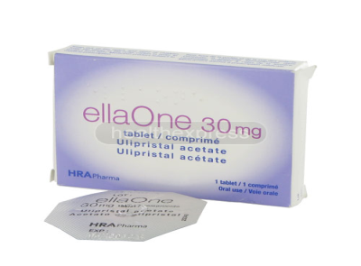
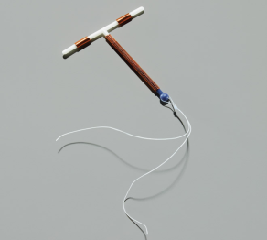
Emergency contraception
Oral
Levonelle/Upostelle (Levonorgestrel 1.5 mg)
Can be use up to 72 hours of UPSI
Effective if used before ovulation
Delays ovulation
Not effective if LH surge begun
Can be use > once/ cycle
Ella One (Ulipristal Acetate- Selective progesterone receptor modulator 30 mg)
Can be used up to 120 hours of UPSI
Effective if used before ovulation
Primary action- Delays ovulation
Can be detected in breast milk
up to 5 days
IUD ( Copper)
Can be used up to 120 hours of UPSI up to Day 19 of cycle
Prevents implantation

Slide 60
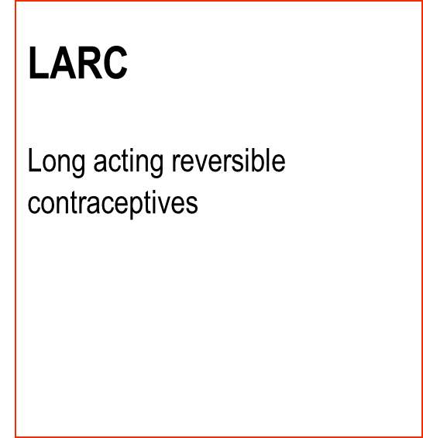
Accidental Pregnancy- First year of use
Trussell J. Contraceptive efficacy. In: Hatcher RA, Trussell J, Stewart R. Contraceptive Technology, ed 17. NY: Ardent Media, 1998;800-801

Slide 61
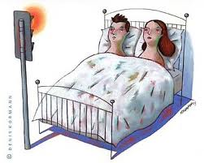
BesT method of contraception?

Slide 62
Which type of birth control should I choose?
How well it prevents pregnancy
How often you have to use it
How easy it is to get
How easy it is to use
Whether it has benefits besides preventing pregnancy
Its side effects or downsides
How much it costs
I want to get pregnant in the future
How soon I might get pregnant

Slide 63
Contraception: Counseling and selection
One fit to all???
GOALS
preventing unintended pregnancy
Personalized counseling with shared decision making
Establish rapport
Identify patient-centered reproductive goals
Identify patients who wish to prevent pregnancy now
One Key Question" in which women are asked if they would like to become pregnant in the next year
Reproductive life plan
Opportunity for preconception counseling
Document medical history/potential contraindications

Slide 64
THE SHARED DECISION-MAKING PROCESS
Initiate the conversation
Elicit informed preferences
How they are taken
How often they are taken
Efficacy
Effect on menstrual bleeding (including regularity and flow)
Other side effects
Noncontraceptive benefits
Privacy
Effect on future fertility
Discuss method characteristics
Side effect etc.
Assess risk of sexually transmitted infections

Slide 65
SPECIAL POPULATIONS
Adolescents
Postpartum women
Postabortion women
Chronic medical conditions
Obesity
Women with substance use disorders
Women who request IUD or implant removal
Intellectual or physical disability
History of cancer
Transgender men

Slide 66
Adolescents
CONFIDENTIALITY
Ethical vs Medical vs Legal issue
Conditional versus unconditional
Public health perspective
EXEPTIONS
Child abuse/neglect
Suicidal ideation or attempt
Sexually transmitted infections
Mental health care

Slide 67
MYTHS OF CONTRACEPTIVE COUNSELING
Unintended pregnancy is not always unwelcome
Unintended pregnancies are not necessarily unhealthy pregnancies
Contraceptive efficacy is only one important contraceptive characteristic

Slide 68
Case 1
Contraceptive counselling in young patients
A 14-year-old girl attends the family planning clinic requesting contraception. She has been using condoms but would like to discuss alternative methods. She has no significant past medical or surgical history and does not take any regular medication.
How would you assess this patient?

Slide 69
What are the ethical issues in this case?
The law in relation to sexual activity in young people and safeguarding
Capacity and consent
What are the contraceptive options for her?

Slide 70
Case 2
Request for permanent contraception
A 27-year-old woman attends requesting sterilisation. She is in a long-term relationship and has two children with her current partner both born by caesarean section. She has used barrier contraception in the past and is currently taking the progesterone only pill but now wants a more reliable form of contraception.
How would you assess this patient?
What alternatives should be offered?
When should sterilisation be performed?

Slide 71
Case 3
Emergency contraception
A 19-year-old nulliparous woman attends requesting emergency contraception (EC). She had UPSI 48 hours ago and is anxious regarding her risk of pregnancy. She has no significant past medical or surgical history.
How would you assess this patient?
Ethical considerations
Options for couples who do not wish to use artificial contraceptives
Natural contraception

Slide 72
Case 4
The most common one
A 20-year-old nulliparous woman attends requesting contraception. She is with her boyfriend. She is anxious regarding her risk of pregnancy. She has no significant past medical or surgical history.
How would you assess this couple?
What are the contraceptive options for her?

Slide 73
Case 5
The next most common
A 33-year-old woman attends requesting contraception . She is in a long-term relationship and has 2 children with her current partner. She has used barrier contraception in the past and is currently taking the COC.
How would you assess this couple?
What are the contraceptive options for her?

Slide 74
CASE 6
An ethical dilemma :
In the future a new test that can predict sexual orientation
??????

Slide 75
1.Which methods of birth control needs a prescription?
A. Birth control pill
B. Contraceptive patch
C. Cervical cap
D. Diaphragm
E. All of the above
2. What do male condoms offer that other forms of birth control do not?
A. Least chance of failure
B. Best protection against STIs
C. Cheapest to use
D. All of the above

Slide 76
3. Besides the condom, which is another barrier method of birth control?
A. Diaphragm
B. IUD
C. Withdrawal
D. Sterilization
4. Which type of intrauterine device (IUD) is available?
A. Copper
B. Titanium
C. Hormonal
D. A and C
E. All of the above

Slide 77
5. Which of these is a possible side effect of birth control pills?
A. Nausea
B. Irregular bleeding
C. Headaches
D. All of the above
E. None of the above
6. How long is the vaginal ring left in place?
A. 1 week
B. 2 weeks
C. 3 weeks
D. 3 months

Slide 78
7. Which of these methods is called natural family planning?
A. Tracking basal temperature
B. Tracking changes in cervical mucus
C. Tracking the menstrual cycle on a calendar
D. All of the above
8. Which of these methods of sterilization is permanent?
A. Tubal sterilization
B. Vasectomy
C. A and B
D. None of the above

Slide 79
References
www.ffprhc.org.uk
www.uptodate.com
John Guillebaud: The Pill
UK Mec Guidelines
Nice Guidelines on LARC

