Slide 1
Core Problem 5 Labour Complications

Slide 2
Normal labour
Abnormal labour
Labour monitoring
Vaginal Birth after Caesarean
Obstetric operations

Slide 3
You arrive for your labour ward shift at 0800 in the morning. You review the board together with the team taking over for the day.

Slide 5
Normal labour
Labour is more difficult in humans than in most other mammals.
The Australopithecines, adopted the upright posture about five million years ago.
Natural selection produced a smaller pelvis, which more efficiently transmits forces from the hind legs to the spine.
About 1.5 million years ago brain size began to increase with the result that the head of the human fetus at term now takes up most of the available space in the mother’s pelvis.

Slide 6
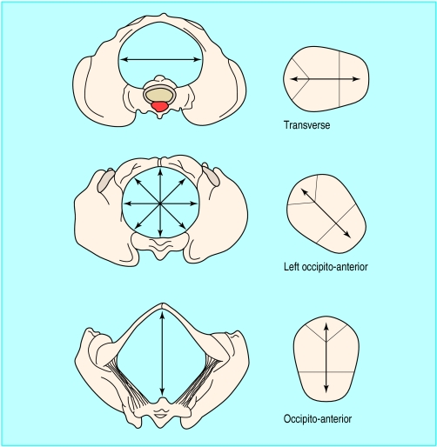
The fetal head usually engages in the occipito-transverse position
rotates to occipito-anterior as it passes through the pelvis, allowing the shoulders to engage in the pelvic brim in the transverse position.
Once the head is born, the shoulders rotate into the anterior-posterior position, which facilitates their delivery.

Slide 7
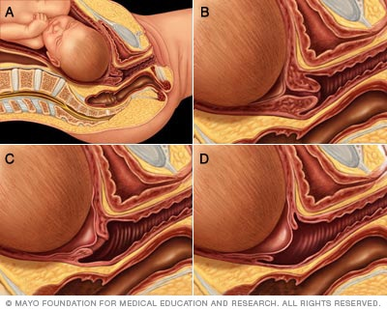
Three stages of labour
First: from the onset of labour to full dilatation
early labor (latent phase)
active labor.
8-12 hours in a first labour
3-8 hours in subsequent labours
Second: from full dilatation of the cervix to delivery of the baby
1-2 hours in a first labour
0.5-1 hour in subsequent labours
Third: from delivery of the baby to the delivery of the placenta
commonly lasts up to an hour

Slide 8
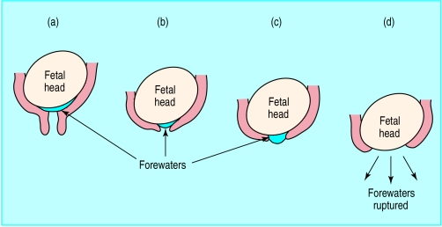

Slide 9
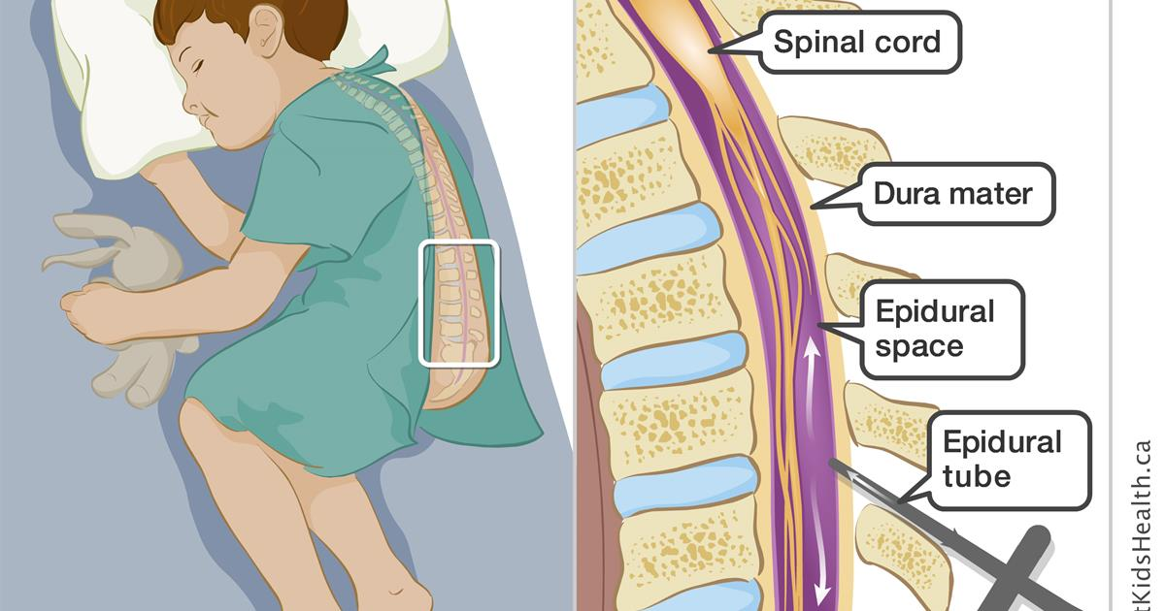
Pain relief for women in labour
Self-help in labour
Gas and air (Entonox) for labour
Pethidine injections in labour
Epidural
TENS machines

Slide 10
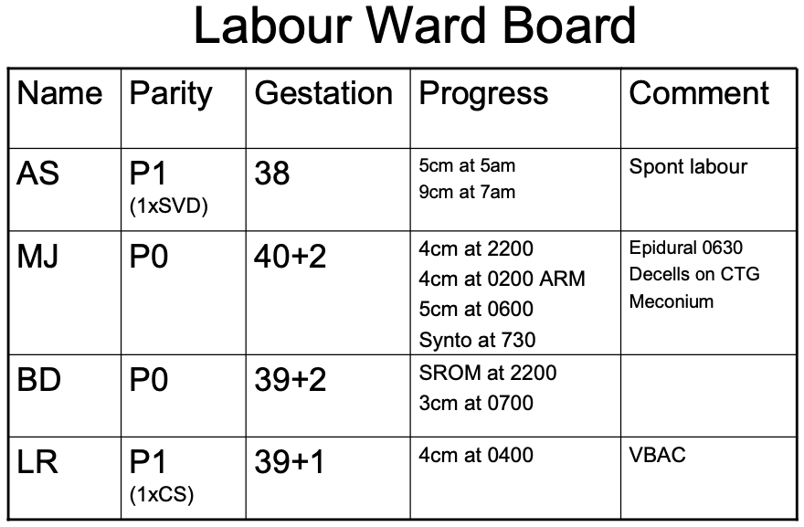
The team then review MJ

Slide 11
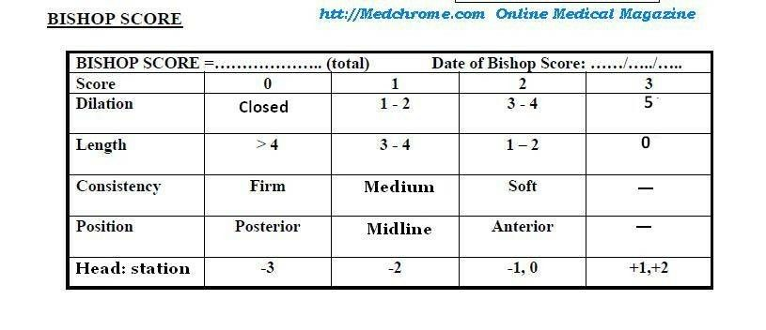
How is progress in labour monitored?
Latent phase of labour
Assessed with the Bishop score.
The cervix should change at a minimum of one Bishop score point an hour
A score of 11 indicates the onset of the active phase of labour,
cervical dilatation in women in their first labour is 1 cm/h.
Parous women the cervix dilates faster—on average 1.6 cm/h.

Slide 12
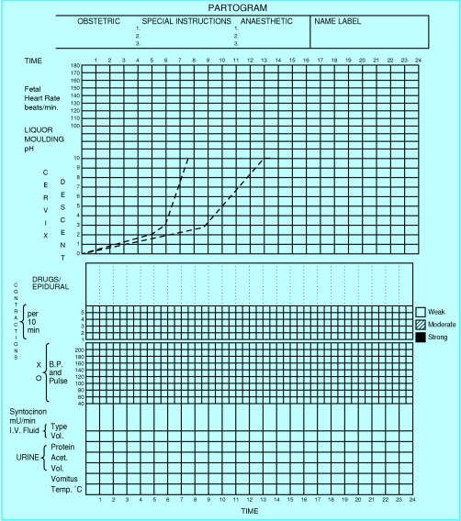
How is progress in labour monitored?
Partogram.
identify abnormally slow labour
graphical representation of the changes that occur in labour,
cervical dilatation
fetal heart rate
maternal pulse
blood pressure
temperature;
urine output and the volume and type of intravenous infusions (including oxytocin drips).

Slide 13
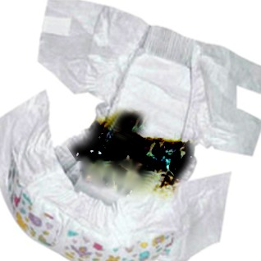
What is the significance of meconium?
Meconium is the initial substance present in the intestines of the developing fetus and constitutes the first bowel movement of the newborn.
Meconium can be green, brown, or yellow. Term healthy neonates pass meconium between 24 to 48 hours following birth.
Preterm infants typically exhibit delayed passage.

Slide 14
What is the significance of meconium?
This assessment is important for the initial newborn examination.
Failure to pass meconium beyond 48 hours in term neonates may indicate disease or obstruction of the infant's bowel.
The presence of meconium-stained amniotic fluid is about 12-20% of deliveries
In-utero passage of meconium may indicate normal gastrointestinal maturation or more concerningly it may be a sign of acute or chronic fetal hypoxia.

Slide 15
What is the significance of meconium?
Some of the conditions associated with meconium passage in-utero include
placental insufficiency,
preeclampsia,
oligohydramnios,
peripartum infections
certain maternal drugs such as cocaine.
Babies born through a meconium-stained amniotic fluid are at higher risk of development of adverse events such as perinatal asphyxia and respiratory distress

Slide 16
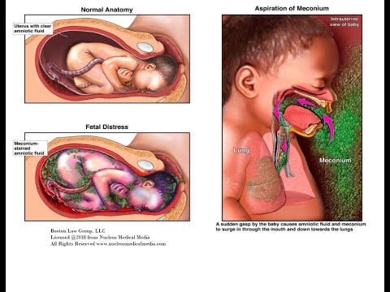
meconium aspiration syndrome.

Slide 17
What is a CTG and what are its limitations?

Slide 18
Abnormal labour
What are the causes of abnormal labour progress?
What are the maternal and fetal risks of prolonged labour?
Discuss management of dystocia in labour.

Slide 19
What are the patterns of abnormal labour progress?
The latent phase
Prolonged latent phase is defined as exceeding 20 hours in patients who are nulliparas or 14 hours in patients who are multiparas.
The most common reason for prolonged latent phase is entering labor without substantial cervical effacement.
uterine contractility
The uterine contraction pattern must repeat every 2-3 minutes.
Pelvis
anthropoid pelvis
A patient who is extremely short, obese, or has had prior trauma to the bony pelvis also may be at increased risk of abnormal labor.
size of the infant and its presentation.
fetal head and the maternal bony pelvis
Fetal macrosomia

Slide 20
maternal and fetal risks of prolonged labour
Maternal
Higher chance of operative delivery
Infection of the uterus
Damage to the birth canal
Postpartum infection
Postpartum hemorrhage
Fetal
Fetal distress
Intracranial hemorrhage.
Increased use of forceps or vacuum extractors.
Meconium aspiration
Sepsis.
cerebral palsy
hypoxic-ischemic
encephalopathy (HIE)
seizure disorders.

Slide 21
management of dystocia in labour.
Dystocia is defined as abnormal or difficult labor
Abnormalities of expulsive forces
Abnormalities of presentation, position, and development
Cephalopelvic disproportion
Abnormalities of the maternal bony pelvis or birth canal

Slide 22
management of dystocia in labour.
Medical Care:
Oxytocin
Prostaglandins
Amniotomy
Surgical Care:
Forceps delivery
Vacuum delivery
CS

Slide 23
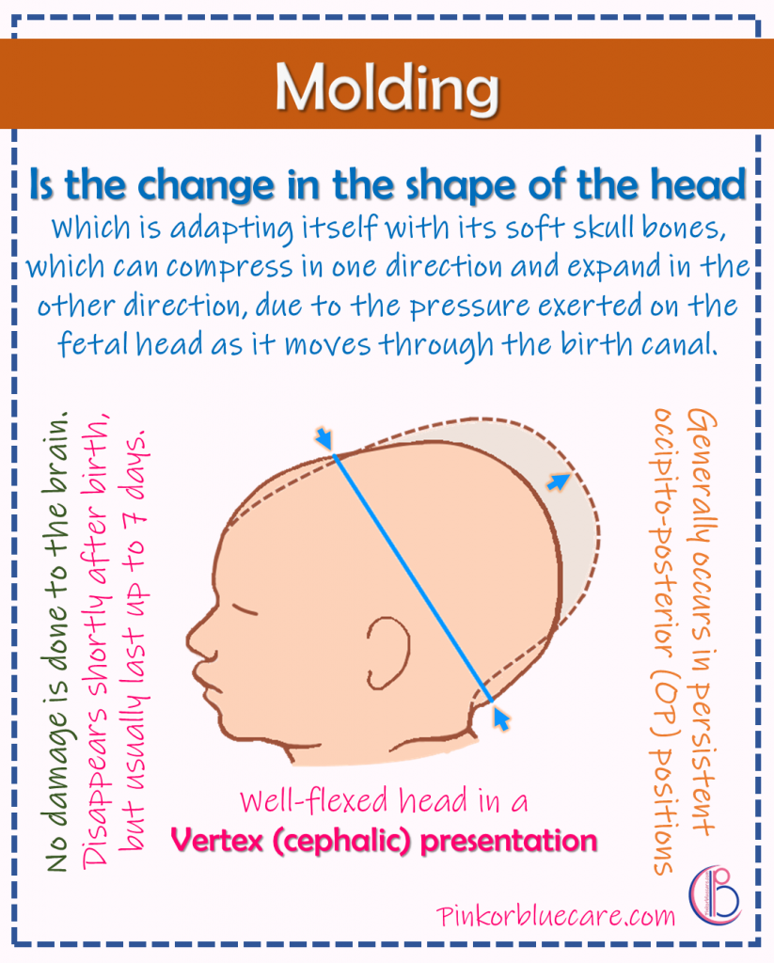
At 3pm the Obstetric reg arrives to review MJ. On abdominal examination there is 2/5 head palpable and on VE there is caput and moulding and the cervix is 6cm dilated.

Slide 24
Obstetric operations
indications for operative delivery?
Fetal
Presumed fetal compromise
Maternal
Inadequate progress
Nulliparous women lack of continuing progress for 3 hours with regional anaesthesia, or 2 hours without regional anaesthesia
Multiparous women lack of continuing progress for 2 hours with regional anaesthesia, or 1 hour without regional anaesthesia
Maternal fatigue/exhaustion

Slide 25
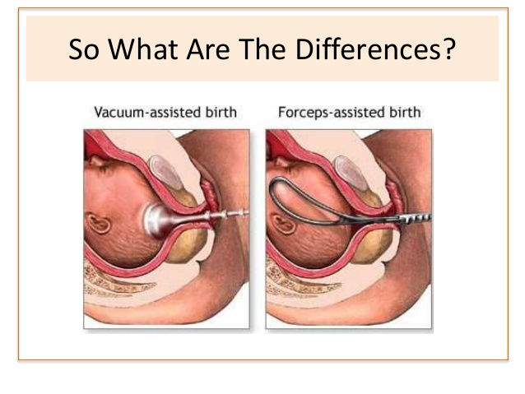
MJ has a healthy 4kg baby boy by LSCS. After assisting with the section the Reg and yourself are asked to review BD. She has now been fully dilated for 2 hours and pushing for over an hour.
Compare and contrast Ventouse and forceps delivery
What are maternal and fetal risks of operative delivery?

Slide 26
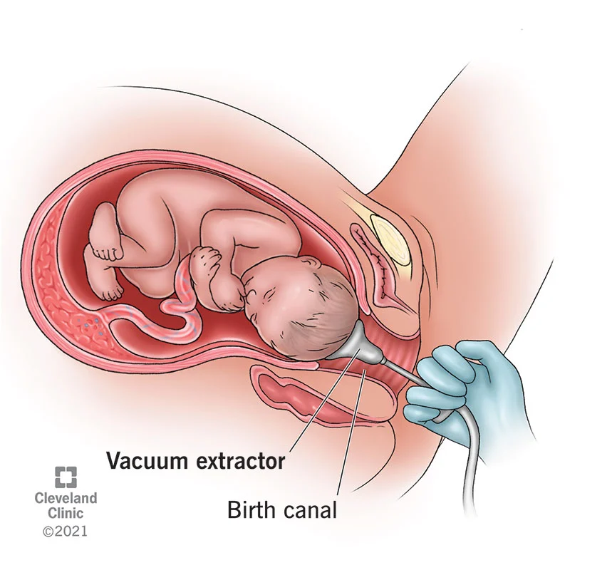
A decision is made to perform a ventouse in theatre. The delivery is complicated by a shoulder dystocia and a third degree tear.

Slide 27
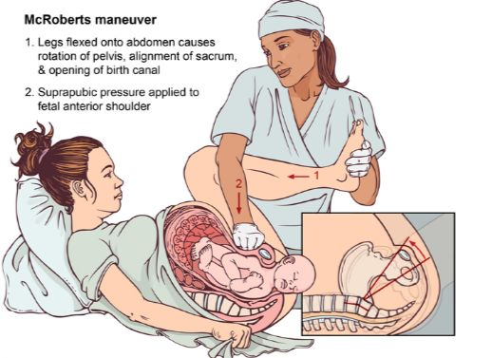
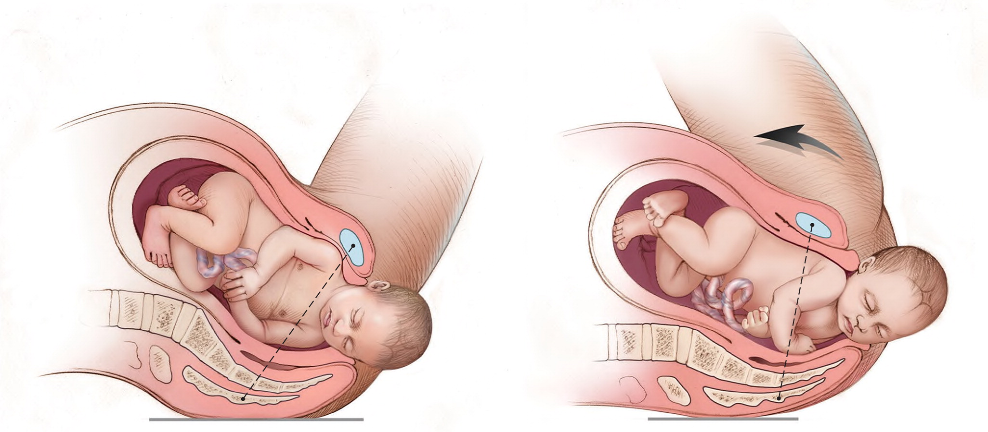
What is shoulder dystocia and how is it managed?

Slide 28
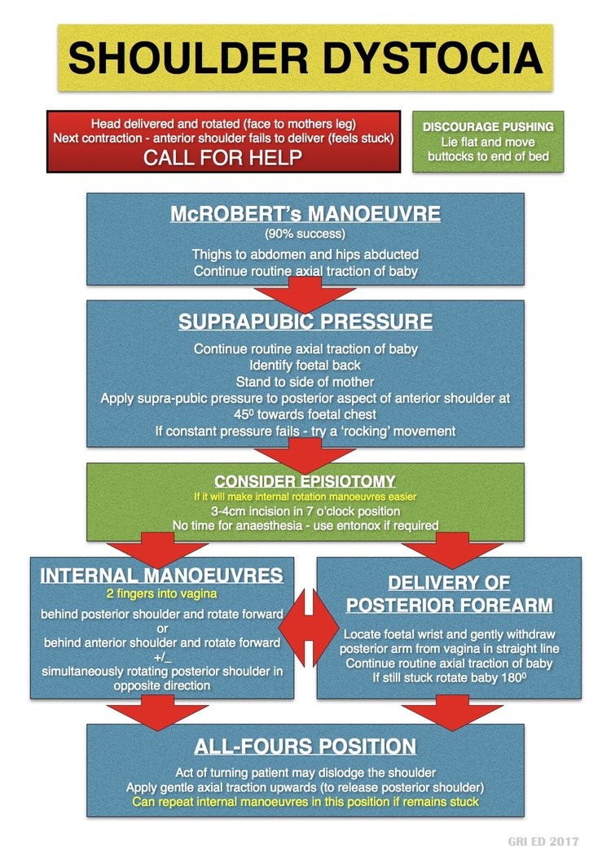

Slide 29
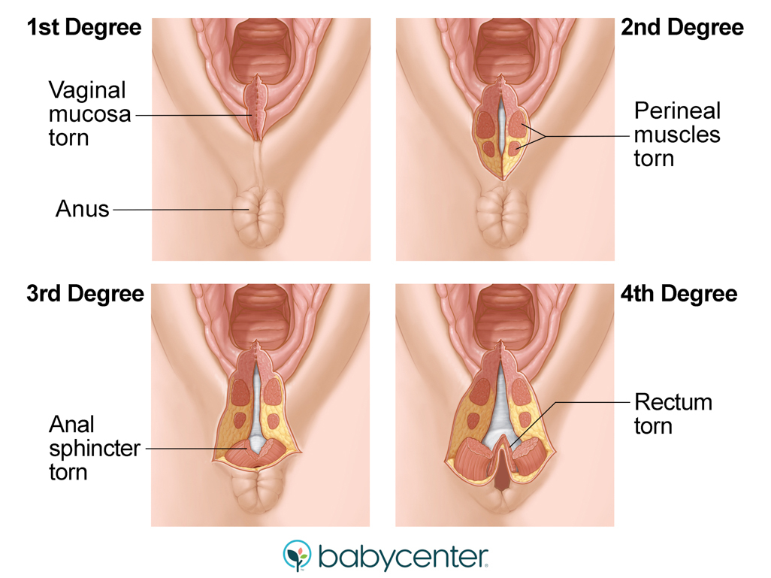
What is a third degree tear?
A third-degree tear is a tear that extends into the muscle that controls the anus (the anal sphincter). If the tear extends further into the lining of the anus or rectum it is known as a fourth-degree tear

