Slide 1
Core Problem 9 The Menopause

Slide 2
A woman aged 50 has had increasingly heavy periods for 2 years
Core Topics
• Menorrhagia • Menopause • Gynaecological operations

Slide 3
Menorrhagia
What is dysfunctional uterine bleeding?
Oligomenorrhea | Bleeding occurs at intervals of > 35 days and usually is caused by a prolonged follicular phase.
Polymenorrhea | Bleeding occurs at intervals of < 21 days and may be caused by a lutealphase defect.
Menorrhagia | Bleeding occurs at normal intervals (21 to 35 days) but with heavy flow (80 mL) or duration (7 days).
Menometrorrhagia | Bleeding occurs at irregular, noncyclic intervals and with heavy flow (80 mL) or duration (7 days).
Amenorrhea | Bleeding is absent for 6 months or more in a nonmenopausal woman.
Metrorrhagia or bleeding intermenstrual | Irregular bleeding occurs between ovulatory cycles; causes to consider include cervical disease, intrauterine device, endometritis, polyps, submucous myomas, endometrial hyperplasia, and cancer.
Midcycle spotting | Spotting occurs just before ovulation, usually because of a decline in the estrogen level.
Postmenopausal bleeding | Bleeding recurs in a menopausal woman at least 1 year after cessation of cycles.
Acute emergent abnormal uterine bleeding | Bleeding is characterized by significant blood loss that results in hypovolemia (hypotension or tachycardia) or shock.
Dysfunctional uterine bleeding | This ovulatory or anovulatory bleeding is diagnosed after the exclusion of pregnancy or pregnancy-related disorders, medications, iatrogenic causes, obvious genital tract pathology, and systemic conditions.

Slide 4
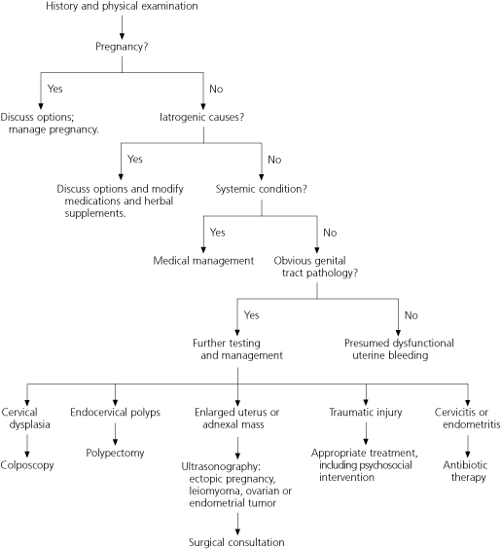

Slide 5
Menorrhagia
What blood tests would you perform?
CBC
Hormons
TSH
Prolactine
FSH
LH
E2
Testoterone
Progesterone

Slide 6
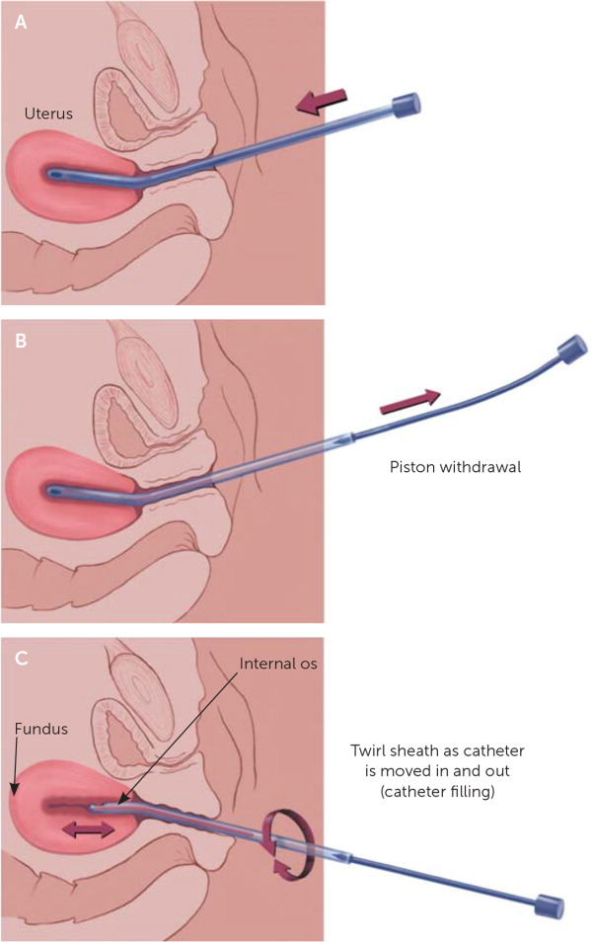
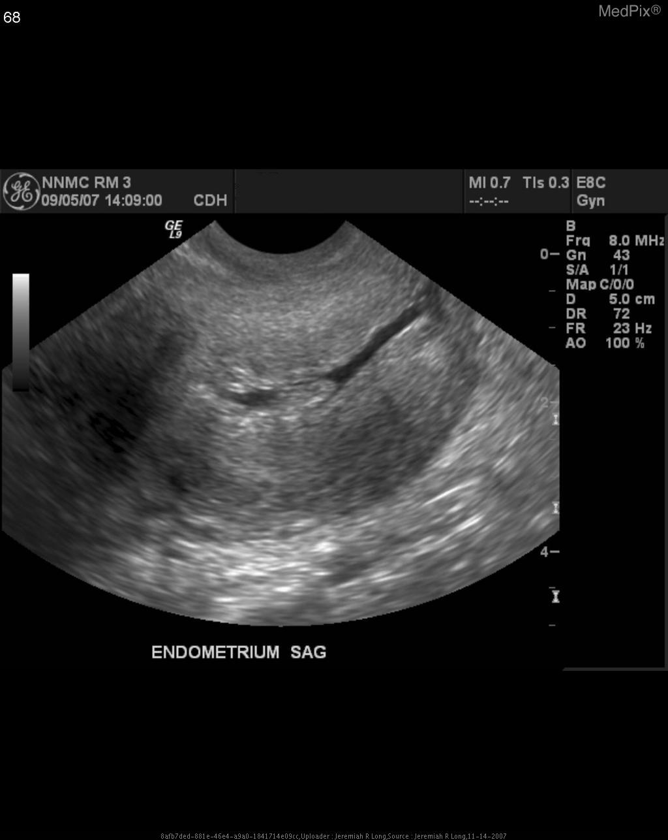
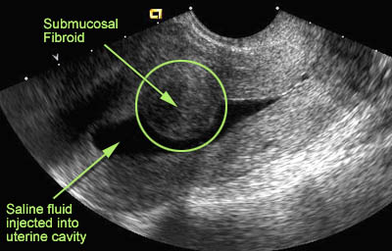
Menorrhagia
Discuss role of ultrasound and endometrial biopsy.

Slide 7
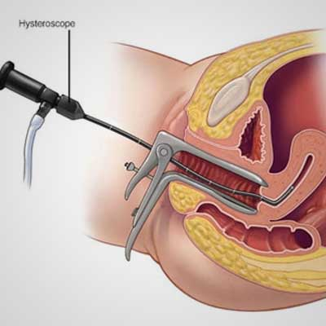
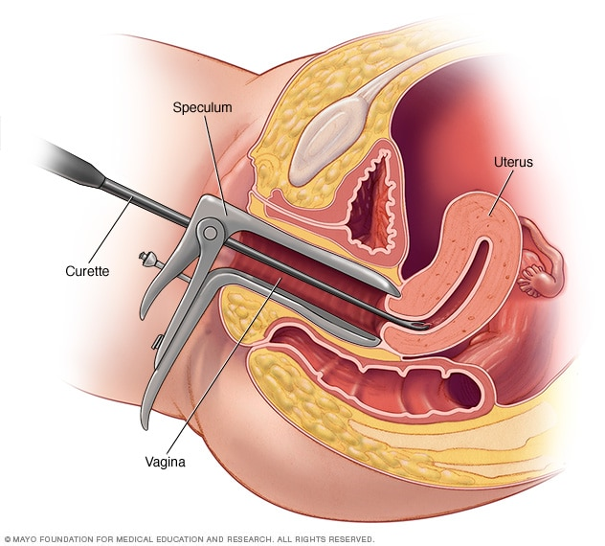
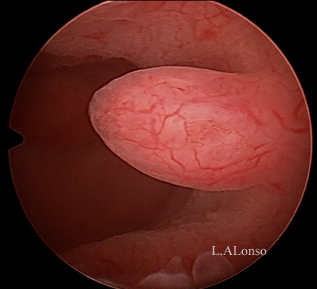
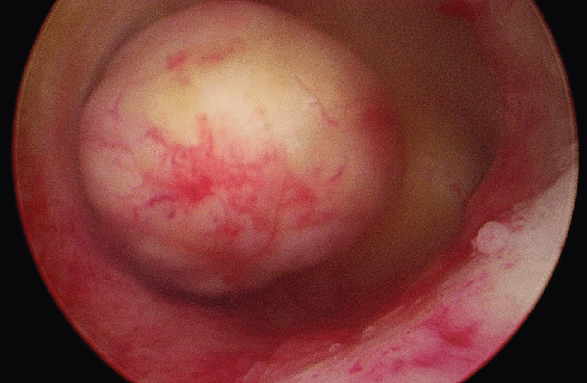
Menorrhagia
Does every patient require an urgent hysteroscopy and D & C?

Slide 8
Menorrhagia
What are the medical treatments for menorrhagia?
Nonsteroidal anti-inflammatory drugs (NSAIDs).
NSAIDs, such as ibuprofen or naproxen sodium, help reduce menstrual blood loss. NSAIDs have the added benefit of relieving painful menstrual cramps (dysmenorrhea).
Tranexamic acid
Tranexamic acid helps reduce menstrual blood loss and only needs to be taken at the time of the bleeding.
Oral contraceptives
Aside from providing birth control, oral contraceptives can help regulate menstrual cycles and reduce episodes of excessive or prolonged menstrual bleeding.
Oral progesterone
The hormone progesterone can help correct hormone imbalance and reduce menorrhagia.
Hormonal IUD (Mirena)
This intrauterine device releases a type of progestin called levonorgestrel, which makes the uterine lining thin and decreases menstrual blood flow and cramping.

Slide 9
Menopause
What are the local/genital effects of menopause?
What are the distant/non-genital effects of menopause?
What routes of administration are available for HRT?
What are the risks and benefits of HRT?

Slide 10
Sexual function
Estrogen deficiency leads to a decrease in blood flow to the vagina and vulva. This decrease is a major cause of decreased vaginal lubrication and sexual dysfunction in menopausal women
The elasticity of the vaginal wall may decrease, and the entire vagina can become shorter or narrower.
Continuing sexual activity may prevent these changes in size and shape of the vagina, even in the absence of estrogen therapy
Symptoms related to genitourinary atrophy are exquisitely responsive to estrogen therapy, in particular, vaginal estrogen therapy

Slide 11
Vaginal dryness
The epithelial lining of the vagina and urethra are estrogen-dependent tissues, and estrogen deficiency leads to thinning of the vaginal epithelium.
This results in vaginal atrophy (atrophic vaginitis), causing symptoms of vaginal dryness, itching, and often dyspareunia.
Symptoms of vaginal atrophy are usually progressive and worsen as time passes and hypoestrogenism continues.
Early in the menopause transition, women may notice a slight decrease in vaginal lubrication upon sexual arousal, which is often one of the first signs of estrogen insufficiency.
On exam, the vagina typically appears pale, with lack of the normal rugae.

Slide 12
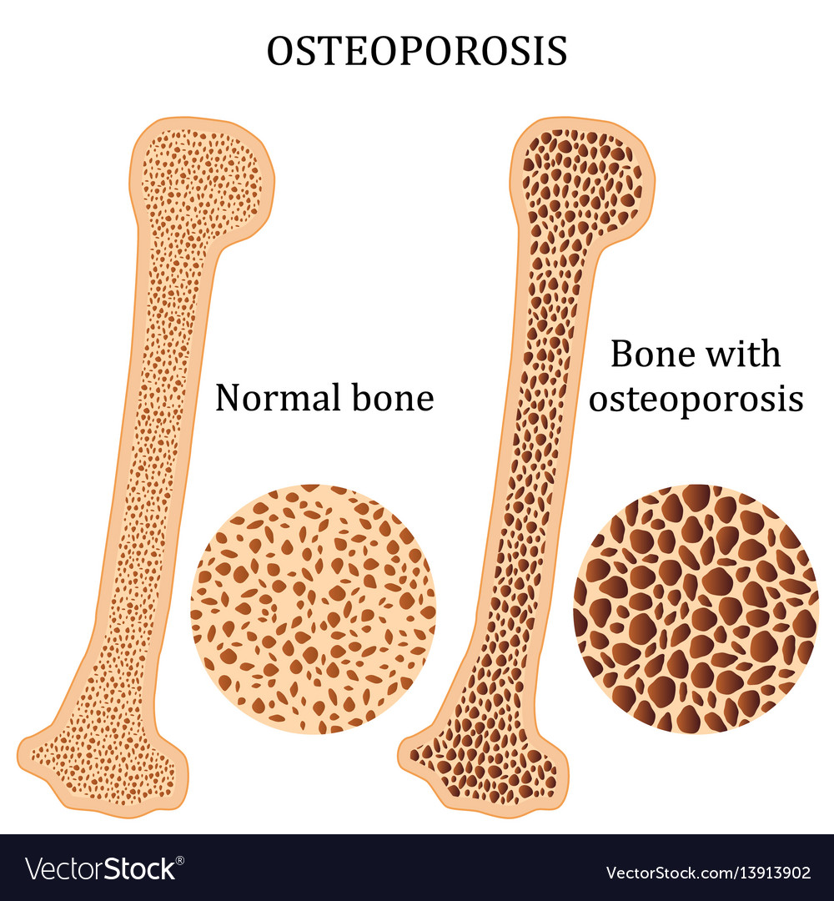
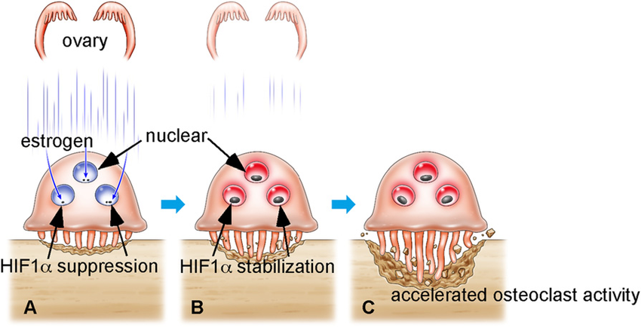
Osteoporosies
Bone loss begins during the menopausal transition.
The annual rates of bone mineral density loss appear to be highest during the one year before the FMP through two years after.

Slide 13
Cognitive changes
Women often describe problems with memory loss and difficulty concentrating during the menopausal transition and menopause, and substantial biologic evidence supports the importance of estrogen to cognitive function.
A decline in cognitive function was not observed in the SWAN study, but increases in anxiety and depression had independent, unfavorable effects on cognitive performance

Slide 14
Depression
Significant increased risk of new onset depression in women during the menopausal transition compared with their premenopausal years
The risk then decreases in the early postmenopause
women with hot flashes are more likely to be depressed

Slide 15
Long-term consequences of estrogen deficiency
Cardiovascular disease
The risk of cardiovascular disease increases after menopause,
Thought to be at least in part due to estrogen deficiency.
lipid profiles that begin to change during perimenopause
small increase in serum low-density lipoprotein (LDL) during the menopausal transition
There was no change in serum high-density lipoprotein (HDL)

Slide 16
Long-term consequences of estrogen deficiency
Dementia
Body composition
Skin changes
Balance
Breast pain
Menstrual migraines

Slide 17
MENOPAUSAL HORMONE THERAPY
Definitions and goals
Menopausal hormone therapy (MHT) is the broad term used to describe the unopposed estrogen use for women in menopause
Hormone therapy
Hormone replacement therapy
The primary goal of MHT is to relieve
hot flashes
sleep disturbances
mood lability/depression
women being treated only for genitourinary syndrome of menopause (GSM) should be treated with low-dose vaginal estrogen

Slide 18
MENOPAUSAL HORMONE THERAPY
Estrogens — All types of estrogen are effective for relieving hot flashes
Estrogen is available in many forms:
oral, transdermal,
topical gels and lotions, and
vaginal rings.
subcutaneous implant

Slide 19
MENOPAUSAL HORMONE THERAPY
Dose
Standard
oral 1 mg/day or transdermal 0.05 mg/day
younger women after bilateral oophorectomy.
higher doses 2 mg oral estradiol or 0.1 mg transdermal
In the past, a "one-size-fits-all"
the current approach is to start with lower doses, such as transdermal estradiol (0.025 mg) or oral estradiol (0.5 mg/day), and titrate up to relieve symptoms.

Slide 20
MENOPAUSAL HORMONE THERAPY
Progestins
Ιntact uterus need a progestin
Women who have undergone hysterectomy should not receive a progestin
Dosing
Our first choice of progestin is oral natural micronized progesterone (200 mg/day for 12 days/month
or 100 mg daily [continuous regimen]).
We advise taking progesterone at bedtime as some of its metabolites are associated with somnolence.
There are reasons to believe that natural progesterone is safer for the cardiovascular system (no adverse lipid effects) and possibly the breast.

Slide 21
MENOPAUSAL HORMONE THERAPY
Side effects
breast soreness
mood symptoms and bloating with progestin therapy.
Vaginal bleeding occurs in almost all women
Some women are unable to tolerate cyclic progestin administration because of the mood side effects and bloating.
For women who unable to tolerate either a cyclic or continuous oral progesterone regimen, alternatives include:
Vaginal use of micronized progesterone
Levonorgestrel-releasing IUDs
Conjugated estrogen/bazedoxifene
bazedoxifene, a selective estrogen receptor modulator (SERM)

Slide 22
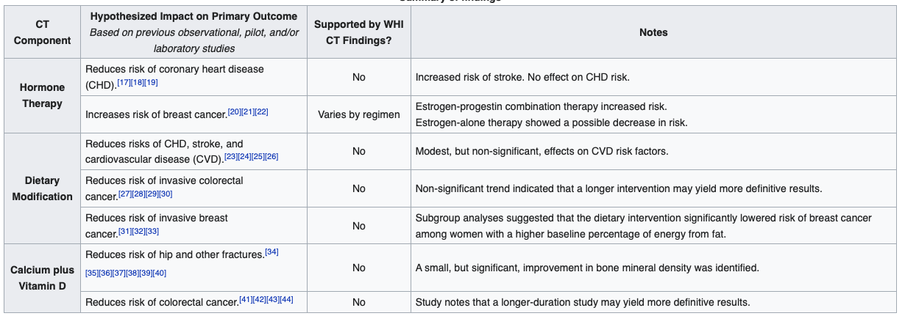
Changes in practice post-WHI
Decline in MHT prescriptions
Use of MHT has decreased approximately 80 percent since the initial publication of the Women's Health Initiative (WHI) results in 2002 [15].
Need for improved training in menopausal medicine
Emerging data suggest that medical school graduates, as well as residents in internal medicine and obstetrics/gynecology, now receive little or no training in the management of menopausal women

Slide 23
Gynaecological operations

Slide 24
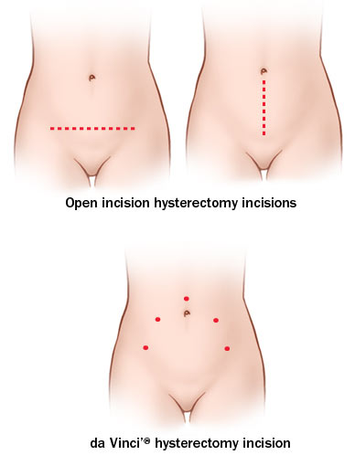
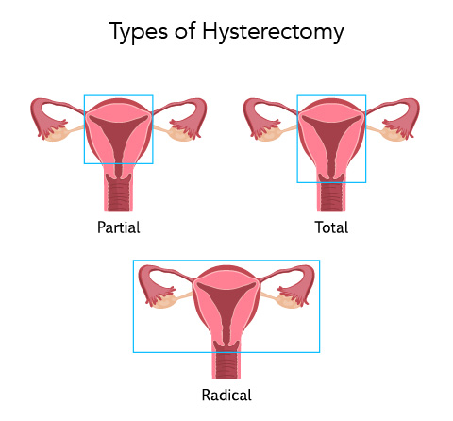
What are the various routes and types of hysterectomy?
Abdominal
Laparoscopic
Robotic
Vaginal
Laparoscopicaly assisted vaginal hysterectomy

Slide 25
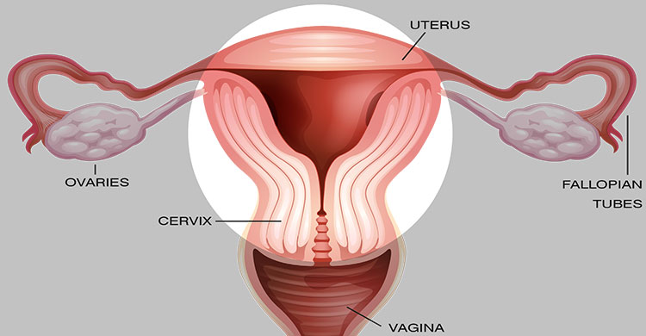
Compare abdominal versus vaginal hysterectomy.

Slide 26
What are the postoperative complications of hysterectomy?
Like any other surgery

Slide 27
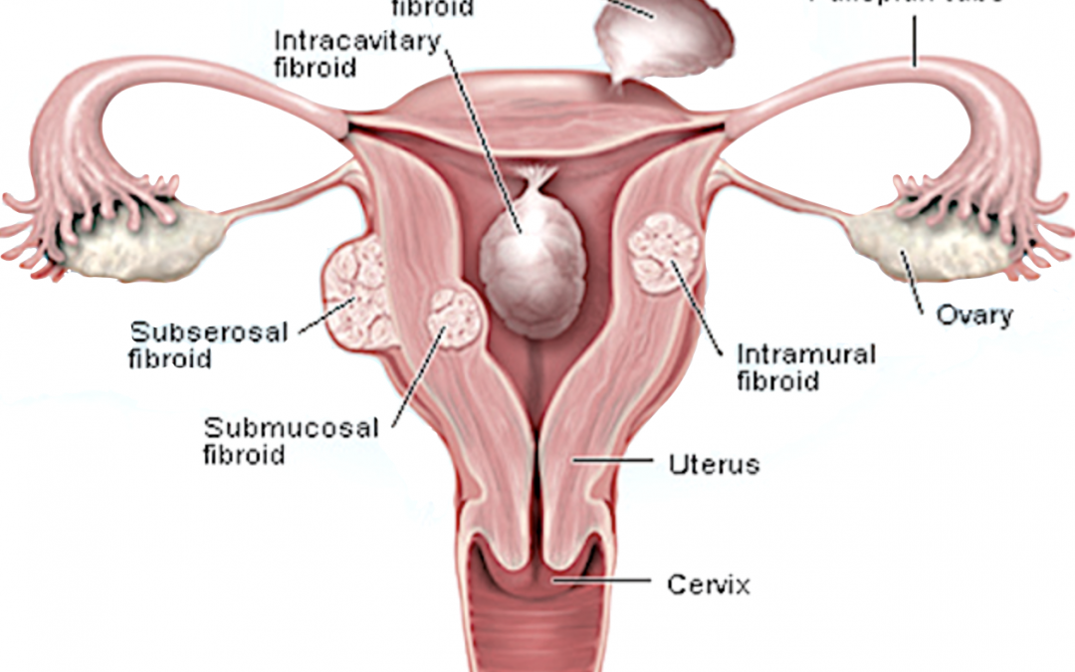
Does myomectomy have a role in treatment of menorrhagia?

Slide 28
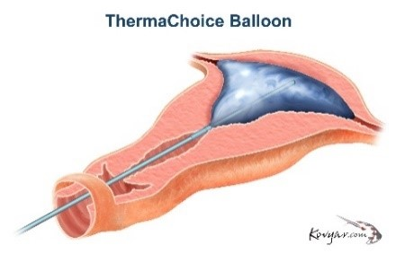
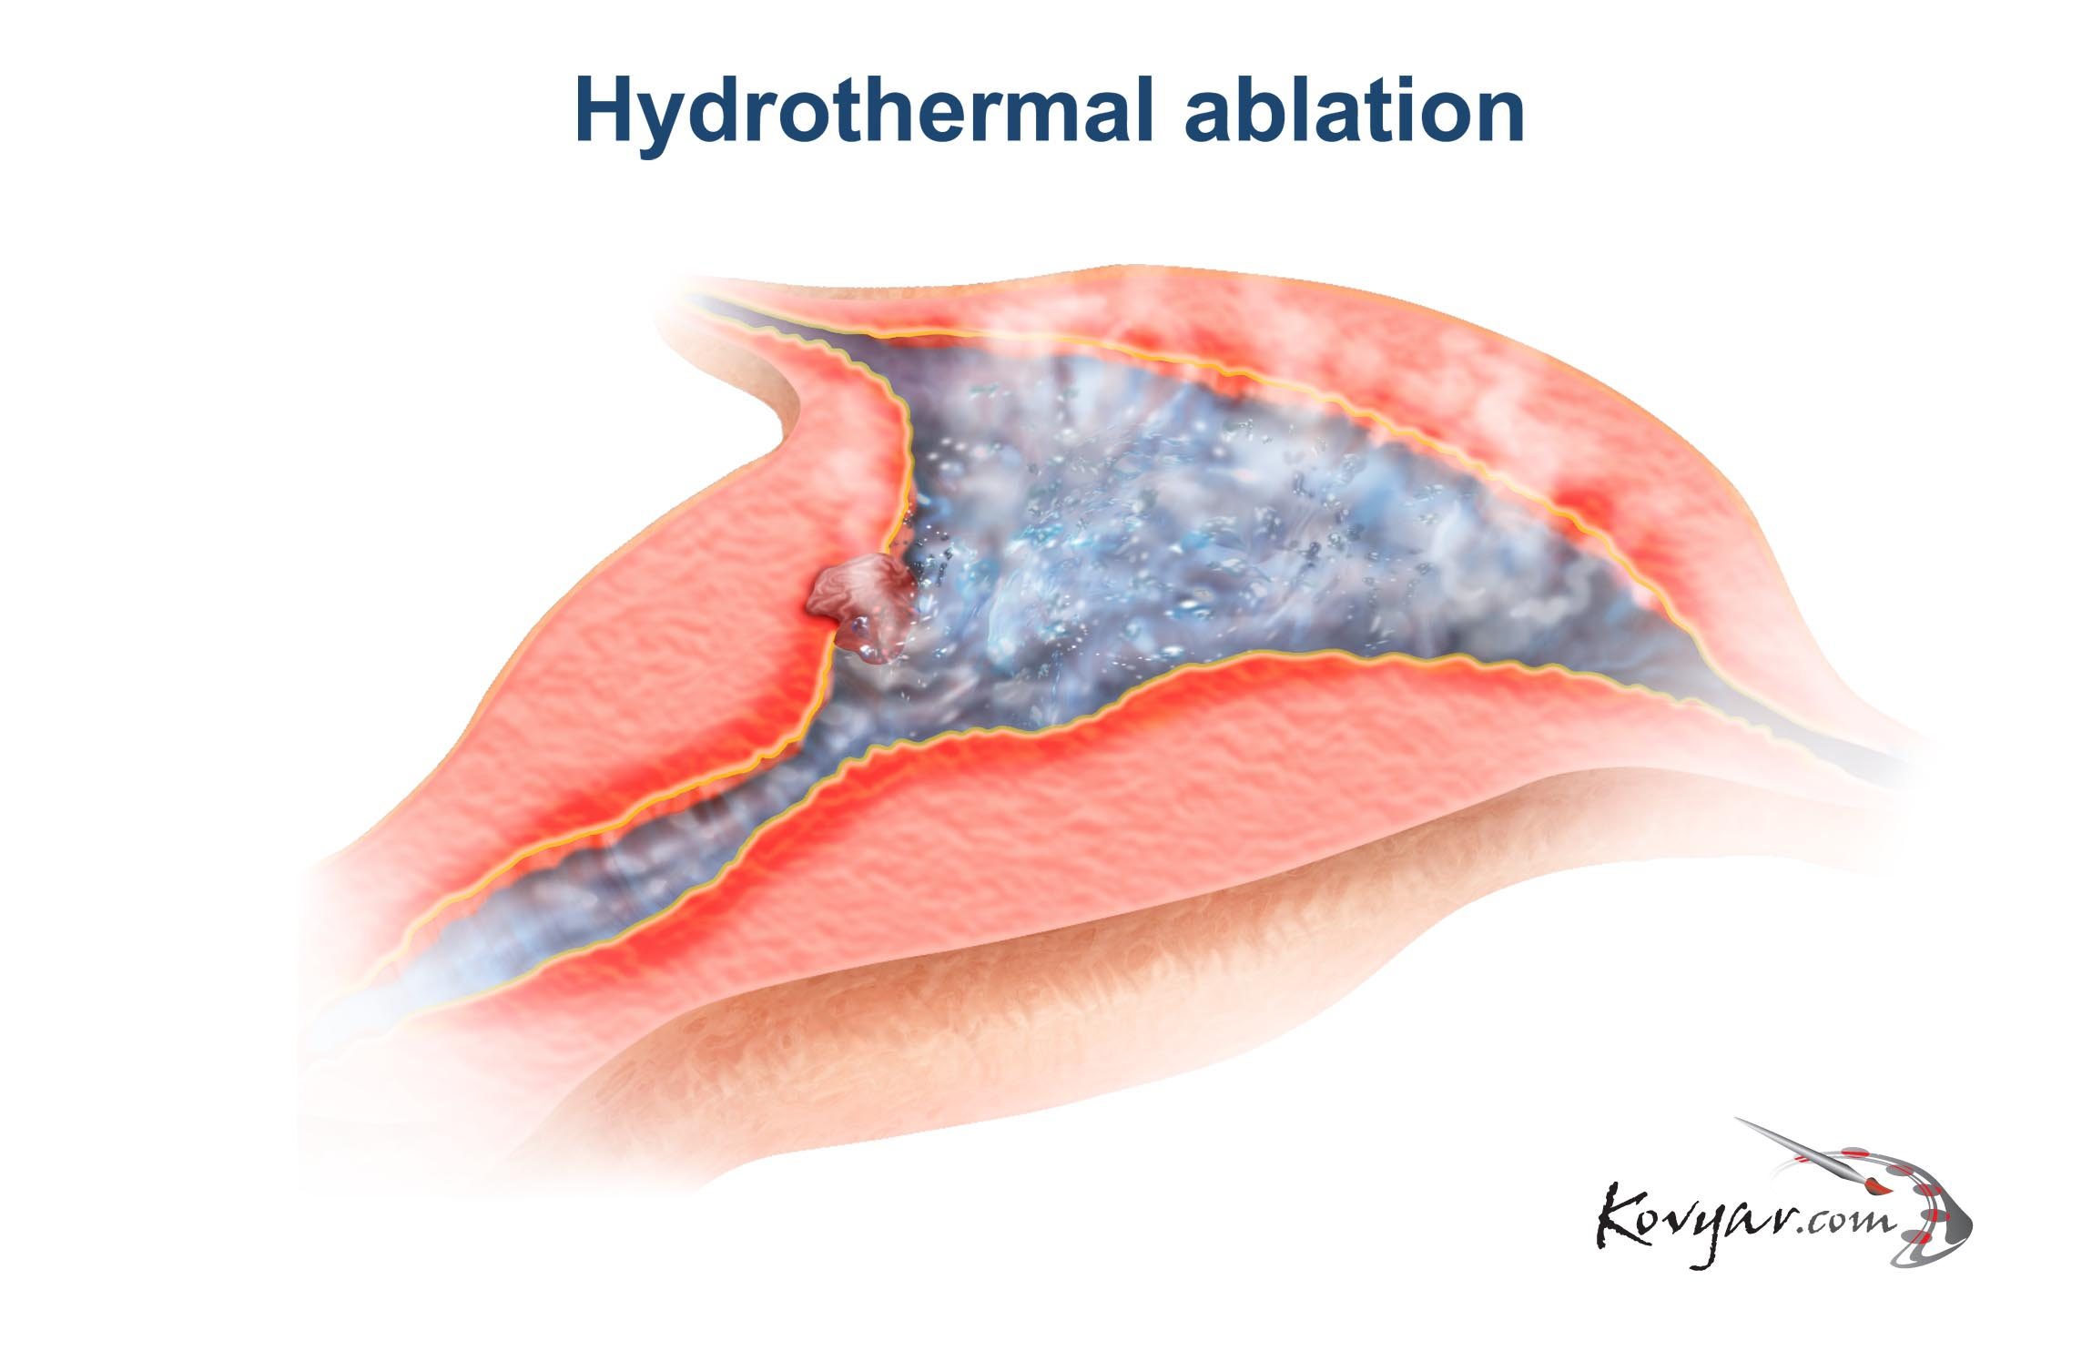
What are the advantages / disadvantages of endometrial ablation?

