Slide 1
Core Problem 8 The Infertile Couple

Slide 2
A couple have been ‘trying for a baby’ for 4 years. She is overweight and has painful, irregular periods.
Core Topics
Infertility
Endometriosis
Amenorrhoea
PCOS

Slide 3
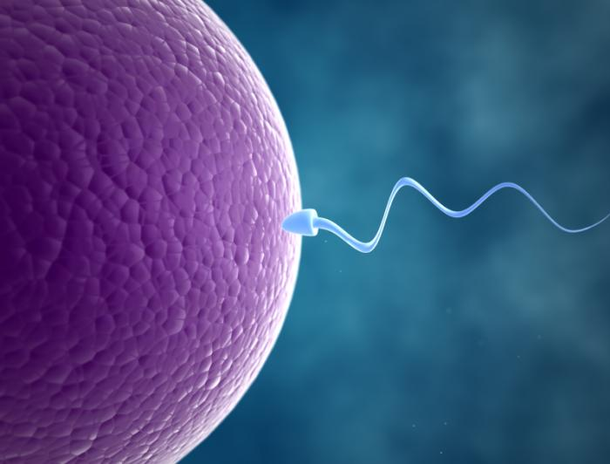
Infertility
Infertility is the inability of a person, animal or plant to reproduce by natural means.
In humans, infertility is the inability to become pregnant after one year of intercourse without contraception involving a male and female partner.
primary and secondary infertility

Slide 4
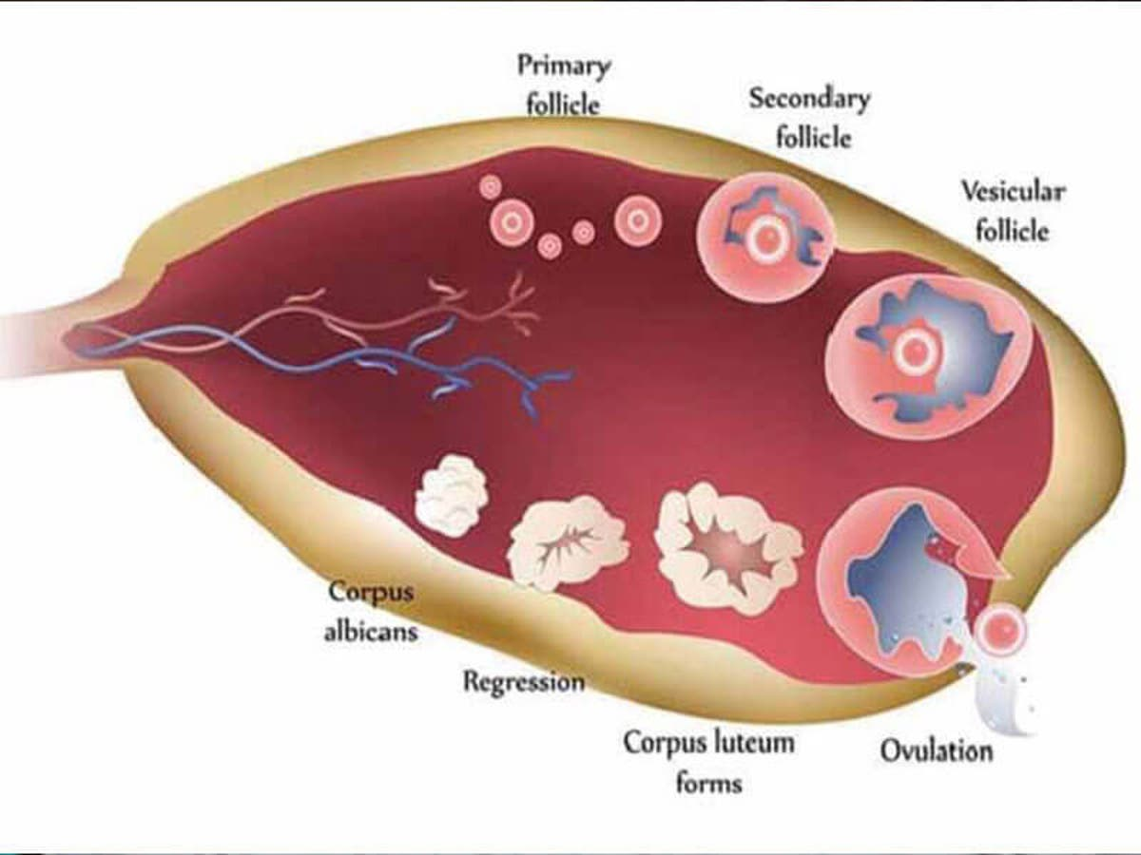
anovulation

Slide 5
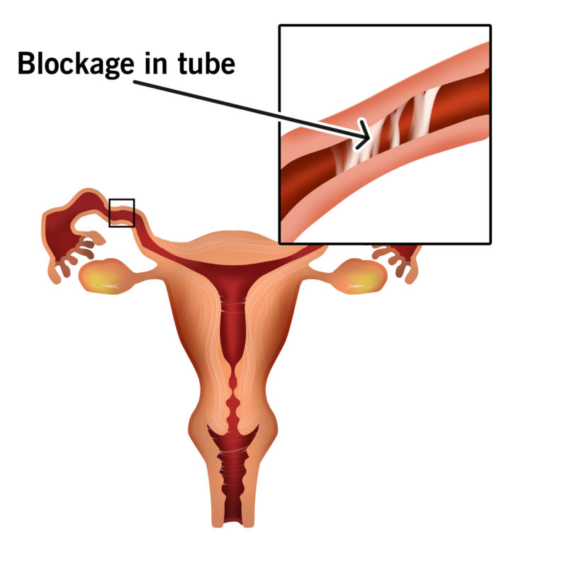
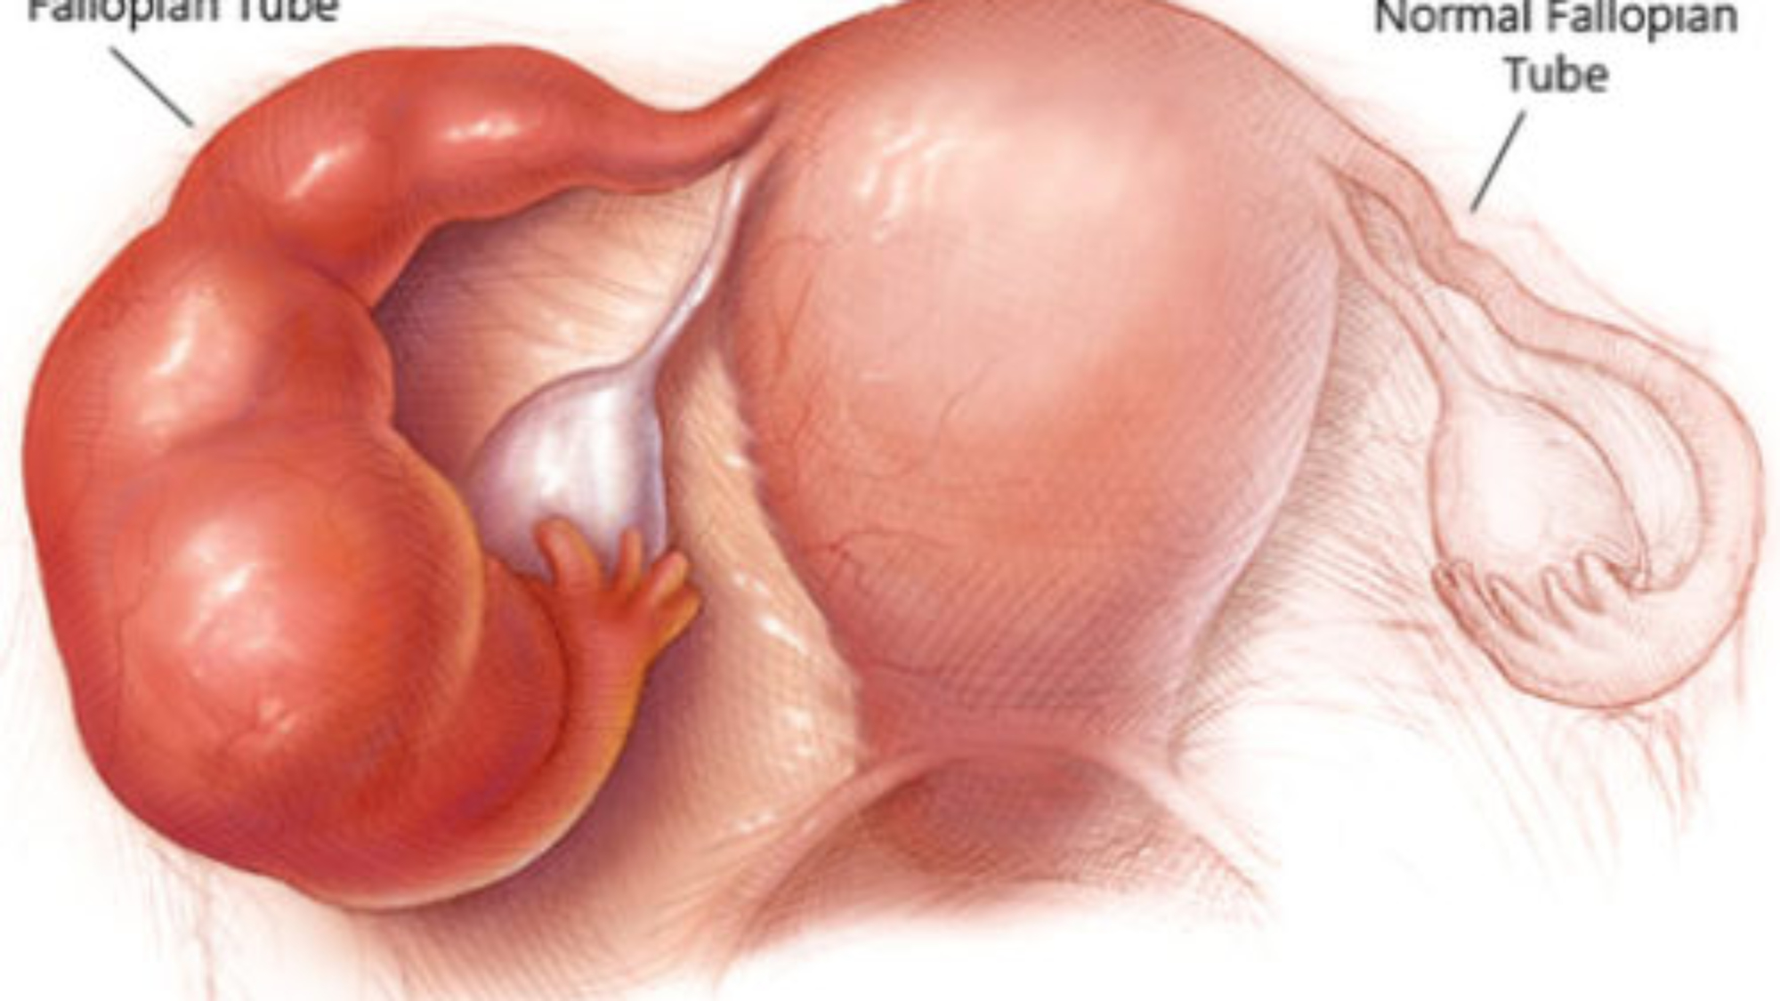
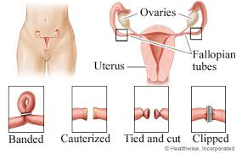
tubal occlusion

Slide 6
What does GIFT, ZIFT, IVF and ICSI stand for?
GIFT (gamete intrafallopian transfer)
GIFT, the sperm and eggs are just mixed together before being inserted and, with luck, one of the eggs will become fertilized inside the fallopian tubes
ZIFT (zygote intrafallopian transfer) in vitro fertilization (IVF)
ZIFT, the zygotes are placed in the fallopian tubes within 24 hours.

Slide 7
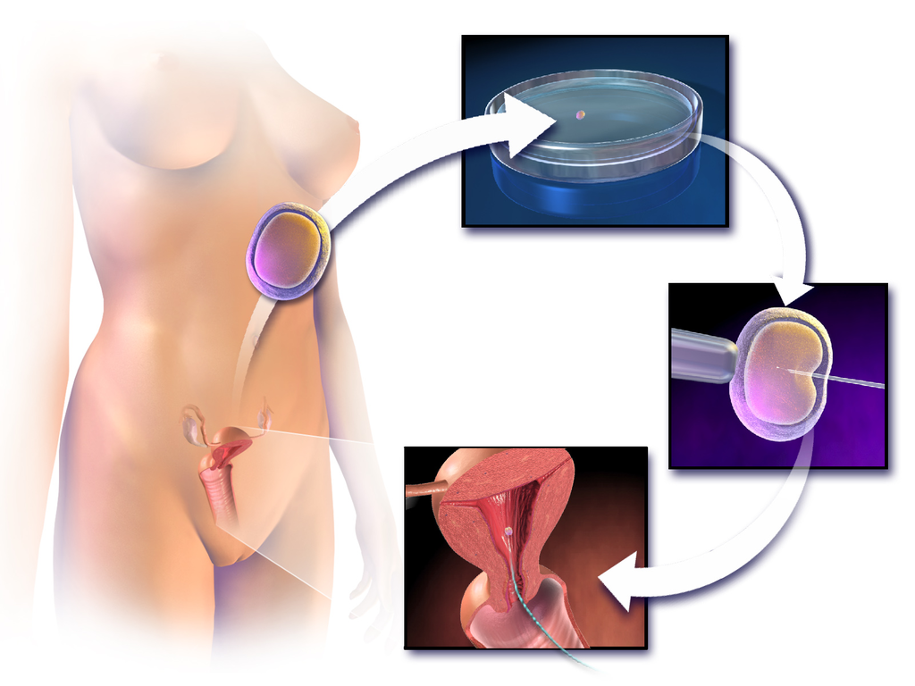
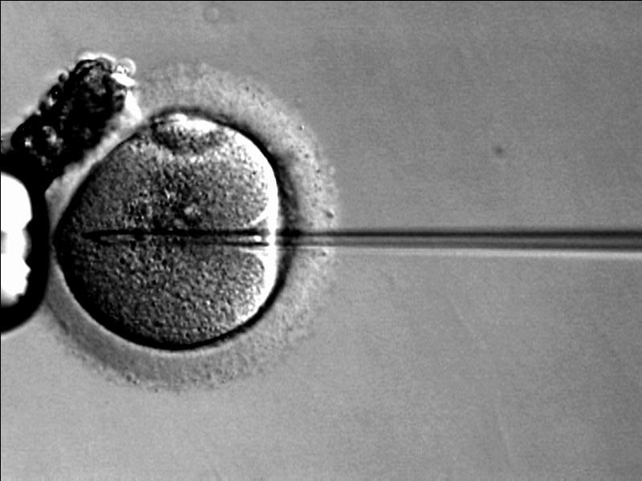
ICSI

Slide 8
male factor infertility
ABNORMALITIES OF SPERM COUNT AND MORPHOLOGY
Abnormalities related to sperm count
Abnormalities related to sperm motility
Abnormal sperm structure and shape (teratozoospermia)
How is male factor infertility treated?

Slide 9
• Endometriosis
What is the aetiology of endometriosis?
Discuss common symptoms and role of laparoscopy.
Discuss medical vs surgical treatment of endometriosis.
What are chocolate cysts?

Slide 10
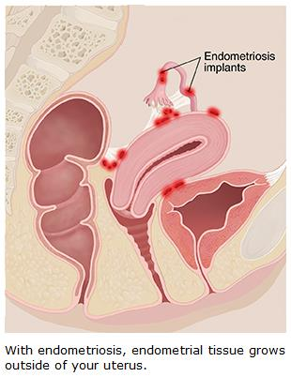
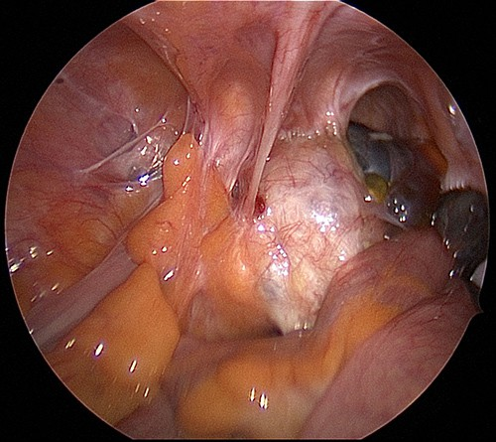

Slide 11
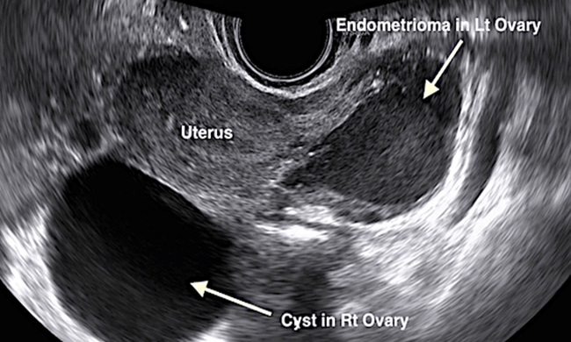

Slide 12
• Amenorrhoea
What is the definition of primary and secondary amenorrhoea?
What investigations would you perform for amenorrhoea?
Discuss the symptoms, investigations and treatment of PCO.
Why should a pituitary tumour cause amenorrhoea?

Slide 14
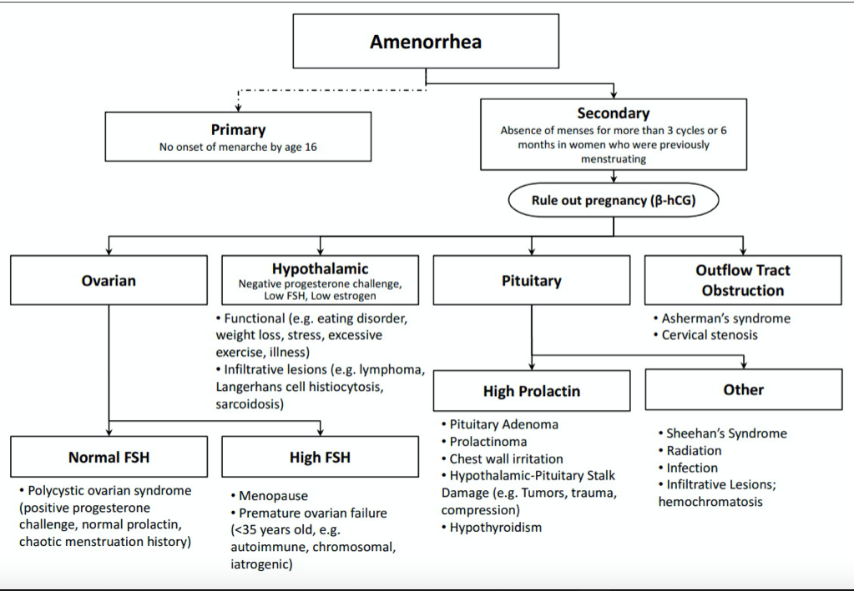

Slide 15
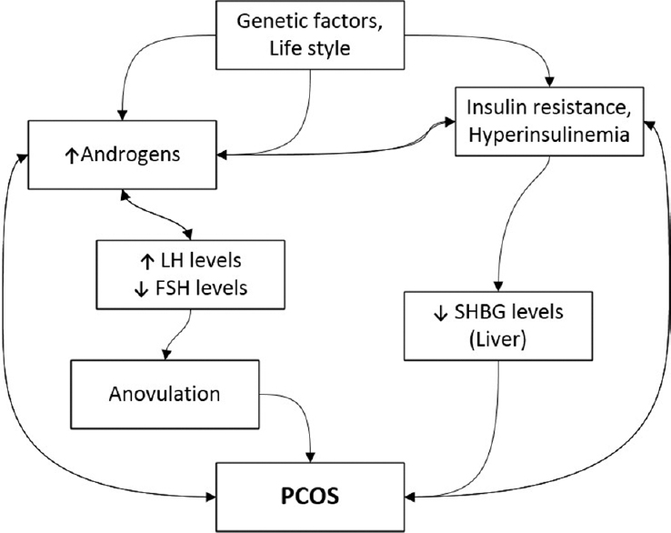
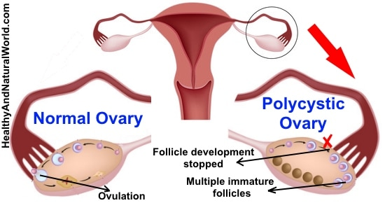
PCOs

Slide 16
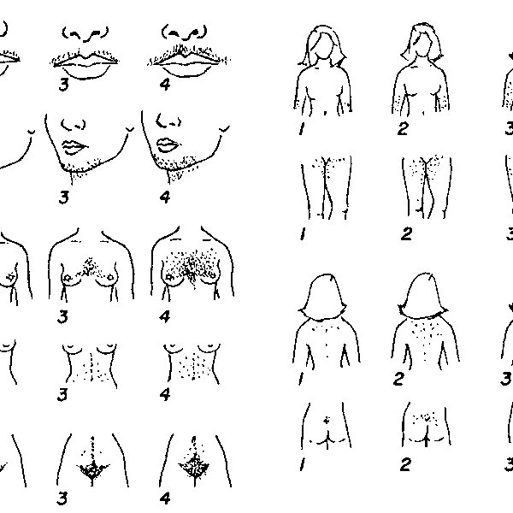
Hirsutism
How would you investigate hirsutism?
Androgens level
What are the cosmetic and medical treatments of hirsutism?

