Slide 1
Core Problem 7 The Problem 14-Year Old

Slide 2
Case
A father brings his 14 year old daughter to the clinic. She is missing school because of regular ‘tummy pains’.

Slide 3
Core Topics
Puberty
Premenstrual syndrome
Contraception
Pelvic infection

Slide 4
Puberty
Puberty is the process of physical changes through which a child's body matures into an adult body capable of sexual reproduction
initiated by hormonal signals that stimulate
Libido
function, and transformation of the brain,
Physical growth
bones,
Muscle
skin, hair
breasts,
Reproductive organs.
begin at ages 10–11
complete puberty at ages 15–17

Slide 5
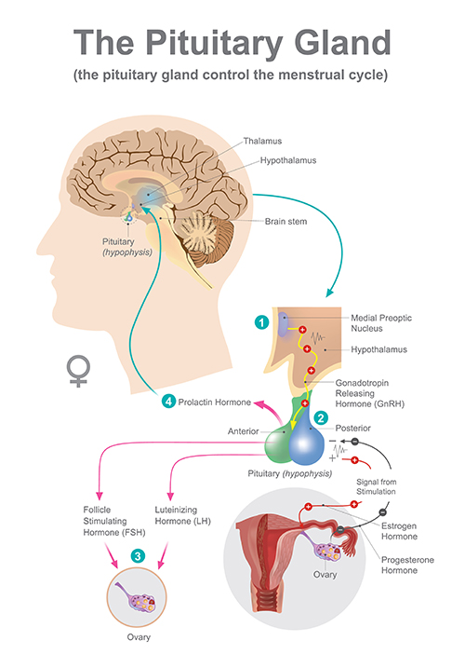
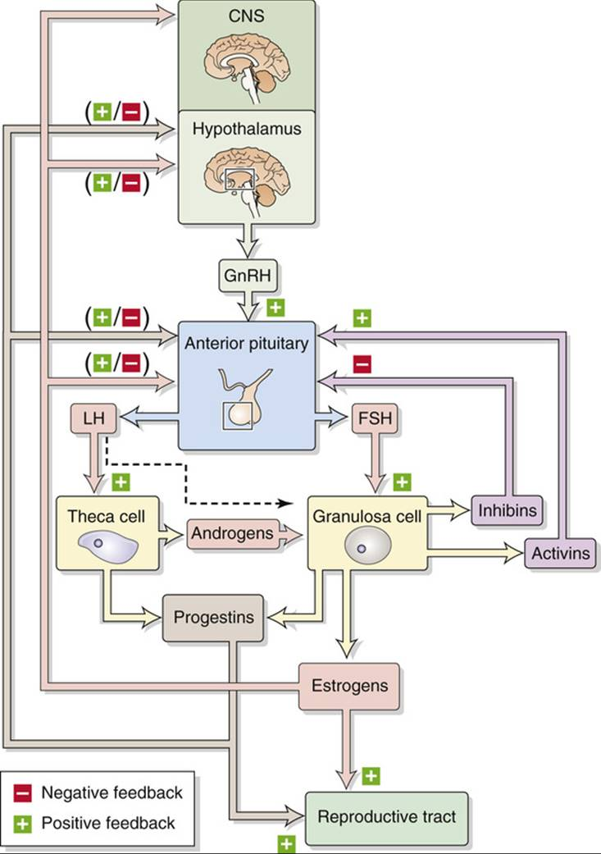
Ovulation

Slide 6
Development secondary sex characteristics
Female secondary sex characteristics include:
Enlargement of breasts and erection of nipples.
Growth of body hair, most prominently underarm and pubic hair
Widening of hips
lower waist to hip ratio than adult males
Elbows that hypertextend 5–8° more than male adults.
Upper arms approximately 2 cm longer, on average, for a given height.
Labia minora, the inner lips of the vulva, may grow more prominent and undergo changes in colour with the increased stimulation related to higher levels of oestrogen.

Slide 7
Menstrual cycle
Average 28 days cycle
Ovulation in 14th day
Normal cycle
proliferative and secretory menstrual phases
follicular and luteal ovarian phases

Slide 8
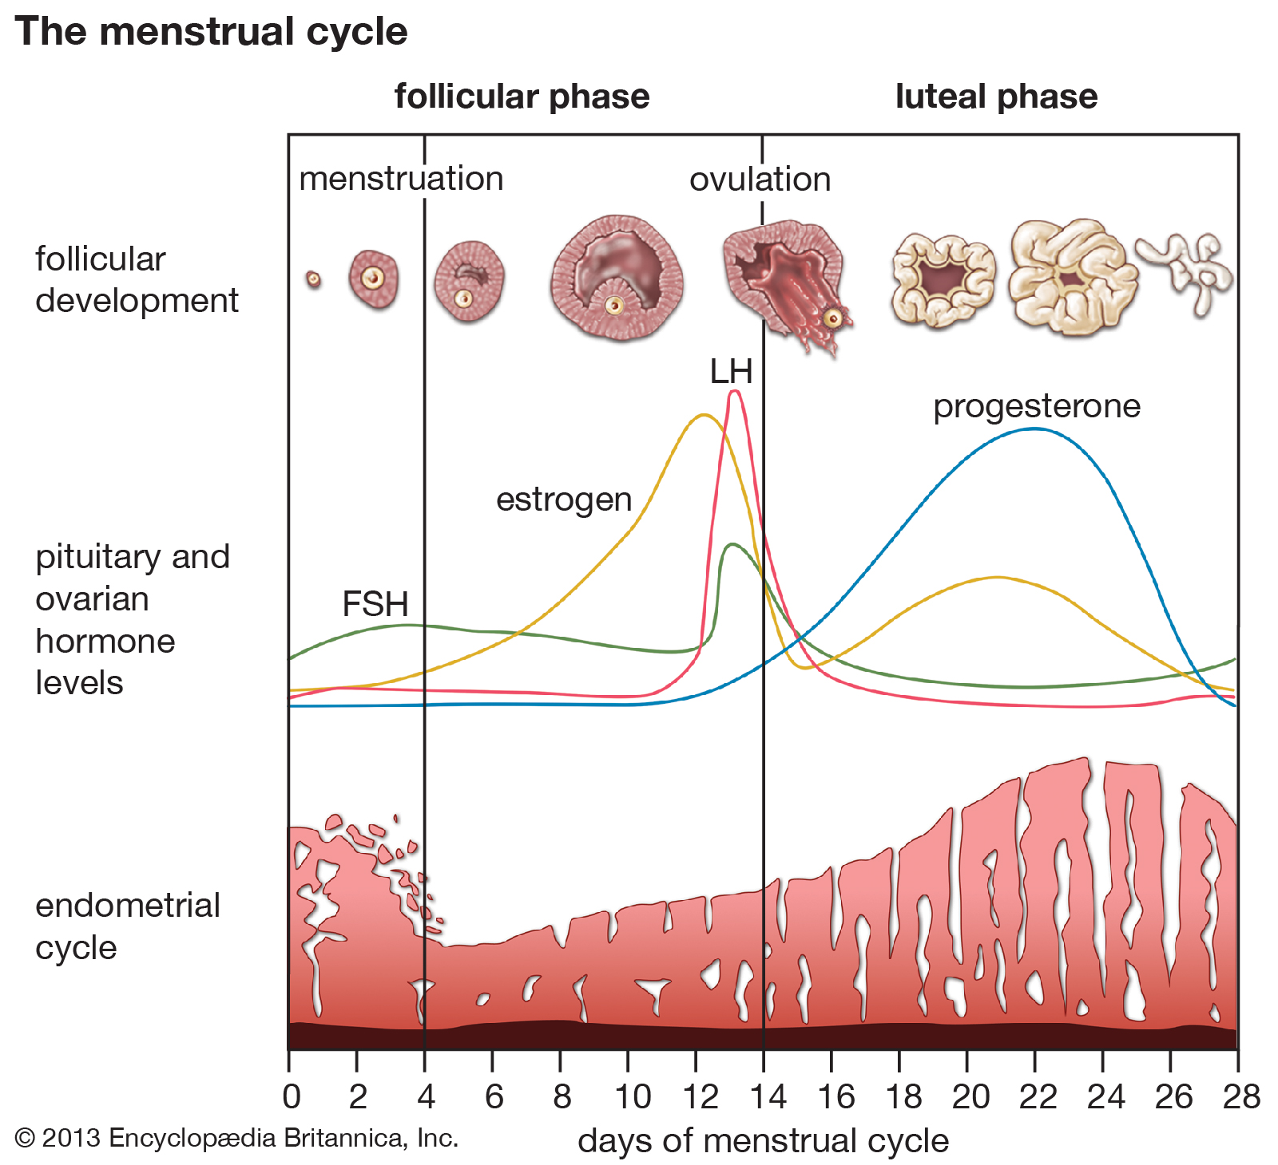

Slide 10
What anatomical abnormalities may this girl have?
Revision
Could it be ‘’normal’’ ?
Medical History
Menarche
Cyclic colic pain
..

Slide 11
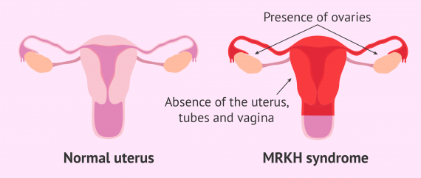
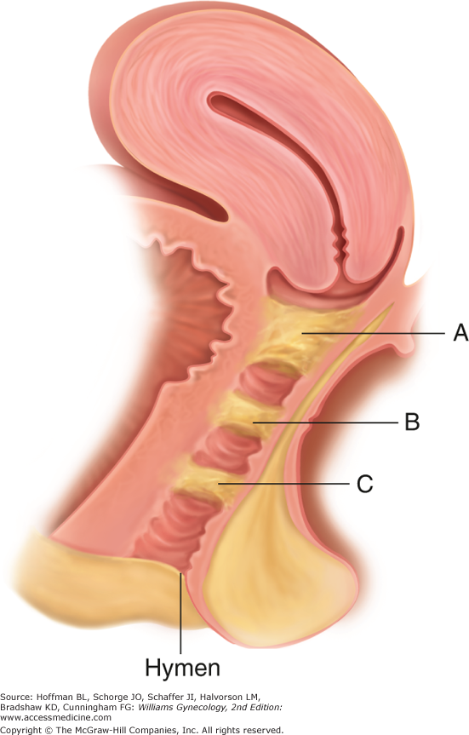
What anatomical abnormalities may this girl have?

Slide 12
Premenstrual syndrome
Most women of reproductive age have one or more emotional or physical symptom in the premenstrual phase of the menstrual cycle
DSM IV axons:
(1) the presence of at least five luteal-phase symptoms (panel), at least one of which must be a mood symptom (ie, depressed mood, anxiety or tension, affect lability, or persistent anger and irritability);
(2) two cycles of daily charting to confirm the timing of symptoms
(3) evidence of functional impairment.
Finally, symptoms must not be the exacerbation of another psychiatric condition.

Slide 13
Symptoms
Depressed mood or dysphoria
Anxiety or tension
Affect lability
Irritability
Decreased interest in usual activities
Concentration difficulties
Marked lack of energy
Marked change in appetite, overeating, or food cravings
Hypersomnia or insomnia
Feeling overwhelmed
Other physical symptoms—eg, breast tenderness, bloating
Symptoms markedly interfere with work, school, social activities, or relationships

Slide 14
treatment options for PMS
Medical history
Depression
dysthymic disorder
anxiety disorders
Hypothyroidism
sexual abuse
post-traumatic stress disorder
Serotonin reuptake inhibitors (SRIs)
Hormonal interventions
GnRH agonist
Vitamin B6

Slide 15
Contraception

Slide 16
Pearl index
The Pearl Index, also called the Pearl rate, is the most common technique used in clinical trials for reporting the effectiveness of a birth control and tampon selection

Slide 17
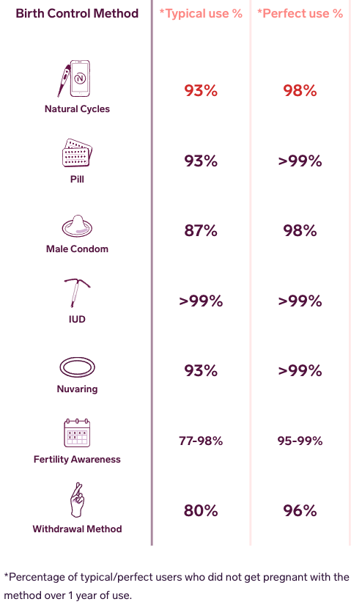
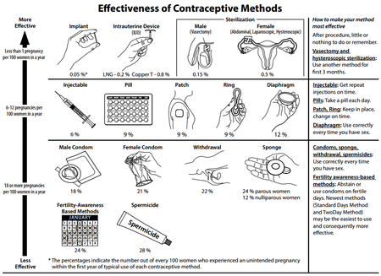
Pearl index
User dependence
Side effects

Slide 18
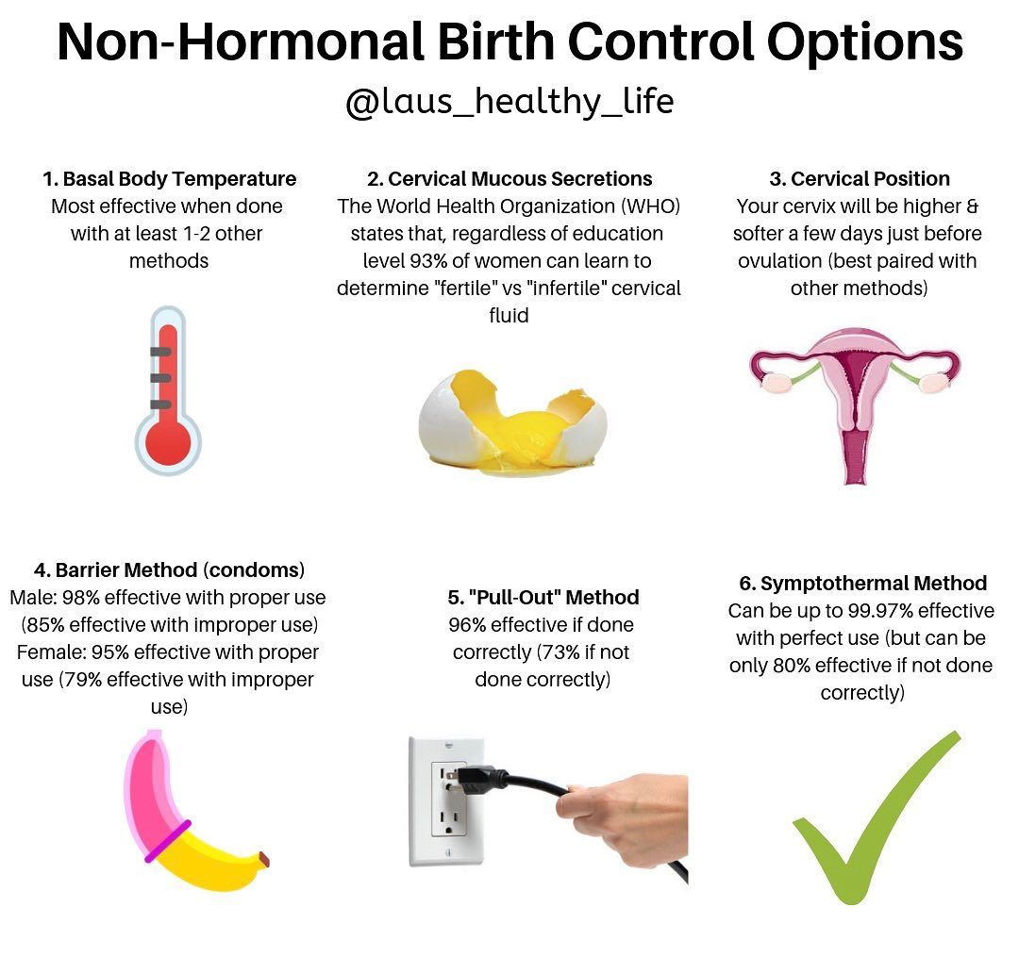
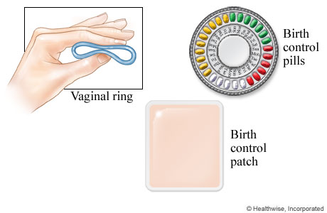
hormonal vs non-hormonal contraceptives

Slide 19
emergency contraception
ECPs containing Ulipristal acetate
ECPs containing Levonorgestrel
combined oral contraceptive pills (Yuzpe method)
copper-bearing intrauterine devices
Emergency contraceptive pills prevent pregnancy by preventing or delaying ovulation and they do not induce an abortion.

Slide 20
contraindications to the COC pill
Thrombophlebitis or thromboembolic disorders
Presence or history of venous thrombosis or arterial thrombosis
History of migraine with focal neurological symptoms
hyperhomocysteinaemia and antiphospholipid antibodies
Valvular heart disease with complications
Severe hypertension
Diabetes mellitus with vascular involvement.
Presence or history of liver tumours (benign or malignant).
Known or suspected malignant conditions of the genital organs or the breasts,
Endometrial hyperplasia.
Known or suspected pregnancy.
Hypersensitivity

Slide 21
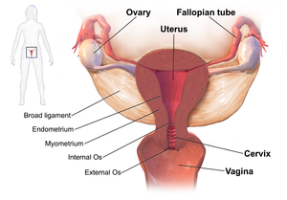
Pelvic infection
Symptoms and signs of PID
none
Fever
cervical motion tenderness
lower abdominal pain
Vaginal discharge
painful intercourse
uterine tenderness
adnexal tenderness
irregular menstruation
Other complications include
endometritis, salpingitis, tubo-ovarian abscess, pelvic peritonitis, periappendicitis, and perihepatitis.

Slide 22
causes of PID and treatment
Chlamydia trachomatis and Neisseria gonorrhoeae are usually the main cause of PID.
Data suggest that PID is often polymicrobial.^{[14]} Isolated anaerobes and facultative microorganisms have been obtained from the upper genital tract. N. gonorrhoeae has been isolated from fallopian tubes, facultative and anaerobic organisms were recovered from endometrial tissues.^{[17][18]}
ascend from the vagina to the pelvic cavity
The disturbance of the naturally occurring vaginal microbiota associated with bacterial vaginosis increases the risk of PID.
Rarely cases of PID have developed in people who have stated they have never had sex.^{[19]}

Slide 24
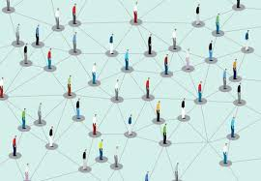
contact tracing
contact tracing is the process of identification of persons who may have come into contact with an infected person ("contacts") and subsequent collection of further information about these contacts

Slide 25
short and long-term complications of PID
chronic pelvic pain
Infertility
ectopic pregnancy (the leading cause of pregnancy-related deaths in adult females),
complications of pregnancy
infection oof the peritoneum causing inflammation and the formation of scar tissue on the external surface of the liver (Fitz-Hugh–Curtis syndrome).[16]

