Slide 1
Core Problem 6 Minor Gynaecological Problems

Slide 2
A woman aged 60 has noticed ‘dampness down below’ together with some pruritus and dysuria.
Vulval tumours
Urinary tract infection
Prolapse
Urine incontinence
Vaginal infections

Slide 3
Vulval tumours
What are the cardinal features of vulval pruritus?
Candida
Lichen
Planus
Sclerosus
VIN
Eczema- psoriasis
Vulvar cancer

Slide 4
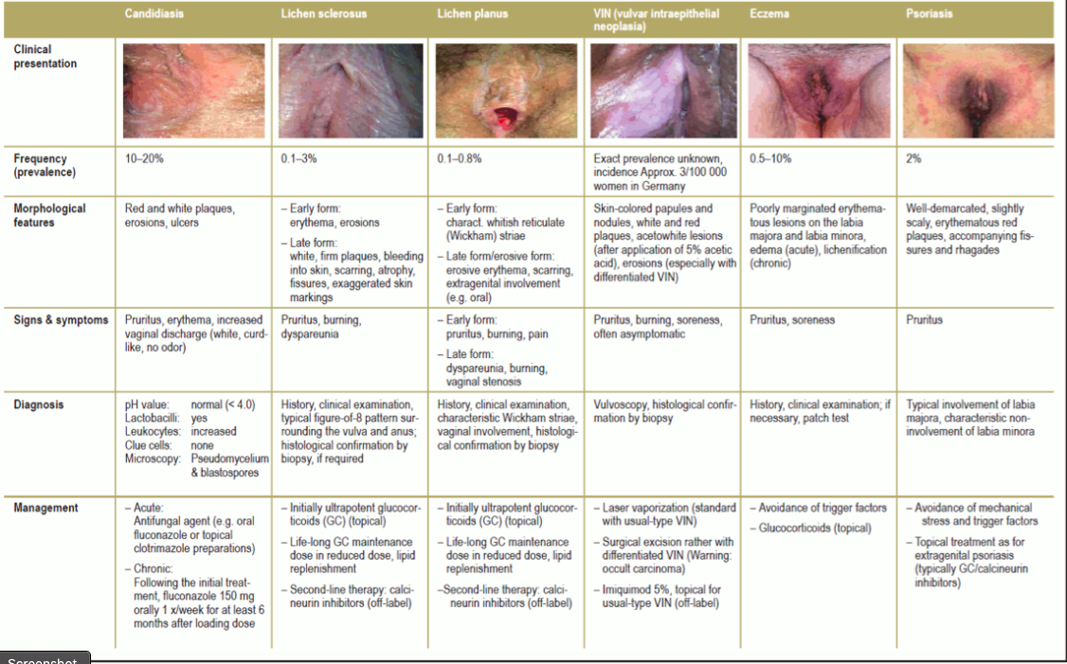

Slide 5
fungal infection
Oral versus topical treatment
Uncomplicated infection
Criteria
Sporadic, infrequent episodes (≤3 episodes/year)
Mild to moderate signs/symptoms
Probable infection with Candida albicans
Healthy, nonpregnant individual
Immunocompetent individual
Initial azole treatment
oral fluconazole

Slide 6
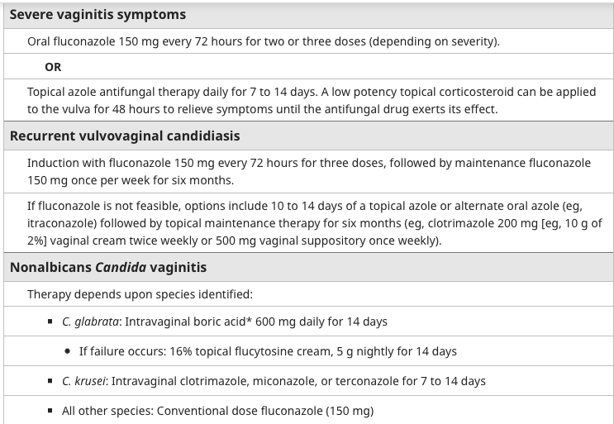
Chronic fungal infection
Complicated infections
Characteristics
Severe signs/symptoms
Candida species other than C. albicans, particularly C. glabrata
Pregnancy, poorly controlled diabetes, immunosuppression, debilitation
History of recurrent (≥3/year) culture-verified vulvovaginal candidiasis
Treatment

Slide 7
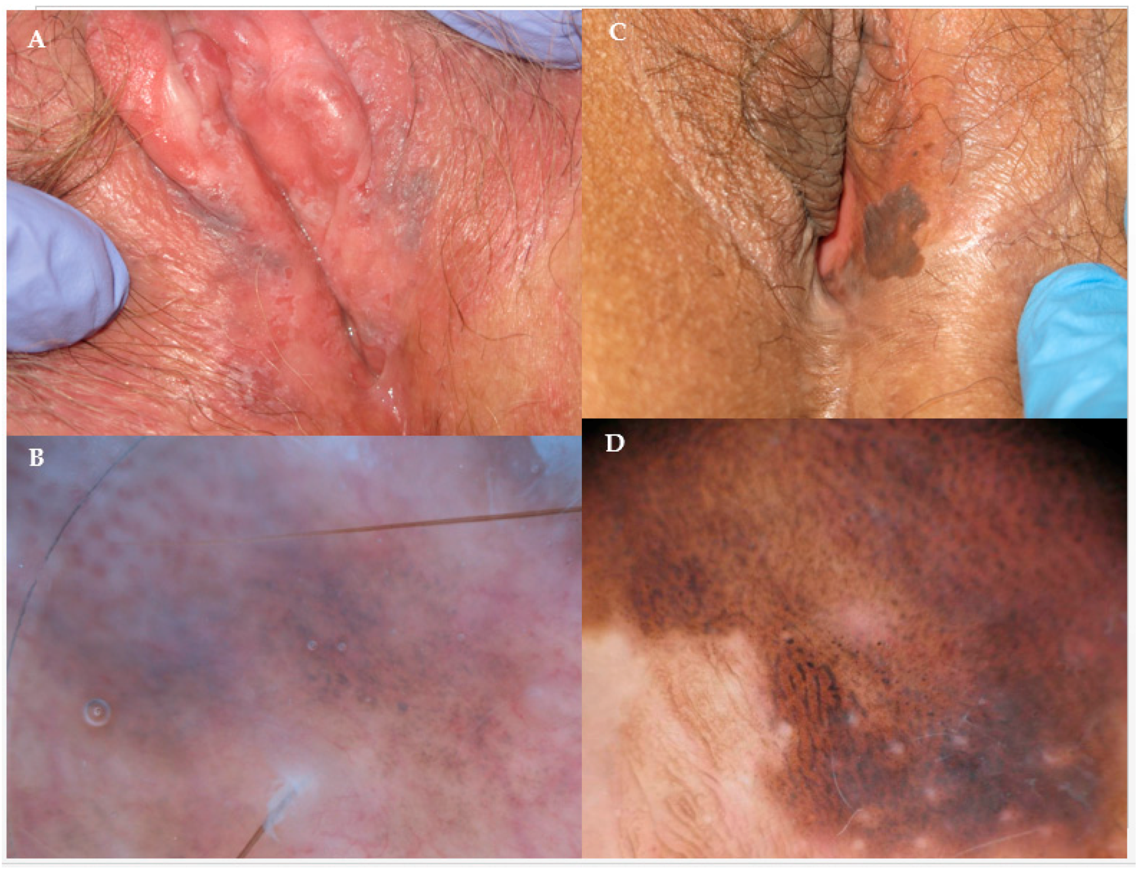
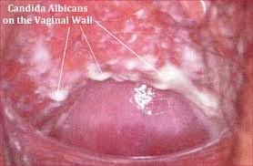
Vulval tumours
How is vulval pruritus treated?

Slide 8
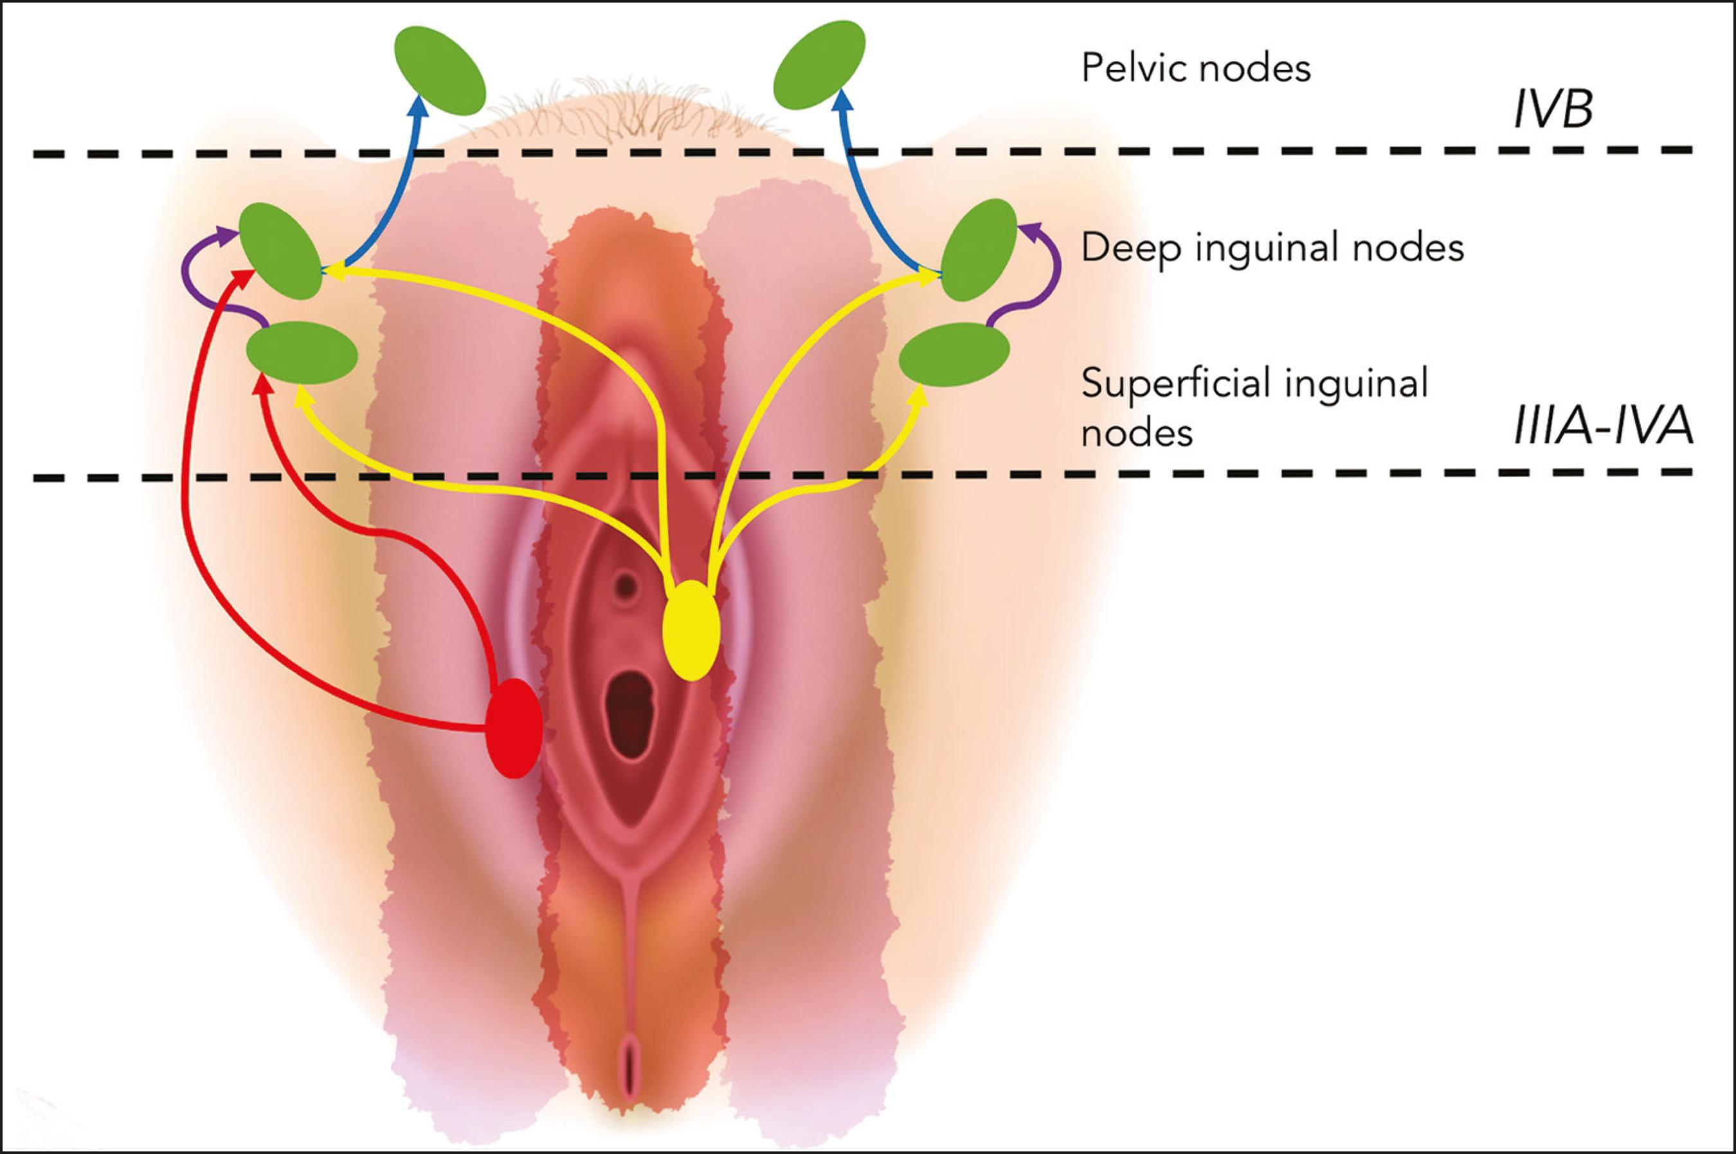
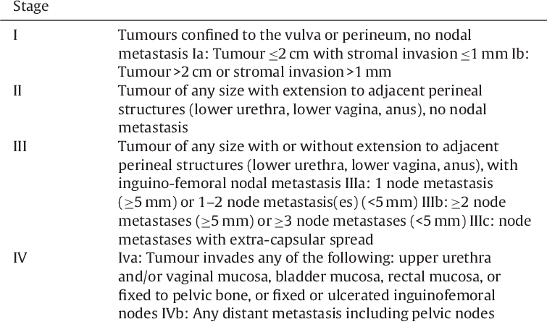
Vulval tumours
Symptoms of vulval cancer can include
a persistent itch in the vulva
pain, soreness or tenderness in the vulva
blood-stained vaginal discharge
an open sore in the vulva
anges should be investigated.
How vulval cancer is treated
surgery
radiotherapy
chemotherapy

Slide 9
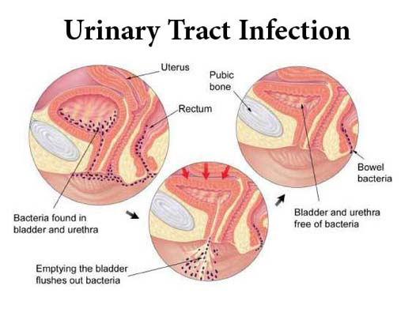
Urinary tract infection
Symptoms
dysuria
nocturia
pee that looks cloudy
Polyuria
Haematuria
Pelvic pain
Fever ?

Slide 10
Urinary tract infection
Common causative organisms
E coli
STIs
Candida ?

Slide 11
Urinary tract infection
What are the predisposing factors for UTI?
A previous UTI
Sexual activity, and especially a new sexual partner
Changes in the bacteria that live inside the vagina (vaginal flora), for example caused by menopause or use of spermicides
Pregnancy
Age (older adults and young children are more likely to get UTIs)
Structural problems in the urinary tract, such as prostate enlargement.
Poor hygiene, particularly in children who are potty-training

Slide 12
Urinary incontinence
What are the different symptoms associated with incontinence?
Stress incontinence.
Urine leaks when you exert pressure on your bladder by coughing, sneezing, laughing, exercising or lifting something heavy.
Urge incontinence.
a sudden, intense urge to urinate followed by an involuntary loss of urine.
Overflow incontinence.
bladder that doesn't empty completely.
Functional incontinence.
A physical or mental impairment keeps you from making it to the toilet in time..
Mixed incontinence.
more than one type of urinary incontinence.

Slide 13
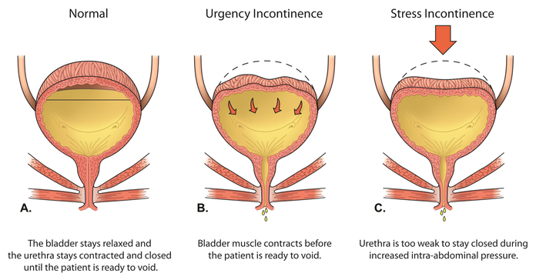
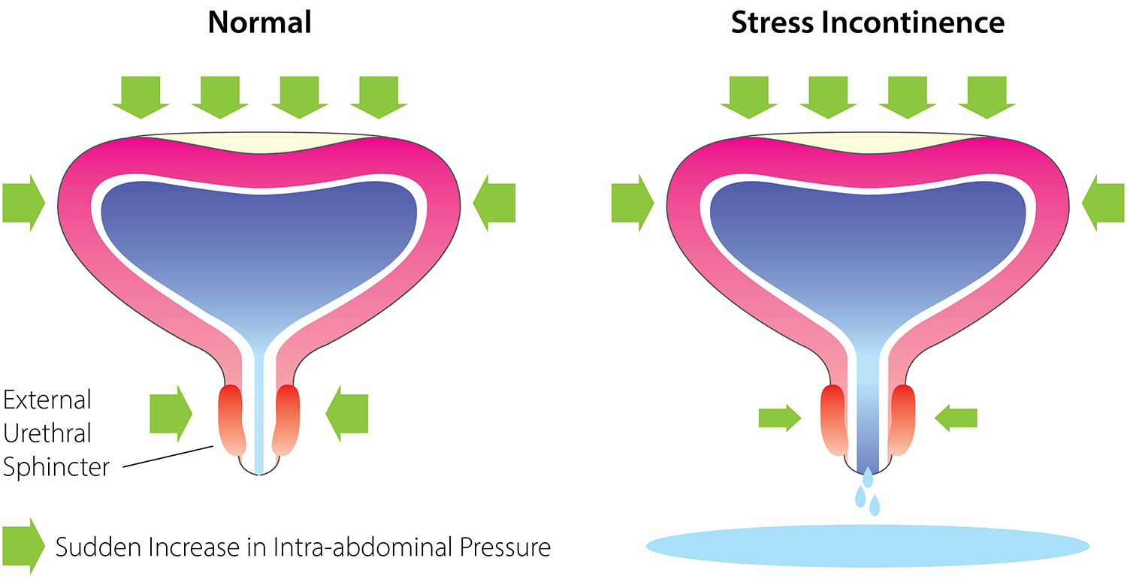
Urinary incontinence
Differentiate ‘stress incontinence’ and ‘urge incontinence’.

Slide 14
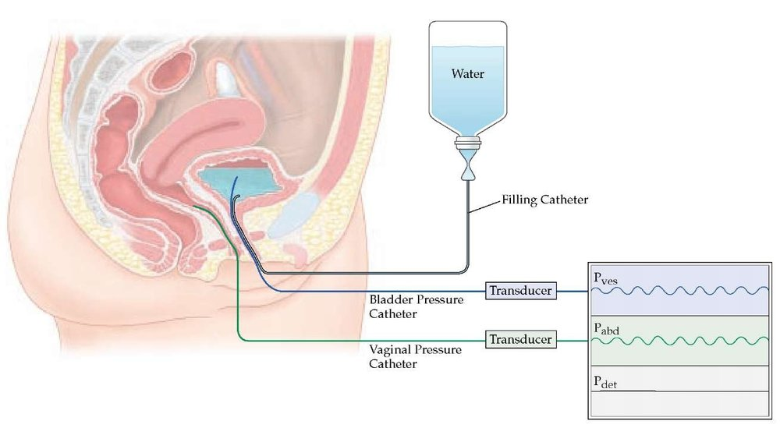
Urinary incontinence
Why is urodynamics needed for diagnosis?

Slide 15
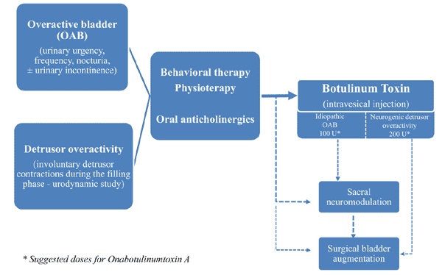
Urinary incontinence
What is the management of detrusor overactivity?

Slide 16
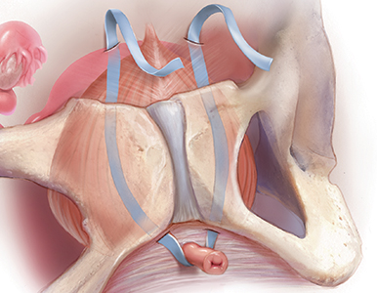
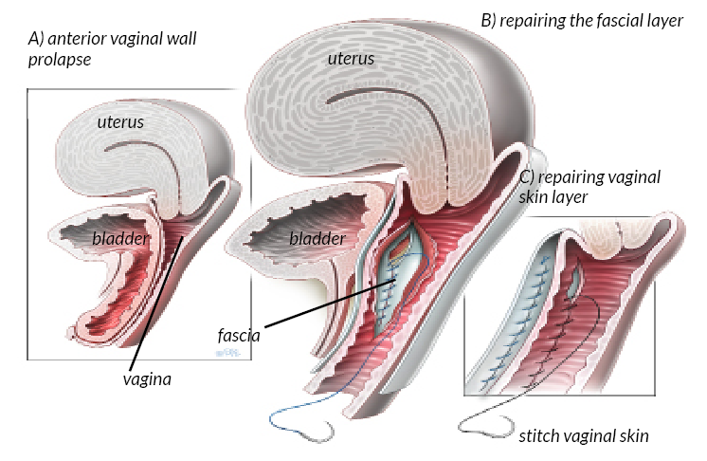
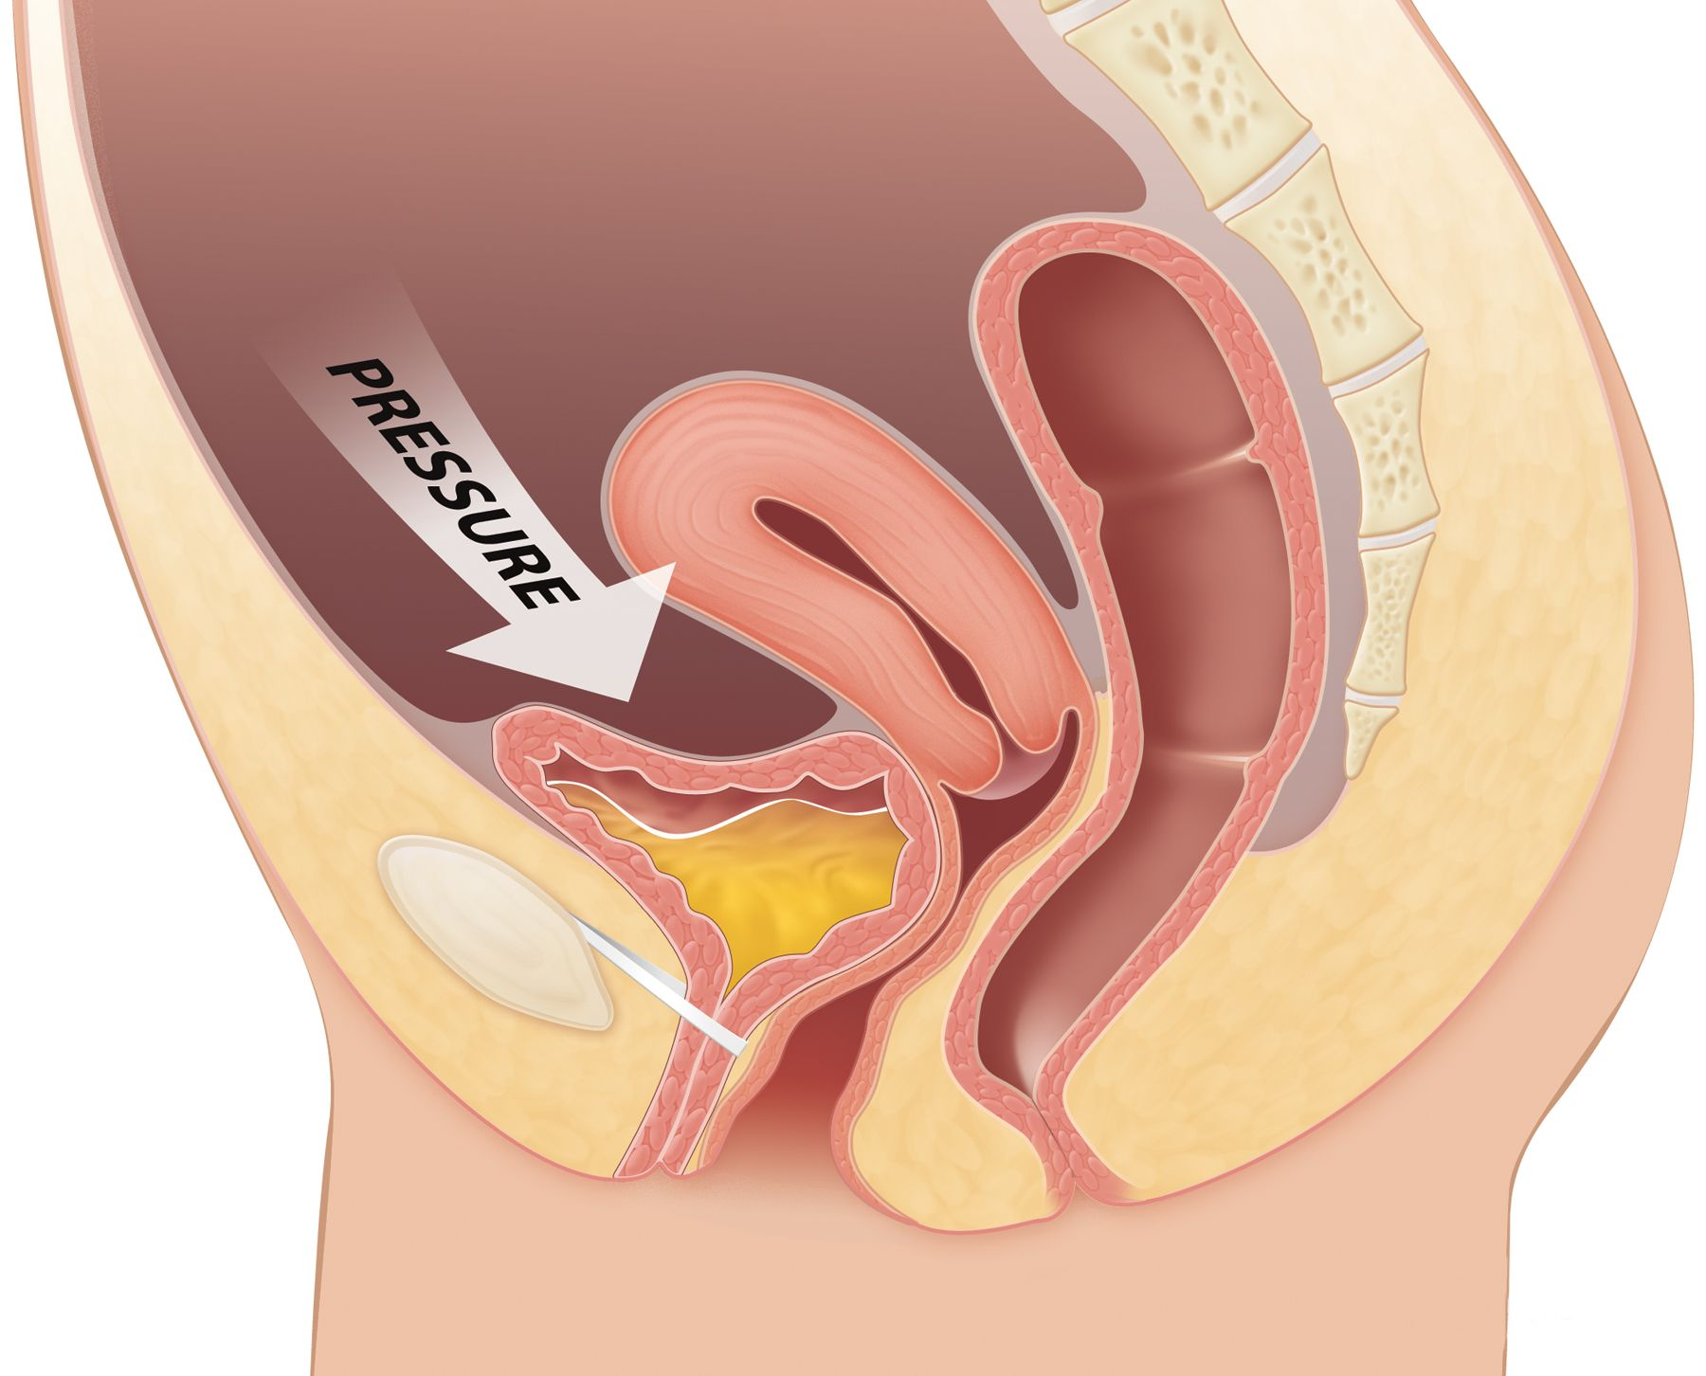
Urinary incontinence
What is the management of stress incontinence?
Conservative ?
Surgical

Slide 17
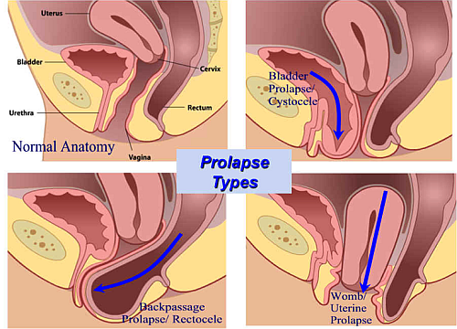
Prolapse
What are the causes for prolapse?
Pregnancy
Difficult labor and delivery or trauma during childbirth
Delivery of a large baby
Being overweight or obese
Lower estrogen level after menopause
Chronic constipation or straining with bowel movements
Chronic cough or bronchitis
Repeated heavy lifting

Slide 18
Prolapse
What are the risk factors for prolapse?
Factors that can increase your risk of uterine prolapse include:
One or more pregnancies and vaginal births
Giving birth to a large baby
Increasing age
Obesity
Prior pelvic surgery
Chronic constipation or frequent straining during bowel movements
Family history of weakness in connective tissue
Being Hispanic or white

Slide 19
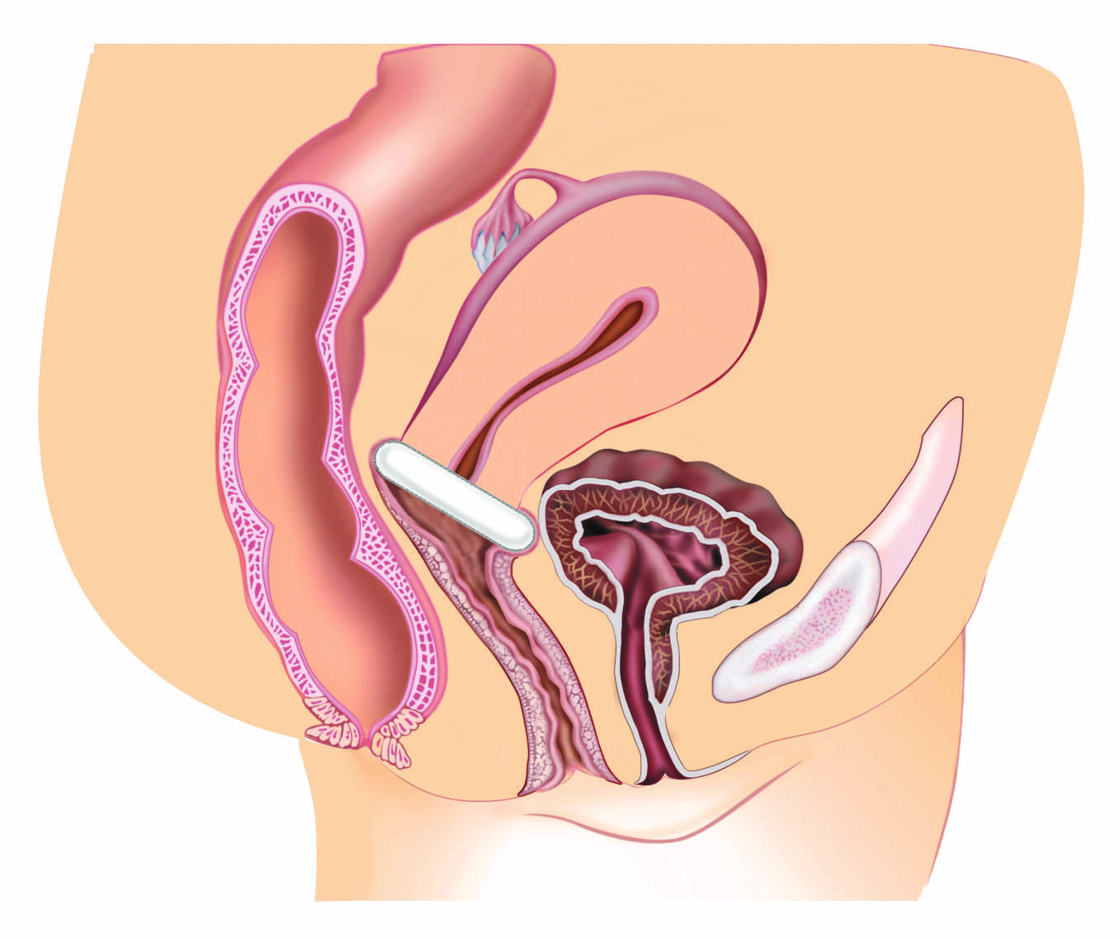
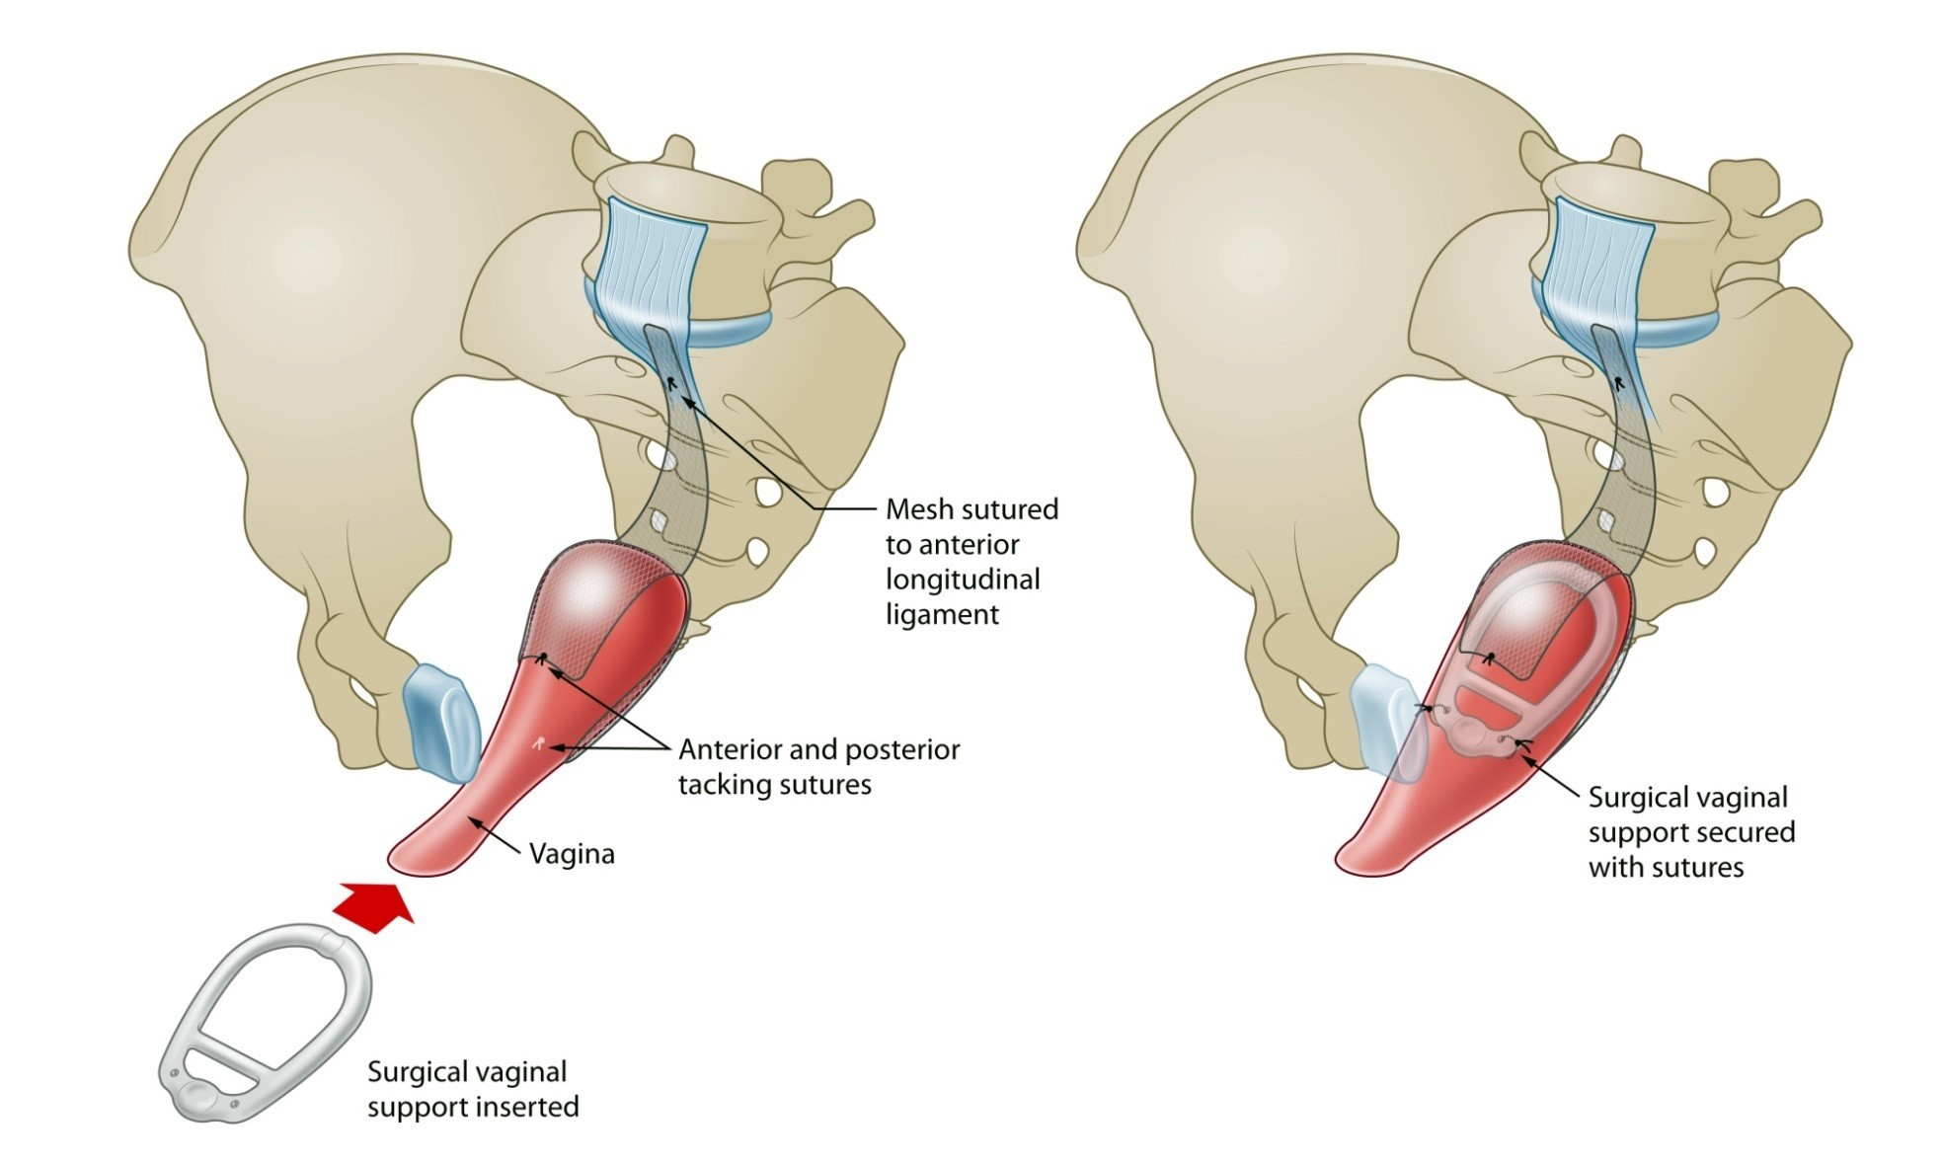
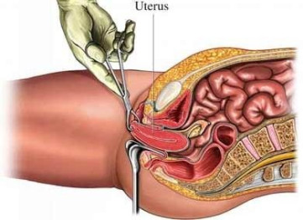
Prolapse
How is prolapse assessed clinically?
How can prolapse be treated?
Conservative
Surgically

