Slide 1
Core Problem 4 Bleeding in Early Pregnancy

Slide 2
Diagnosis of pregnancy
Miscarriage
Maternal disease
Uterine anomalies
Trophoblast tumours

Slide 3
A woman aged 32 with rheumatoid arthritis has had two previous miscarriages. After missing a period for 6 weeks she has had irregular bleeding and pain for the past 3 weeks.

Slide 4
What are the signs and symptoms of pregnancy?
History
Secondary amenorrhea
Last normal menstrual cycle

Slide 5
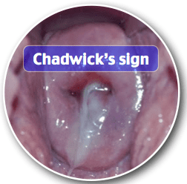
Pregnancy diagnosis
Physical examination
Pickacek’s sign
Enlarged uterus
Breast changes
Hegar sign
softening and enlargement of the cervix
6 wk.
Osiander’s sign
Palpation of lateral fornisies
Goodle’s Sign
Softening of cervix
Chadwick sign
bluish discoloration of the cervix from venous congestion
8-10 weeks.

Slide 6
When would serum βhCG be preferred to urinary βhCG?

Slide 7
Pregnancy diagnosis
Hormonal test
β-HCG
2 times (0- 48h)
Double
Second measurement less than the first
Plateau

Slide 8
What is the role of ultrasound in diagnosis of pregnancy?

Slide 9
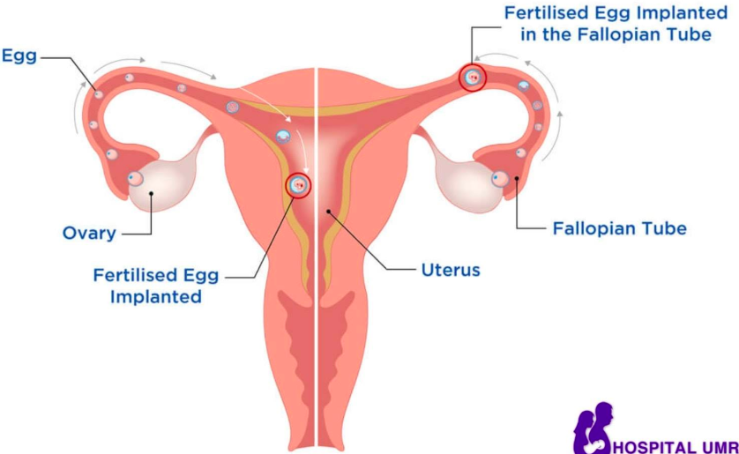
Pregnancy diagnosis
Goal:
Location
Intrauterine
Ectopic
Embryo growing
FHR
Estimated Delivery Date
Trophoblastic disease
Hydatidiform mole
Choriocarcinoma

Slide 10
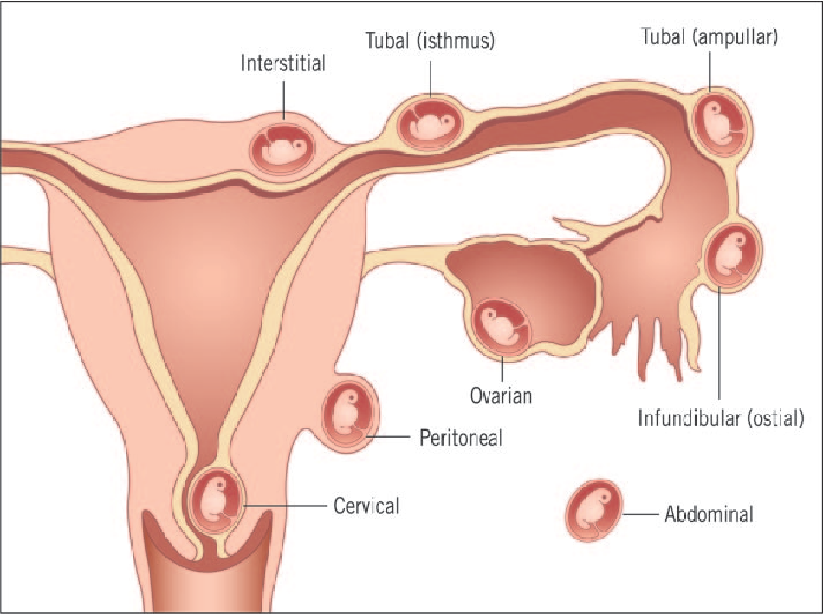
Miscarriage
What are the causes of miscarriage or ectopic pregnancy?
Insufficiency of corpus luteum
No implantation
Subchorionic hematoma
No development of chorionic villi

Slide 11
Miscarriage
What are the maternal risks of miscarriage or ectopic pregnancy?
Bleeding
Abdominal pain
Hemoperitoneum
Hypovolemic shock
Infertility

Slide 12
Miscarriage
What are the different types of miscarriages?
Clinical categorization
Complete
EPL with complete passage of pregnancy tissue.
Complete passage can occur spontaneously or may be diagnosed following treatment with either medical or surgical intervention.
Incomplete
with tissue retained within the uterus (fetal or placental tissue)
Asymptomatic
without bleeding, cramping, or passage of tissue.
Symptomatic
with bleeding and often cramping

Slide 13
Miscarriage
Management of miscarriage
Conservative
Misoprostol
Surgical
D&C

Slide 14
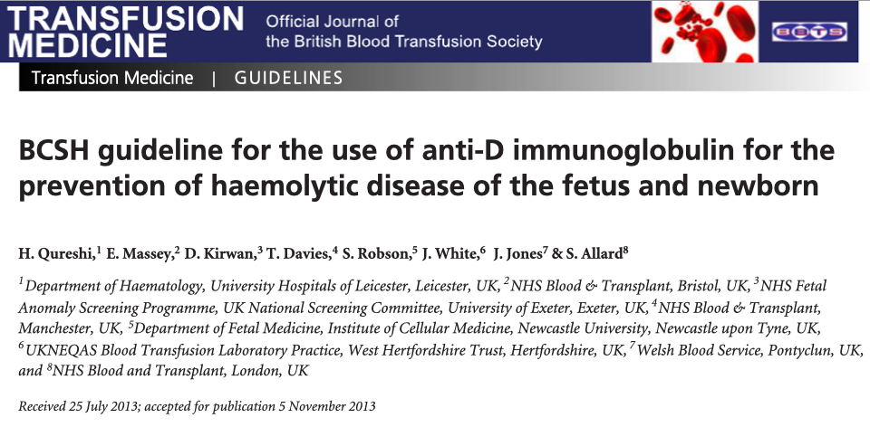
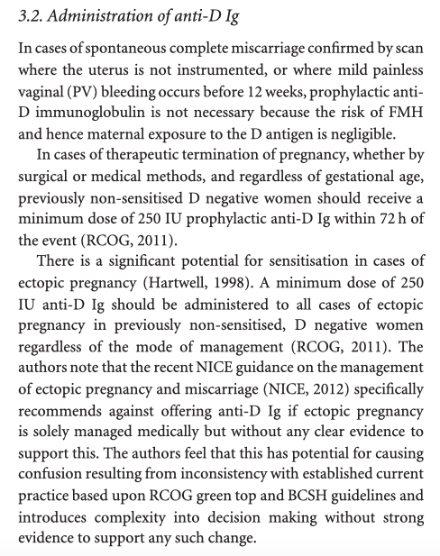
Miscarriage
Why and when is anti-D used?
Recurrent uterine bleeding
Anti-D Ig is unnecessary in women with threatened miscarriage
If bleeding is heavy or repeated or where there is associated abdominal pain and gestation approaches 12 weeks a dose of 1500 iu anti-D Ig may be considered.

Slide 15
Miscarriage
How often and why do spontaneous miscarriages occur?
Spontaneous pregnancy loss is common,
15% of all clinically recognized pregnancies resulting in miscarriage.
90% chromosomal anomalies

Slide 16
Maternal disease
Factors related to miscarriage
Race and ethnicity
Environmental factors and exposures
Medication and substance use
Diseases related to miscarriage
Infection
Pregnancy with intrauterine device (IUD) in place
Diabetes
Obesity
Inherited thrombophilias
Thyroid disease
Paternal

Slide 17
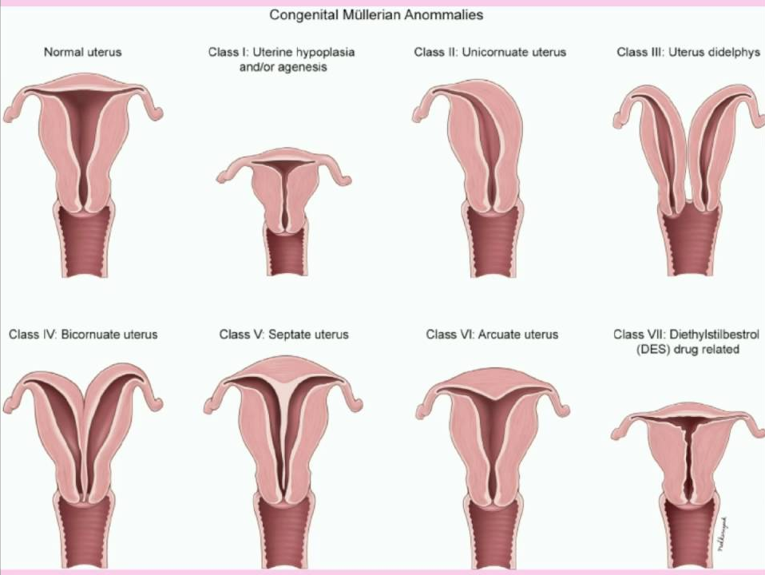
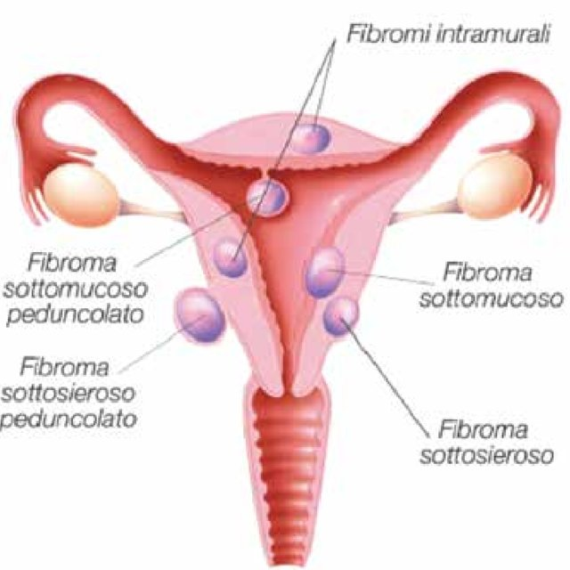
Uterine anomalies

Slide 18
Miscarriage
What is the definition of recurrent miscarriage?
Recurrent pregnancy loss (RPL)
is historically defined as 3 consecutive pregnancy losses prior to 20 weeks from the last menstrual period.
1% to 2% of women experience recurrent pregnancy loss.
Defining RPL as a clinical entity requiring diagnostic testing and therapeutic intervention rests on knowledge of the elevation of risk for subsequent fetal loss and the probability of finding a treatable etiology for the disorder.

Slide 19
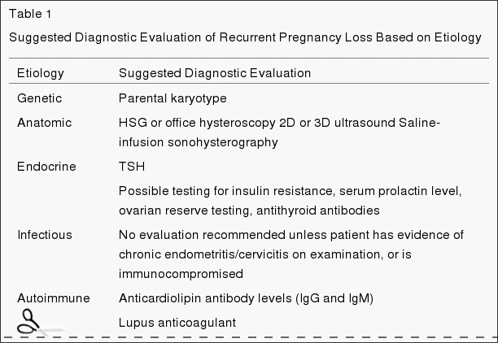
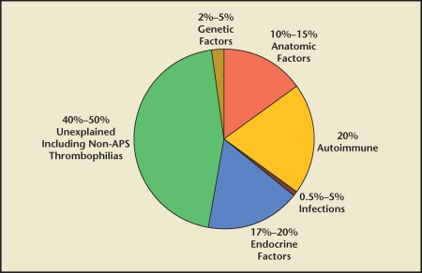

Slide 20
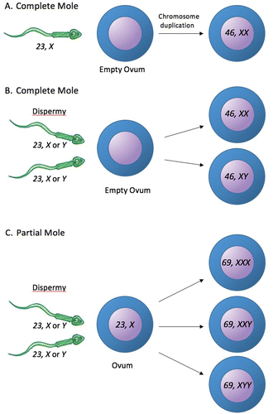
Gestational Throphoblastic disease
How does throphoblastic disease usually present?
is a group of tumors defined by abnormal trophoblastic proliferation
Trophoblast cells produce human chorionic gonadotropin (hCG).
GTD is divided into
hydatidiform moles
Partial
Complete
invasive mole
Choriocarcinoma
placental site trophoblastic tumor
epithelioid trophoblastic tumor.

Slide 21
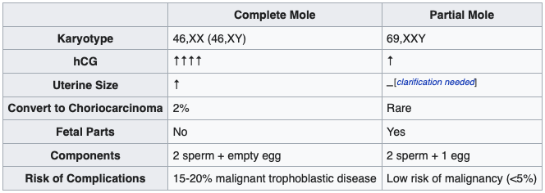
hydatidiform moles
Partial
Complete

Slide 22
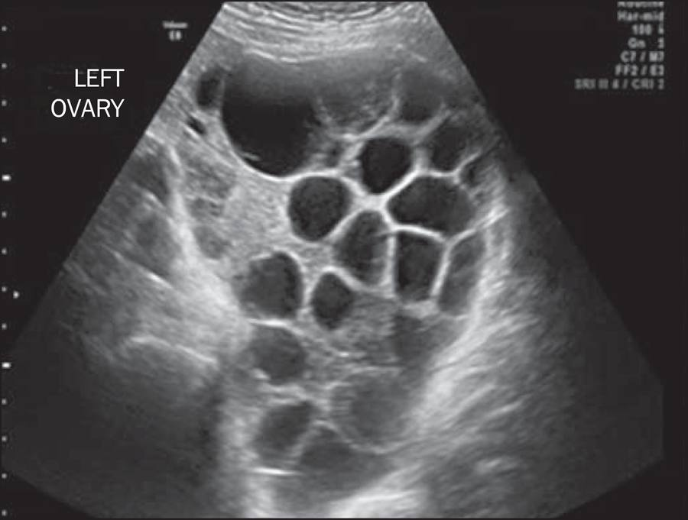
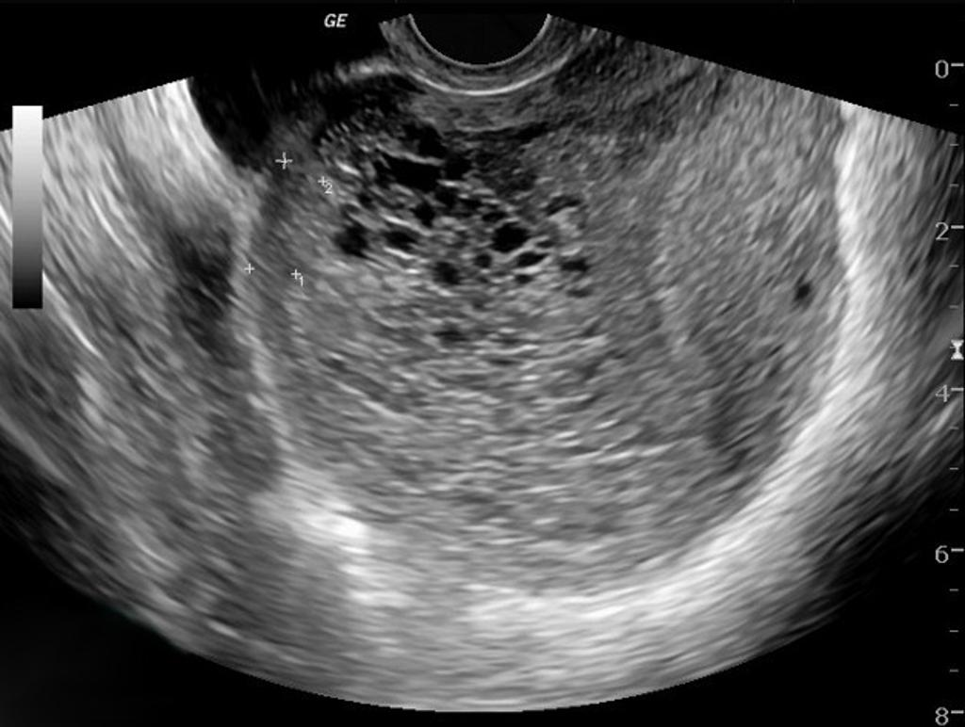

Slide 23
Gestational Throphoblastic disease
Management of molar pregnancy
Hydatidiform moles should be treated by evacuating the uterus
Followed up until their serum human chorionic gonadotrophin (hCG) level has fallen to an undetectable level.
Invasive moles may require
methotrexate.

Slide 24
Gestational Throphoblastic disease
What is choriocarcinoma?
Choriocarcinoma is a malignant, trophoblastic cancer,
Placenta
Testis
Ovary

Slide 25
Gestational Throphoblastic disease
What is choriocarcinoma?
Choriocarcinoma is a malignant, trophoblastic cancer,
Placenta
Testis
Ovary

