Slide 1
Core Problem 3 – Pregnancy Complications

Slide 2
Antenatal care
Tests of fetal wellbeing
Pregnancy hypertension
Antepartum haemorrhage
Obstetric operations

Slide 3
Sally is 36 weeks in her first pregnancy, she has been having ‘low risk’ shared care. She attends her antenatal appointment and complains of feeling unwell. Her BP is 150/95 and she has proteinuria ++.

Slide 4
Antenatal carer
How do we assess pregnancy risk at booking visit?
Can you???
History
Vital signs
Physical examination
Ultrasound

Slide 5
History
Medical/obstetric history:
Personal and demographic information
Personal medical history, including immunizations; risk assessment for heritable disorders and substance use; infection history/exposure; and teratogen exposure
Past surgical history
Family medical history
Menstrual and gynecologic history
Past obstetric history
Travel to areas endemic for malaria, tuberculosis, Zika virus
Exposure to potentially toxic environmental agents
Psychosocial information
Current pregnancy history

Slide 6
Physical examination
Baseline blood pressure
chronic (preexisting) hypertension
Weight and height
Calculating body mass index (BMI)
counselling about the appropriate amount of weight gain over the course of pregnancy.
A complete physical examination should be performed:
with special attention to uterine size and shape and evaluation of the adnexa.
Scars
Signs of abuse
When fetal cardiac activity is present, the fetal heart can usually be heard by 12 weeks of gestation using a hand-held Doppler ultrasound device.

Slide 7
What would you check at each antenatal visit and why?
In every visit
Measurement of blood pressure
Measurement of weight
Urine dipstick for protein
Assessment of foetal growth
Documentation of foetal heart rate

Slide 8
Where would BP monitoring be performed – hospital or at home?
In every visit
Measurement of blood pressure
Measurement of weight
Urine dipstick for protein
Assessment of foetal growth
Documentation of foetal heart rate

Slide 9
Pregnancy hypertension
What is the classification of hypertension of pregnancy?
1) chronic hypertension
2) preeclampsia-eclampsia
3) preeclampsia superimposed on chronic hypertension
4) gestational hypertension
transient hypertension of pregnancy or chronic hypertension identified in the latter half of pregnancy
National High Blood Pressure Education Program Working Group on High Blood Pressure in Pregnancy

Slide 10
Pregnancy hypertension
Pathophysiology of PET
During a normal pregnancy, fetal syncytial trophoblasts penetrate and remodel maternal spiral arteries, causing them to dilate into large, flaccid vessels.
This remodeling accommodates the vast, increased maternal circulation needed for adequate placental perfusion.
This remodeling is somehow prevented in preeclamptic pregnancies: the placenta is unable to properly burrow into the maternal blood vessels, leading to intrauterine growth restriction and other fetal manifestations of the disorder

Slide 11
Preeclampsia
Elevated blood pressure after 20 weeks of gestation
≥ 140 mm Hg systolic or ≥ 90 mm Hg diastolic)
plus proteinuria (> 0.3 g/24 hours).
Two elevated blood pressure measurements 6 hours apart
Proteinuria of 300 mg in a 24-hour urine specimen.
Preeclampsia used to be diagnosed by the “30-15” rule:
systolic pressure more than 30 mm Hg above baseline and diastolic pressure more than 15 mm Hg above baseline

Slide 12
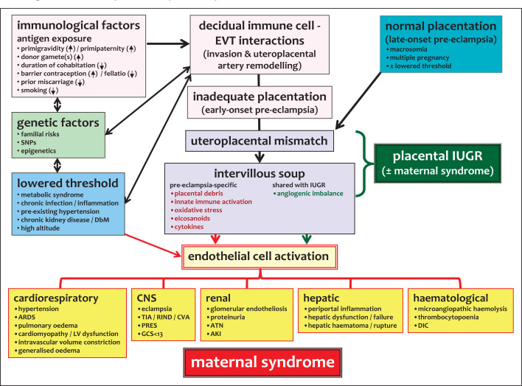

Slide 13
Pregnancy hypertension
What signs and symptoms can PET present with?
proteinuria
Severe headaches
Changes in vision
Upper abdominal pain, usually under your ribs on the right side
Nausea or vomiting
Decreased urine output
Thrombocytopenia
Impaired liver function
Shortness of breath

Slide 14
Pregnancy hypertension
What are the maternal and fetal complications of PET?
Fetal growth restriction
Preterm birth
Placental abruption
HELLP syndrome
Eclampsia
Other organ damage
Cardiovascular disease

Slide 15
Pregnancy hypertension
How do we assess severity of PET?

Slide 16
Pregnancy hypertension
What is the cure for PET?
If the pregnancy is at term:
the baby should be delivered.
Delivery is generally not indicated for women with mild preeclampsia until 37 to 38 weeks of gestation
She will need:
Baseline and serial laboratory tests (complete blood cell count, BUN, creatinine, uric acid, ALT, AST).
Ultrasonography
Doppler ultrasonography. Umbilical artery systolic/diastolic ratios measured by Doppler ultrasonography may detect early uteroplacental insufficiency.
Antenatal testing
A 24-hour urine collection for protein. The goals of treatment are to prevent seizures, lower blood pressure to avoid maternal end-organ damage, and expedite delivery.

Slide 17
Pregnancy hypertension
What is the cure for PET?
Magnesium sulfate is still the drug of choice for preventing and arresting eclamptic seizures. It has the additional benefit of reducing the incidence of placental abruption
Magnesium toxicity can lead to
respiratory paralysis
central nervous system depression
cardiac arrest.
The antidote is calcium gluconate, 1 g infused intravenously over two minutes.

Slide 18
Pregnancy hypertension
When would antihypertensives be used in PET?
no effect on disease progression or preventing eclampsia.
Preferred medications are
hydralazine 5-10 mg intravenous bolus every 10-15 minutes,
labetalol, nicardipine, and sodium nitroprusside.
Intravenous labetalol and hydralazine are commonly used for the acute management of preeclampsia.
Diuretics are usually contraindicated because of the already collapsed intravascular volume.
Intravenous hydration for oliguria must be given cautiously to avoid pulmonary edema, ascites and cardiopulmonary overload.

Slide 19
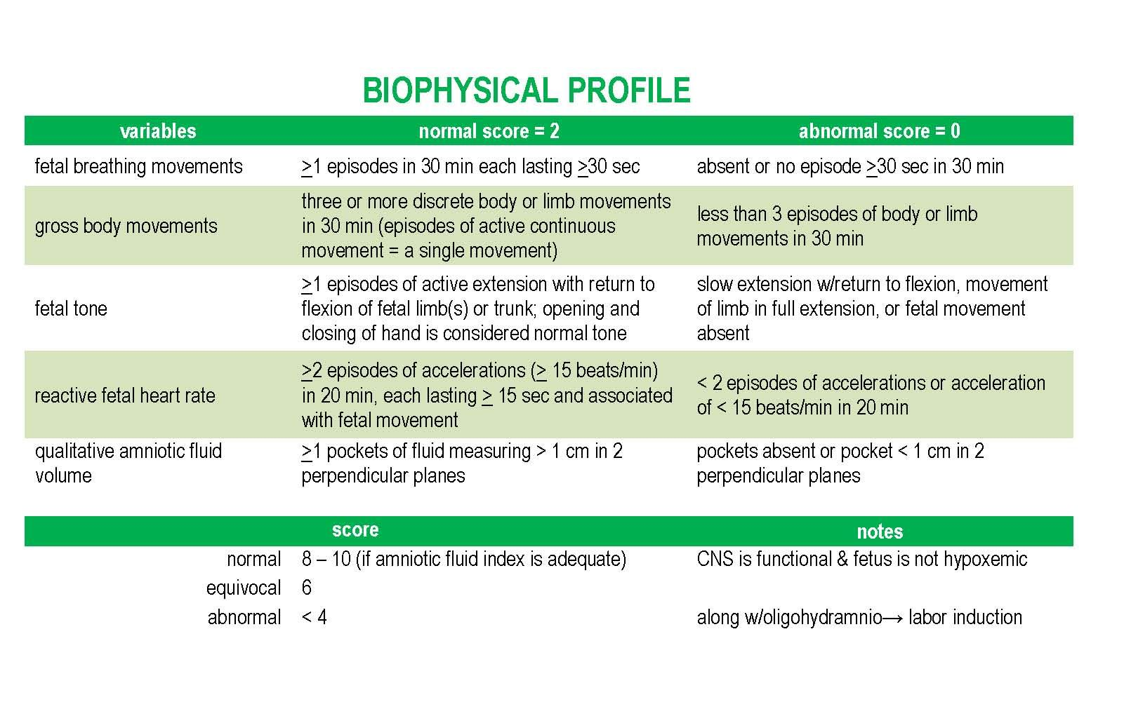
Tests of fetal wellbeing
What is the fetal biophysical profile?
U/S only
U/S plus CTG

Slide 20
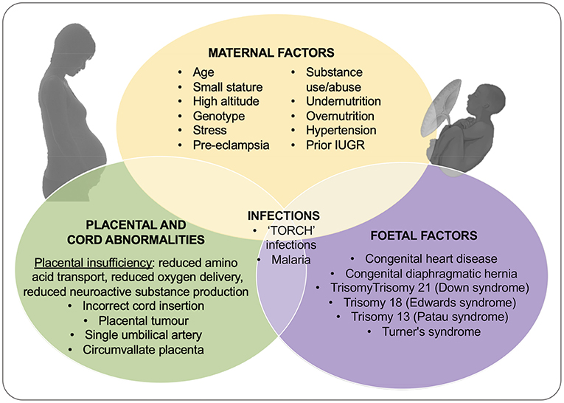
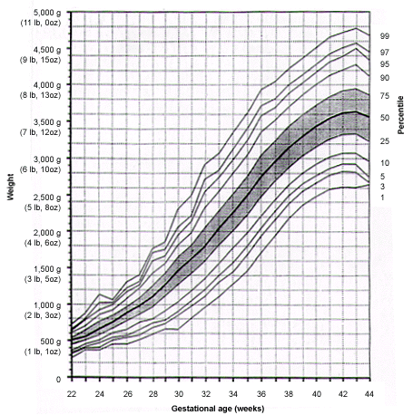
Tests of fetal wellbeing
What are the possible reasons for a baby being “small”?
IUDR
Symmetrical
Asymmetrical

Slide 21
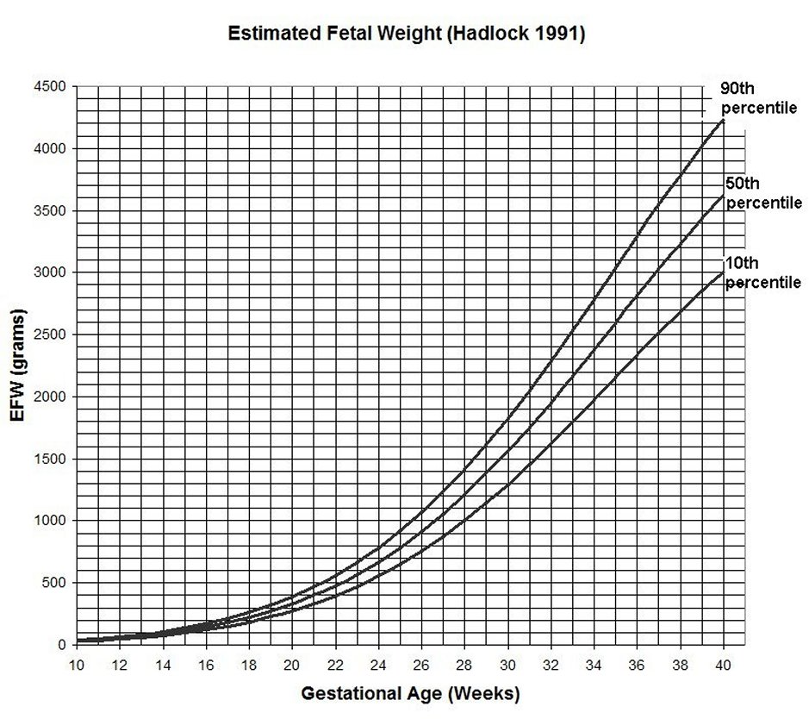
Tests of fetal wellbeing
How do we assess fetal hypoxaemia in growth restricted fetuses?
CTG / Biophysical profile
Growth
EFW
Hadlock: BPD-AC-FL
Amniotic fluid index
Placenta grade (?)

Slide 22
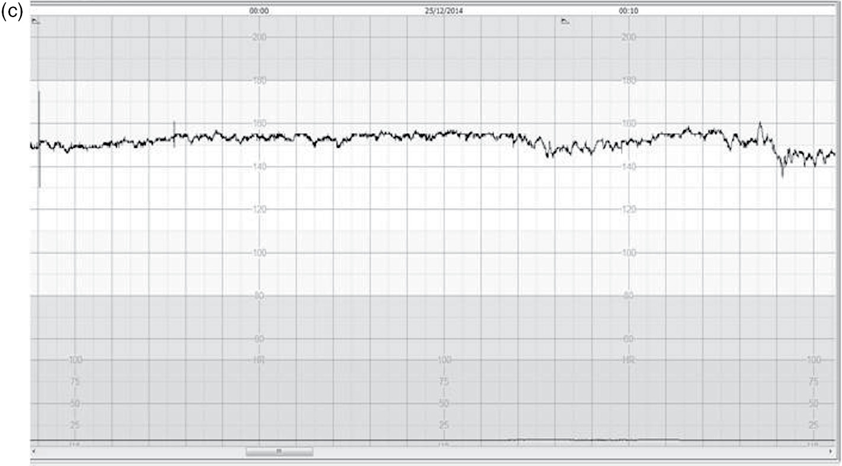
CTG in 33weeks IUGR foetus
Is it ok?

Slide 23
The day after she is admitted Sally has fresh vaginal bleeding.

Slide 24
Antepartum haemorrhage
Definition : vaginal bleeding > 24week of gestation
Is it all the time dangerous ?
Mild
Severe
DD: rectal bleeding? Vaginal trauma ?

Slide 25
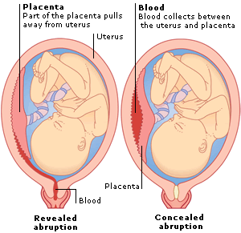
Antepartum haemorrhage
Signs and symptoms of placenta abruption
Premature separation
Pain
Concealed blood with in the uterus
Tender uterus
Shock

Slide 26
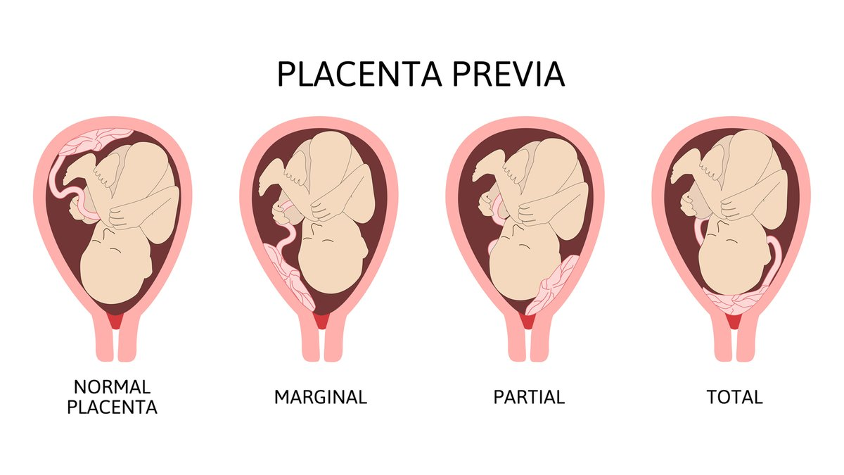
Antepartum haemorrhage
Signs and symptoms placenta praevia.
Placenta is near or covering the os
Painless
No concealed bleeding
Sudden
Unpredictable

Slide 27
Antepartum haemorrhage
Fetal risks of abruption
Maternal risks of abruption

Slide 28
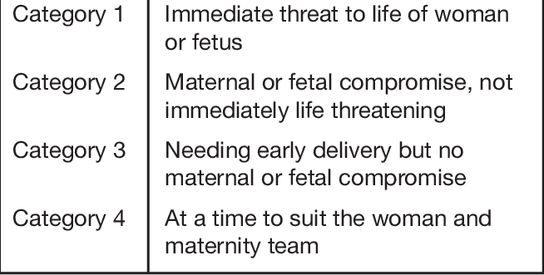
Obstetric operations
When would the delivery be indicated?
Immediately

Slide 29
Obstetric operations
How would delivery be affected?
Natural
CS

Slide 30
Obstetric operations
How is induction of labour performed?
Cervical ripening
Induction of the contractions

Slide 31
Obstetric operations
Would anaesthesia in women with PET be altered?
Epidural or General
What is the difference between classical and lower segment Caesarean section?

