Slide 1
Core Problem 2 – Prenatal Screening

Slide 2
Chromosome abnormalities
Single gene defects
Anatomical defects
Rhesus iso-immunisation
Twin pregnancy
Obstetric operations

Slide 3
Katherine is 34 years old and 11 weeks pregnant for the first time. An early ultrasound diagnosed twins. She is worried about chromosomal problems and requests prenatal screening.

Slide 4
Chromosomal abnormalities vs single gene defects
Discuss differences between chromosomal abnormalities and single gene defects.
one chromosome contains thousands of genes.
A person can have normal chromosomes in number and structure, but still have a disease or condition caused by a mutation in one or more of the genes on the chromosomes.
A single gene defect usually does not cause the chromosome structure or number to be abnormal.

Slide 5
single gene defects
1.1Autosomal dominant
1.2Autosomal recessive
1.3X-linked dominant
1.4X-linked recessive
1.5Y-linked
1.6Mitochondrial

Slide 6
examples of these defects
Trisomy 21
ChA
Turner
ChA
Cystic fibrosis
AR
Klinefelter
ChA
B- Thalassaimia
AR
B- Thalassaimia
AR
Sickle cell anemia
AR
Huntington's disease
AD
Marfan syndrome
AD
Von Willebrand disease
AD

Slide 7
Chromosomal abnormalities vs single gene defects
What is the difference between screening and diagnosis?
What are the currently available screening test’s for Down’s?
Discuss timing and possible complications of diagnostic tests.

Slide 8
congenital defects
What are the commonest major congenital abnormalities?
Genetic factors
Socioeconomic and demographic factors
Environmental factors
Infections

Slide 9
Anatomical defects
Discuss the value of routine anomaly scan.
18 to 22 weeks of gestation
Screen for fetal anomalies
Fetal structural anomalies, the procedure is optimally performed in the second trimester, between 18 and 22 weeks of gestation.
Screen for short cervix

Slide 10
the value of routine anomaly scan
Fetal number, including number of amnionic sacs and chorionic sacs for multiple gestations
Fetal cardiac activity
Fetal position relative to the uterus and cervix
Location and appearance of the placenta, including site of umbilical cord insertion
Amnionic fluid volume
Gestational age assessment
Fetal weight estimation
Fetal anatomical survey
Evaluation of the maternal uterus, ovaries, and bladder when appropriate
Placenta location

Slide 11
What is the value of prenatal detection of congenital defects?

Slide 12
2nd trimester
24 to 28 weeks of gestation
Administer anti-D immune globulin to RhD-negative women

Slide 13
Rhesus iso-immunisation
What are the consequences of incompatibility of the rhesus antigen between the mother and the fetus?
Rhesus disease only happens when the mother has rhesus negative blood (RhD negative) and the baby in her womb has rhesus positive blood (RhD positive).
The mother must have also been previously sensitised to RhD positive blood.

Slide 14
Rhesus iso-immunisation
What prenatal and postnatal problems can rhesus disease produce?
If rhesus disease is left untreated,
Stillbirth
foetal hydrops
Haemolytic anaemia
brain damage
learning difficulties
However, treatment is usually effective and these problems are uncommon
What preventive measures can help reduce maternal sensitisation?

Slide 15
Twin pregnancy
Discuss the importance of determining chorionicity in twins.
How is screening and diagnosis modified in twin pregnancy?
How is antenatal care different in twin pregnancy?
Discuss the timing and management of delivery in twins.

Slide 16
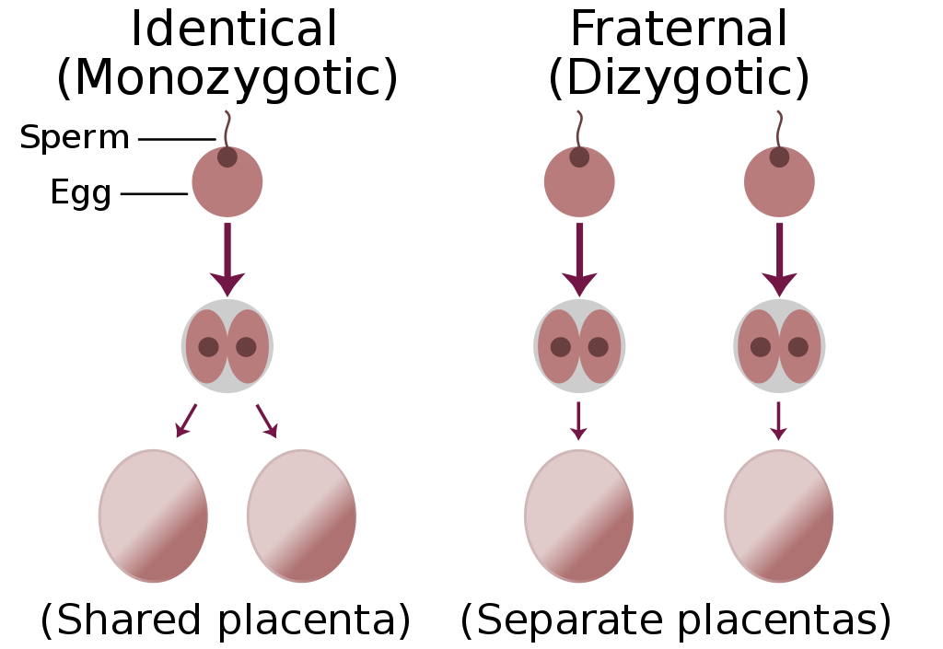
Importance of determining chorionicity in twins

Slide 17
Discuss the importance of determining chorionicity in twins
Dichorionic-Diamniotic | Dichorionic-Diamniotic twins form when splitting takes place by the third day after fertilization.
Monochorionic-Diamniotic | Days 4-8
Monochorionic-Monoamniotic | Monoamniotic twins occur when the split takes place after the ninth day after fertilization.
Conjoined twins | If the division of the zygote occurs later than the 12 days then conjoined twins are usually the result.

Slide 18
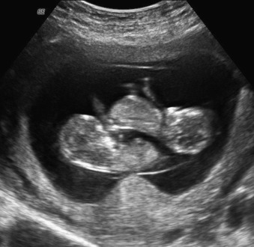

Slide 19
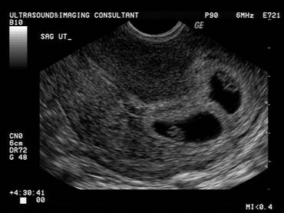

Slide 20
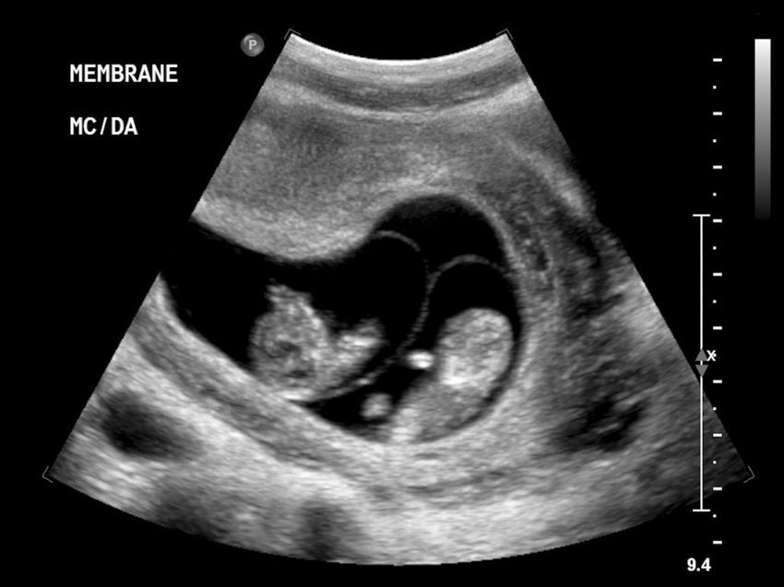

Slide 21
Twin pregnancy
How is screening and diagnosis modified in twin pregnancy?
Ultrasound
Chromosomal defects
How is antenatal care different in twin pregnancy?
Closer follow up after 26 week
Growth deference between the twins
TTTS
Preterm delivery
Cervical length

Slide 22
Twin pregnancy
Timing and management of delivery in twins

Slide 23
Obstetric operations
What is legally required before a termination can be performed?
How can termination of pregnancy be performed?
Chemical
Surgical
What are the complications of termination of pregnancy?
Infection
Perforation
Haemorrhage
Infertility

