Slide 1
Core Problem 11 Puerperium and Breastfeeding

Slide 2
You go to the postnatal ward to follow up on a delivery you helped with yesterday. While you are there the midwives ask you to see a few other women. Jolanta had a normal delivery yesterday of a 3.4kg girl. You assisted at her delivery and she is delighted to see you. She asks you what to expect in the next few days and weeks.
Core Topics
Physiological changes in puerperium
Common puerperial complications
Perineal tears and care in the postpartum period
Breast feeding: physiology and problems

Slide 4
What physiological changes occur in the puerperial period in various organ systems?
Organ Systems Involved
General Physiological Changes
Reproductive
Lactation
Endocrine
Renal
Fluids
Hematologic
Cardiovascular
Gastrointestinal

Slide 5
What are the commonly observed problems of puerperium?

Slide 6
She also wants to ask you about breastfeeding
What are the advantages of breast feeding to the baby and the mother?
What can we, as health professionals do, to encourage breastfeeding?
What is the physiology of breastfeeding?

Slide 7
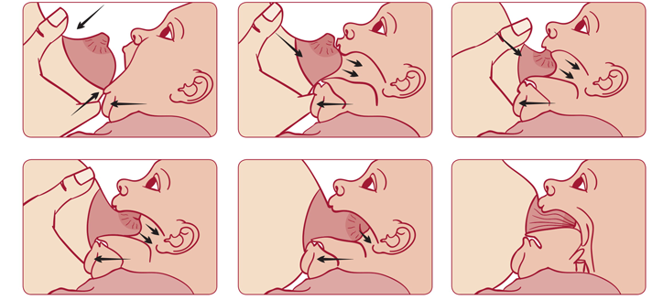
What is the correct position for breast feeding for the baby and the mother?

Slide 8
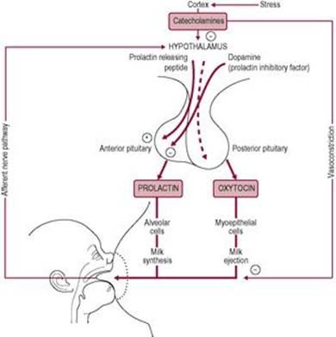
What is the physiology of breastfeeding?
Prolactin and oxytocin
Source | Anterior Pituitary Gland | Posterior Pituitary Gland (but Synthesized in Hypothalamus)
Primary control | Lifting of dopamine inhibition | Neural pathway
Modulating factors | Positively stimulated by oestrogen, TSH | Neurotransmitters
Peak response | 30 min | 30 s
Stimulus | Suckling | Suckling, sound, sight and thought of baby
Target cell | Alveolar cell | Myoepithelial cell
Effect | Milk synthesis | Milk ejection

Slide 9
Breastfeeding
What can we, as health professionals do, to encourage breastfeeding?
?

Slide 10
Shanti had a normal vaginal delivery yesterday after being induced for ruptured membranes. She had a 3.1kg boy who is feeding well. She “is feeling awful”. She looks flushed and unwell.

Slide 11
What observations are important in a mother in the postpartum period?
Vital signs
Blood Pressure
BPM
Temperature
Breast examination
Uterine contraction
Lochia
Episiotomy

Slide 12
What observations are important in a mother in the postpartum period?

Slide 13
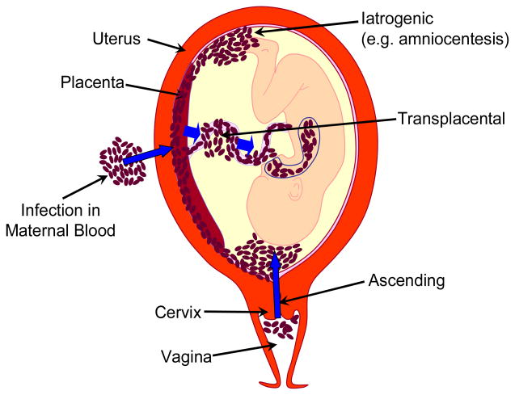
Shanti’s temperature is 38.6 ̊c
What are the possible causes of her pyrexia?
Mastitis ?
Chorioamnionitis
Infection of the episiotomy
UTI
Other causes

Slide 14
What would you do next?
Blood tests
WBC
CRP
ESR
Follow up
Antibiotics

Slide 15
Sarah had a 4.3kg baby girl by ventouse delivery yesterday. She had a third degree tear repaired in theatre. The midwives have asked you to evaluate her with a view to arranging her discharge.
She asks: ‘what kind of tear did I have and what should I do?’

Slide 16
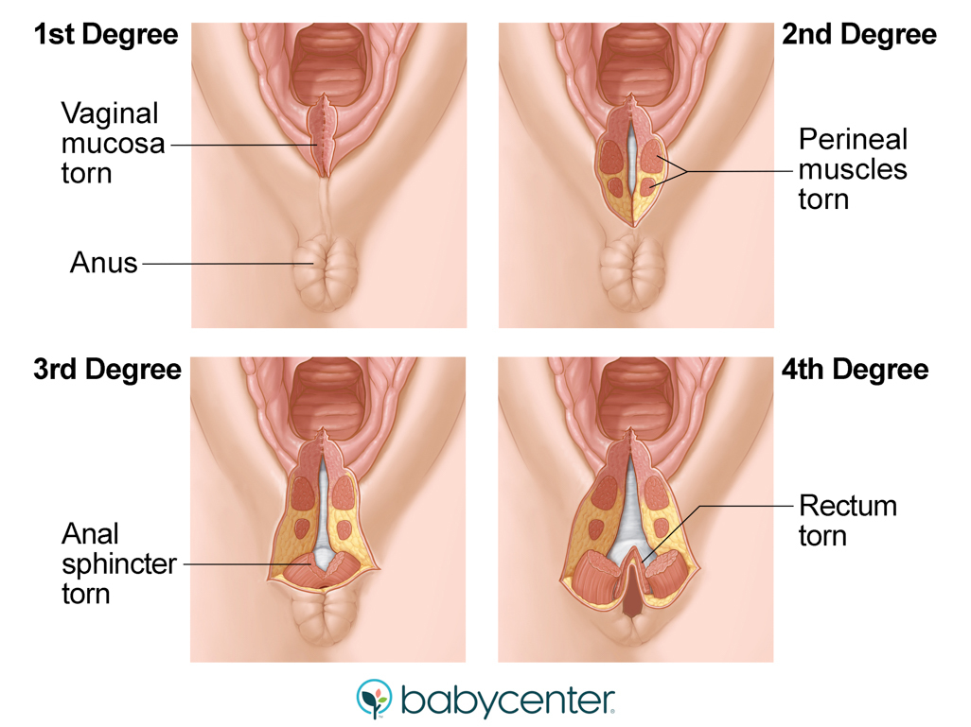
What is a third degree tear?

Slide 17
How should we manage perineal tears postnatally?
Caring
Keep clean and free from infection
Wash several times a day and after each bowel motion.
Change sanitary pads every four to six hours.
Do not use a hairdryer to dry perineum
Avoid the use of creams, ointments or powder.
Antibiotics may be prescribed
Postnatal exercises
Follow up care
Six weeks

Slide 18
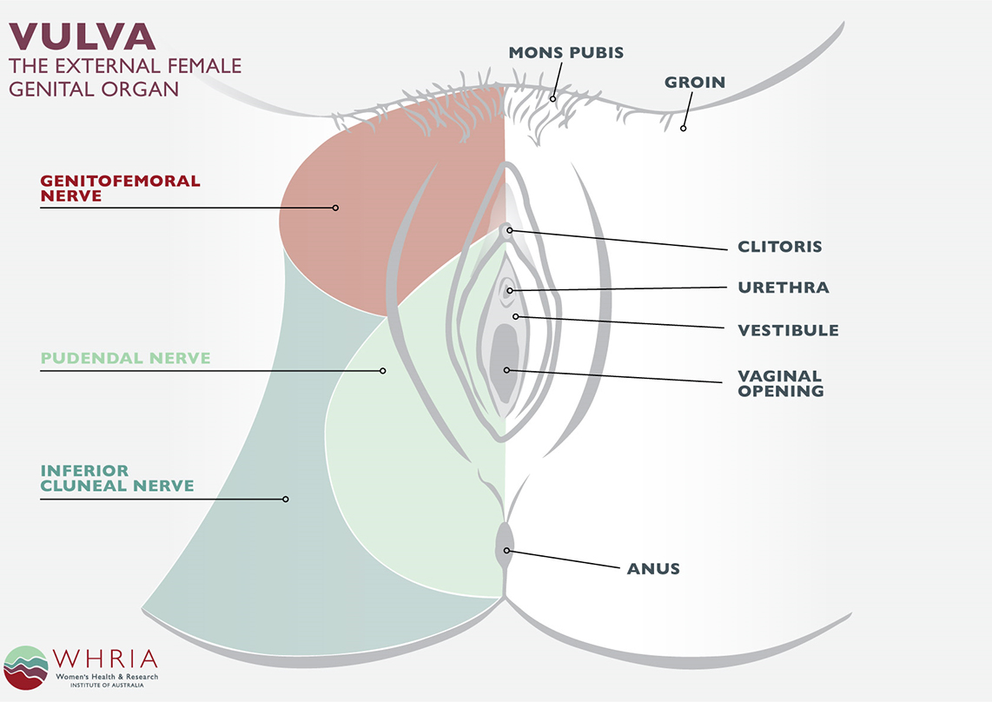
How common are perineal problems?
Pudendal nerve entrapment
Pelvic floor dysfunction
Infection
Injuries
UTIs
Faecal incontinence
Urinary incontinence

Slide 19
She is finding breastfeeding difficult and asks you: ‘is the baby getting enough milk’?
What common concerns do mothers have regarding breast feeding?
What are the signs a baby is successfully feeding?

Slide 20
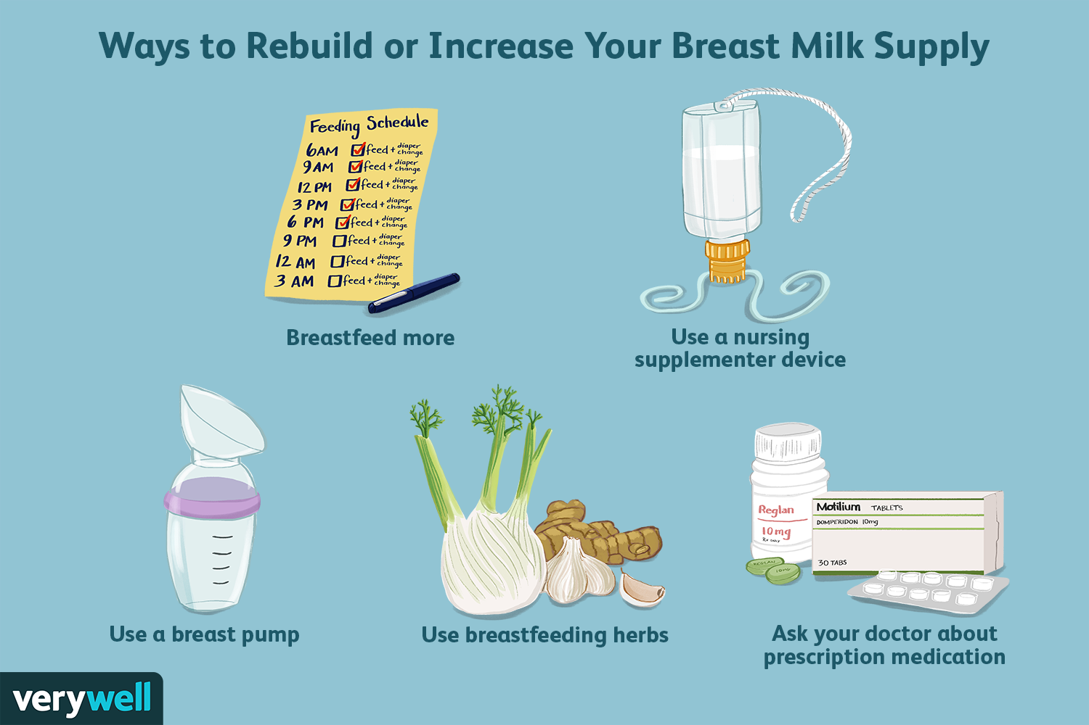
What can be done to improve milk production?

Slide 21
Grace had an elective Caesarean section 2 days ago; at term for breech presentation. She asks “why do the midwives keep giving me painful injections?” Her BMI is 42. What are you going to explain?

Slide 22
Thromboembolism
Women should be encouraged to mobilise as soon as appropriate following the birth.
Women with unilateral calf pain, redness or swelling should be evaluated for deep venous thrombosis (emergency action).
Women experiencing shortness of breath or chest pain should be evaluated for pulmonary thromboembolism (emergency action).
Routine use of Homan's sign as a tool for evaluation of thromboembolism is not recommended.
Obese women are at higher risk of thromboembolism and should receive individualised care.
Postpartum haemorrhage
In the absence of abnormal vaginal loss, assessment of the uterus by abdominal palpation or measurement as a routine observation is unnecessary.
Assessment of vaginal loss and uterine involution and position should be undertaken in women with excessive or offensive vaginal loss, abdominal tenderness or fever. Any abnormalities in the size, tone and position of the uterus should be evaluated. If no uterine abnormality is found, consider other causes of symptoms (urgent action).
Sudden or profuse blood loss, or blood loss accompanied by any of the signs and symptoms of shock, including tachycardia, hypotension, hypoperfusion and change in consciousness, should be evaluated (emergency action).
Pre-eclampsia and eclampsia
A minimum of one blood pressure measurement should be carried out and documented within 6 hours of the birth.
Routine assessment of proteinuria is not recommended.
Women with severe or persistent headache should be evaluated and pre-eclampsia considered (emergency action).
If diastolic blood pressure is greater than 90 mmHg, and there are no other signs and symptoms of pre-eclampsia, measurement of blood pressure should be repeated within 4 hours.
If diastolic blood pressure is greater than 90 mmHg and accompanied by another sign or symptom of pre-eclampsia, evaluate further (emergency action).
If diastolic blood pressure is greater than 90 mmHg and does not fall below 90mmHg within 4 hours, evaluate for pre-eclampsia (emergency action).
Genital tract sepsis
In the absence of any signs and symptoms of infection, routine assessment of temperature is unnecessary.
Temperature should be taken and documented if infection is suspected.
If the temperature is above 38ºC, repeat measurement in 4-6 hours.
If the temperature remains above 38ºC on the second reading or there are other observable symptoms and measurable signs of sepsis, evaluate further (emergency action).

Slide 23
Why is venous thrombosis common at this time?
What measures can be taken to avoid the problem of venous thrombosis?
Antithrombotic shocks
LMH
Early mobilization

