Slide 1
Core Problem 10 Have I got cancer?

Slide 2
A woman aged 65 has had irregular vaginal bleeding for several weeks
Core Topics
Cancer (all sites)
Gynaecological operations

Slide 3
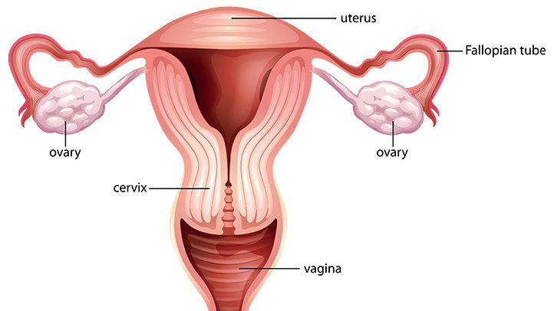

Slide 4
Cervical cancer

Slide 5
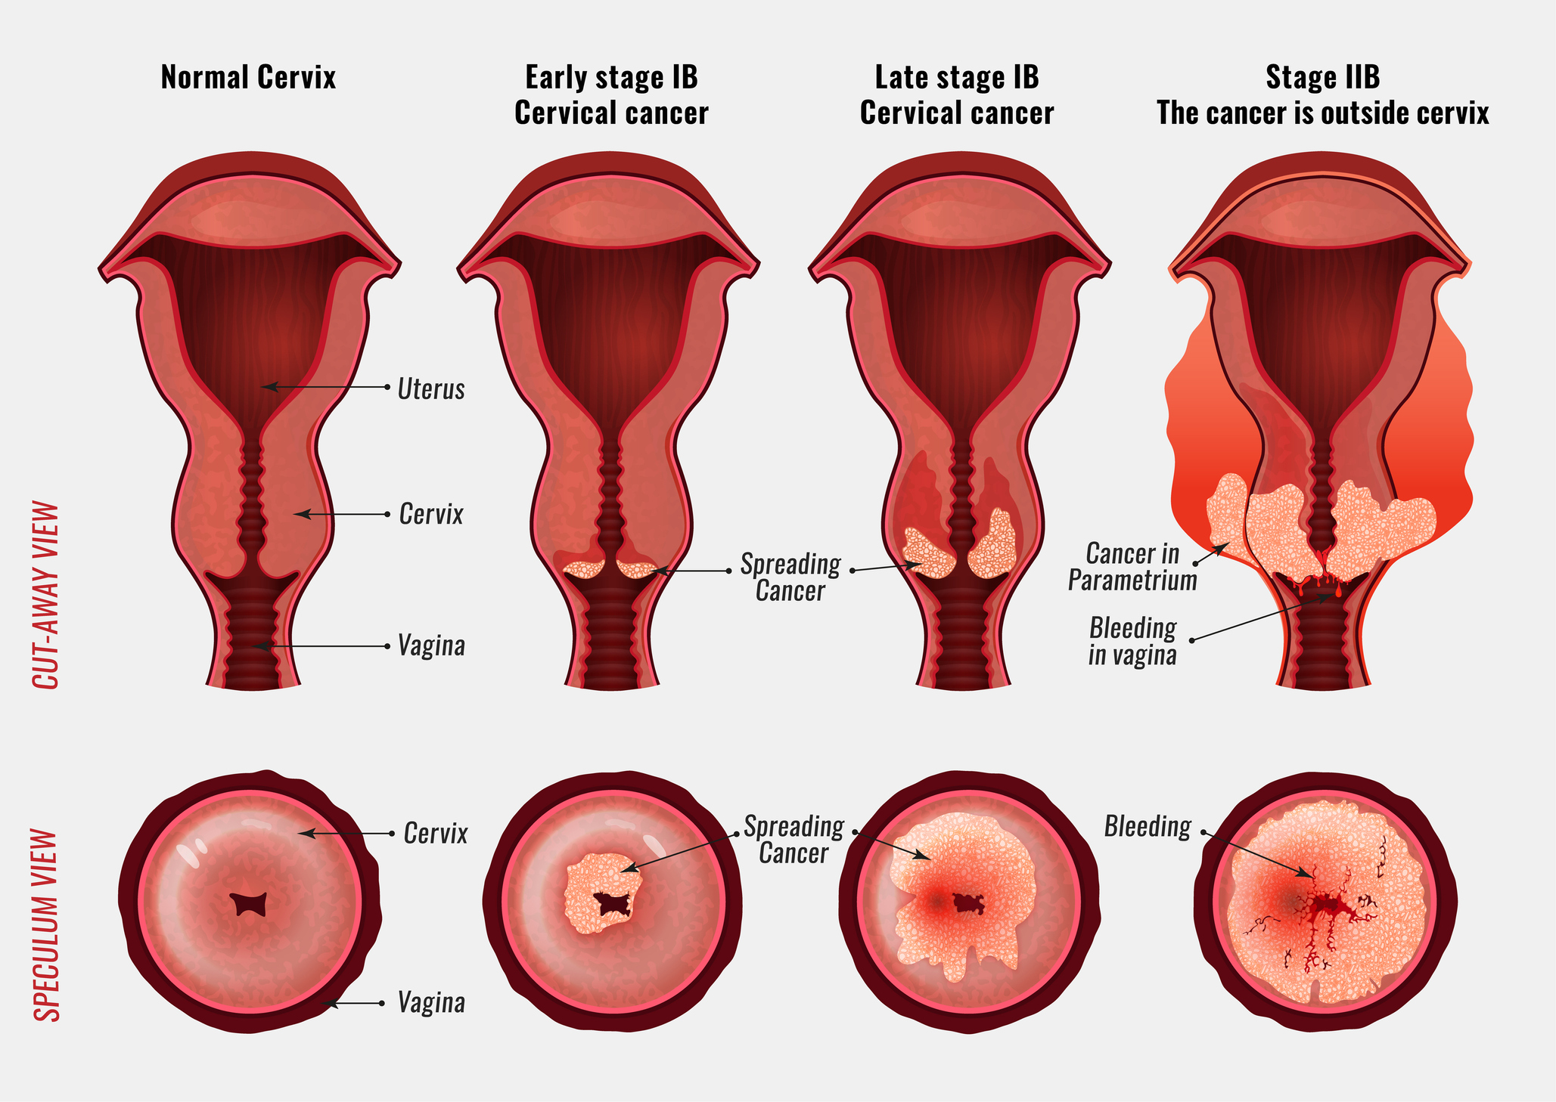
Cervical cancer

Slide 6
Cervical cancer
What are the major risk factors for cervical cancer?
What is the difference between dyskaryosis and dysplasia?
What colour are abnormal cells on colposcopy and why?
How do we stage cervical cancer?

Slide 7
What are the major risk factors for cervical cancer?
High Risk HPV
Smoking
HIV (the virus that causes AIDS) or another condition that makes it hard for your body to fight off health problems.
Using birth control pills for a long time (five or more years).
Having given birth to three or more children.
Having several sexual partners.

Slide 8
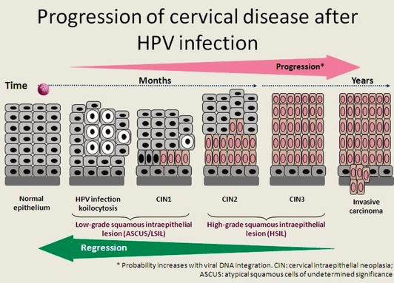

Slide 9
What is the difference between dyskaryosis and dysplasia?
Dyskaryosis : The appearance of abnormal cells whose nuclei show the features characteristic of the earliest stage of malignancy.
Mild Dyskaryosis Indicates mild or slight cell changes in the cervix
Moderate Dyskaryosis Indicates moderate cell changes in the cervix
Severe Dyskaryosis Indicates severe cell changes in the cervix
Dysplasia is any of various types of abnormal growth or development of cells
Mild Dysplasia Indicates mild or slight cell changes in the cervix
Moderate Dysplasia Indicates moderate cell changes in the cervix
Severe Dysplasia Indicates severe cell changes in the cervix

Slide 10
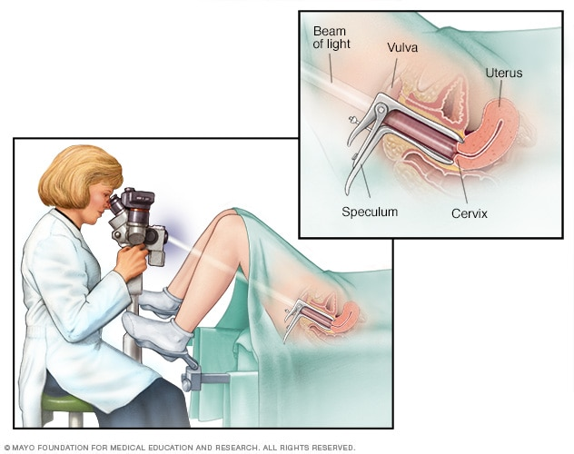
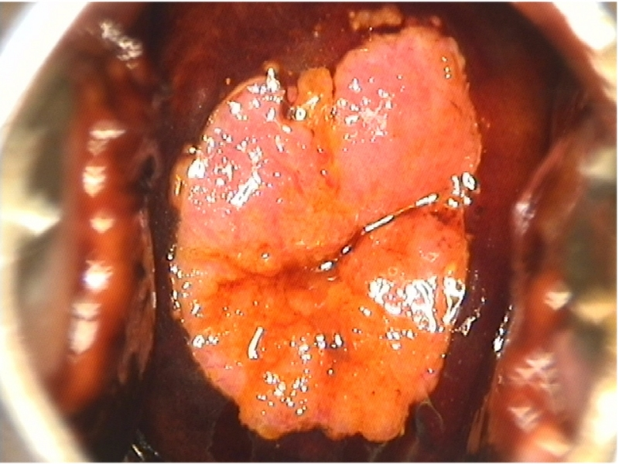
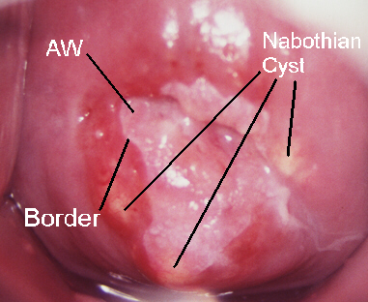
What colour are abnormal cells on colposcopy and why?
acetic acid
Lugol solution

Slide 11
Acetic acid
Acetic acid is thought to cause swelling of the epithelial tissue, columnar and any abnormal squamous epithelial areas in particular.
It causes a reversible coagulation of the nuclear proteins and cytokeratins.
Thus, the effect of acetic acid depends upon the amount of nuclear proteins and cytokeratins present in the epithelium.
When acetic acid is applied to normal squamous epithelium, little coagulation occurs in the superficial cell layer, as this is sparsely nucleated.

Slide 12
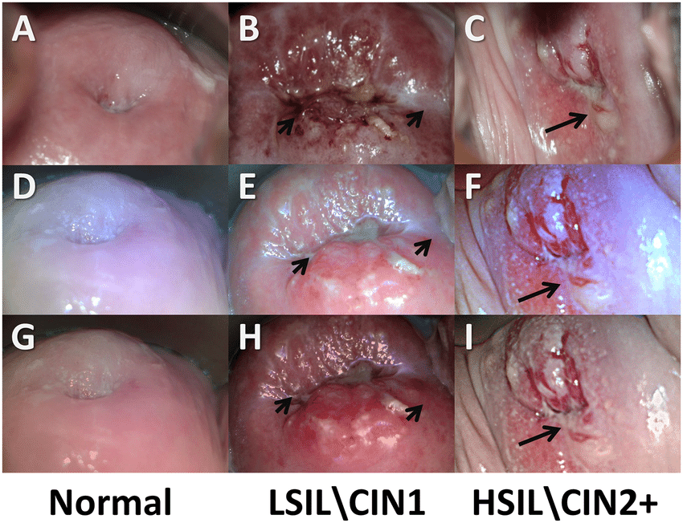

Slide 13
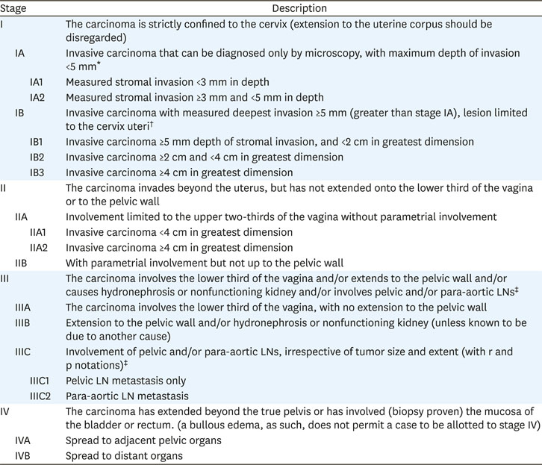
How do we stage cervical cancer?
Clinical
Vs
Surgical

Slide 14
Endometrial cancer
What are the risk factors for endometrial cancer?
How is endometrial cancer staged?
How is endometrial cancer treated?

Slide 15
What are the risk factors for endometrial cancer?
Older age.
A personal or family history of cancer.
Using tobacco.
Obesity.
Alcohol.
Some types of viral infections, such as human papillomavirus (HPV)
Specific chemicals.

Slide 16
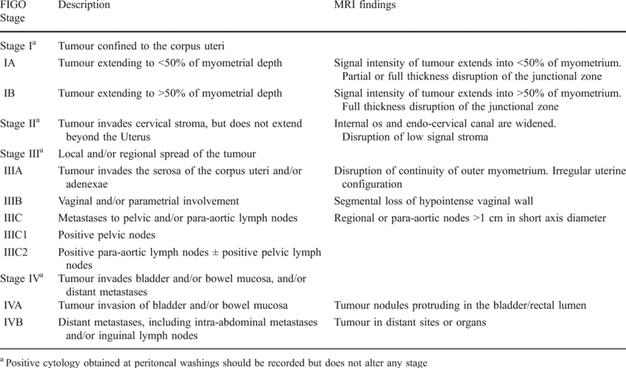
How is endometrial cancer staged?

Slide 17
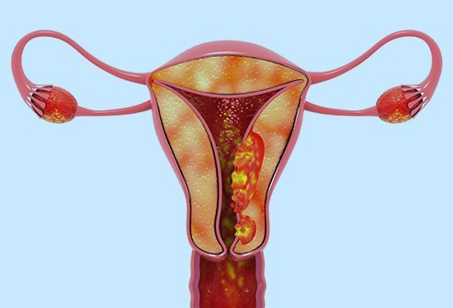
How is endometrial cancer treated?
Conservative treatment
Fertility preservation
D&C plus progesterone
Surgical

Slide 18
Ovarian cancer
Is screening for ovarian cancer routine?
Is screening possible
Ultrasound
MRI???
CA-125????
Roma Index
CA-125 + HE4

Slide 19
Why is the prognosis for ovarian cancer relatively poor?
Diagnosis in advance stage
No symptoms
Multiple metastasis
Liver
Peritoneum
Uterus
Lungs

Slide 20
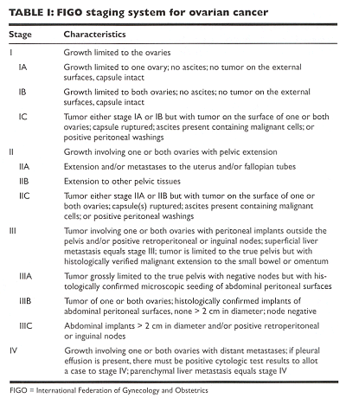
How is ovarian cancer staged?
Clinical
or
Surgical

Slide 21
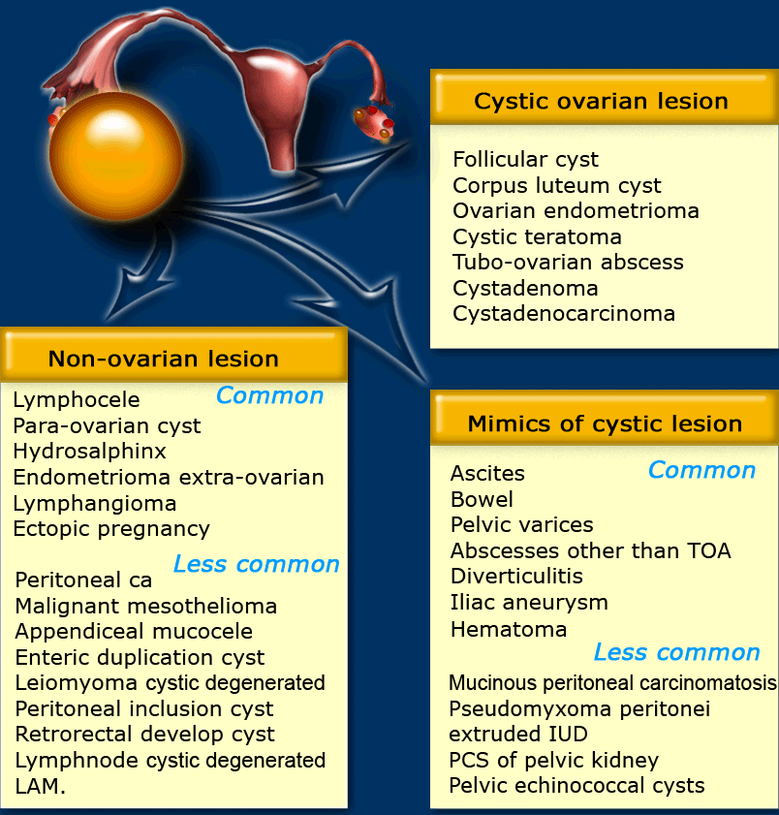
What is the differential diagnosis of ovarian cysts in postmenopausal women?

Slide 22
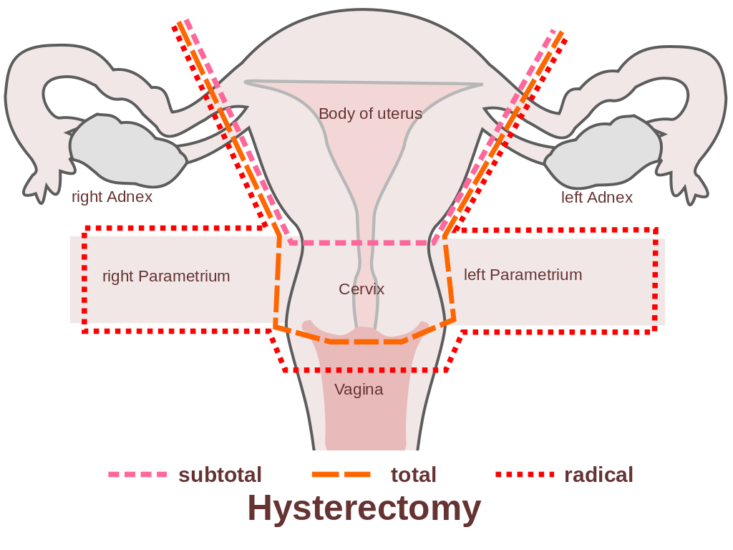
Gynaecological operations
Discuss indications and complications of Wertheim’s hysterectomy.
Would surgery be indicated even in advanced ovarian cancer?

