Slide 1
Core Problem 1 – Obstetric Tragedies

Slide 2
Core Topics
Assessment of gestational age
Antenatal care
Premature labour
Tests of fetal wellbeing

Slide 3
A woman is in premature labour at 26 weeks. She had a previous neonatal death after delivery at the same gestation week.

Slide 4
Assessment of gestational age
Is assessment of gestational age important?
Discuss dating of pregnancy by USS vs LMP.
When is USS assessment of gestational age best performed?

Slide 5
Calculation of estimated date of delivery
Naegele’s Rule
Due Date Calculator (web)
CRL

Slide 6
Antenatal care
What type of antenatal care would you recommend for this patient?
Discuss types of antenatal care.

Slide 7
FREQUENCY OF PRENATAL VISITS
prenatal care saves lives
association between the number of prenatal visits and/or early gestational age at the initiation of care and pregnancy outcomes, after controlling for confounding factors.
For nulliparous women with uncomplicated pregnancies are:
every 4 weeks until 28 weeks of gestation,
every 2 weeks from 28 to 36 weeks
Then weekly until delivery [3].
Parous women with uncomplicated medical obstetric histories may be seen less frequently.
Women with problems are seen more frequently,
Higher risk pregnancies

Slide 8
FREQUENCY OF PRENATAL VISITS
16 prenatal visits but……
The National Institute of Health:10 appointments for nulliparous women and 7 appointments for parous women
World Health Organization (WHO) antenatal care guidelines suggest a minimum of 8 antenatal visits for all women, regardless of parity

Slide 9
Antenatal care
Who
How often
What should we evaluate in each visit
Where ( hospital or home)

Slide 10
Premature labour
term pregnancy
deliveries occurring at or beyond 37 0/7 weeks of gestation.
early term (37 0/7 weeks of gestation through 38 6/7 weeks of gestation),
full term (39 0/7 weeks of gestation through 40 6/7 weeks of gestation),
late term (41 0/7 weeks of gestation through 41 6/7 weeks of gestation)
postterm (42 0/7 weeks of gestation and beyond)
https://www.acog.org/clinical/clinical-guidance/committee-opinion/articles/2013/11/definition-of-term-pregnancy

Slide 11
Definition of labour
Labor is a physiologic process during which the fetus, membranes, umbilical cord, and placenta are expelled from the uterus.
regular contractions
opening of your cervix
Premature labour.
labour occurs after week 20 and before week 37 of pregnancy
Until 19+6 the term is abortion

Slide 12
Viability

Slide 13
Premature labour
What proportion of women deliver prior to 37 weeks?
5% in developed countries
25% in developing countries.
significant ethnic variation in preterm birth rates,
higher rates in black women.
iatrogenic delivery is responsible for almost half of the births between 28 and 35 weeks;
hypertension and pre-eclampsia are the major pathologies.
Other factors include multiple pregnancy, intrauterine growth restriction, maternal stress and heavy physical work
https://www.acog.org/clinical/clinical-guidance/committee-opinion/articles/2013/11/definition-of-term-pregnancy

Slide 14
What are the risk factors for premature delivery?
Age of the mother
Women younger than age 18 are more likely to have a preterm delivery.
Women older than age 35 are also at risk of having preterm infants
Certain lifestyle and environmental factors, including:
Late or no health care during pregnancy
Smoking
Drinking alcohol
Using illegal drugs
Domestic violence, including physical, sexual, or emotional abuse
Lack of social support
Stress
Long working hours with long periods of standing
Exposure to certain environmental pollutants

Slide 15
What are the risk factors for premature delivery?
Mother
Premature preterm rapture of the amniotic membranes
Infections
Urinary tract infections
Sexually transmitted infections
Certain vaginal infections
Bleeding from the vagina
Cervical length
High blood pressure
Pregnancy resulting from in vitro fertilization
Being underweight or obese before pregnancy
Short time period between pregnancies (less than 6 months between a birth and the beginning of the next pregnancy)
Being at risk for rupture of the uterus
Pregnancy resulting from in vitro fertilization
https://www.acog.org/clinical/clinical-guidance/committee-opinion/articles/2013/11/definition-of-term-pregnancy

Slide 16
What are the risk factors for premature delivery?
Placenta
Placenta previa
Abruption
Baby
Major pathologies
multiple pregnancy
Certain developmental abnormalities in the fetus
https://www.acog.org/clinical/clinical-guidance/committee-opinion/articles/2013/11/definition-of-term-pregnancy

Slide 17
Diagnosis of preterm labor
Diagnosis using clinical examination
Bishop score
Diagnosis using biochemical tests
Phosphorylated insulin-like growth factor binding protein-1 (pIGFBP-1)
Fetal fibronectin
Fetal fibronectin before or after digital cervical examination
Diagnosis using ultrasound features
Cervical length measured using transvaginal ultrasound

Slide 18
Management of premature labour
What is the role of antenatal steroids?
What is the role of tocolytics in management of premature labour?
Discuss problems of extreme prematurity for the neonate.
How do survival rates vary with gestation?
https://www.acog.org/clinical/clinical-guidance/committee-opinion/articles/2013/11/definition-of-term-pregnancy

Slide 19
Management of premature labour
What is the role of antenatal steroids?
Protocol
two 12-mg doses of betamethasone given intramuscularly 24 hours apart
four 6-mg doses of dexamethasone administered intramuscularly every 12 hours
A single course of corticosteroids is recommended for pregnant women between 24 0/7 weeks and 33 6/7 weeks of gestation who are at risk of preterm delivery within 7 days, including for those with ruptured membranes and multiple gestations.
https://www.acog.org/clinical/clinical-guidance/committee-opinion/articles/2017/08/antenatal-corticosteroid-therapy-for-fetal-maturation

Slide 20
Management of premature labour
What is the role of tocolytics in management of premature labour?
Tocolysis
Drugs used to stop or delay the progress of labour
https://www.acog.org/clinical/clinical-guidance/committee-opinion/articles/2017/08/antenatal-corticosteroid-therapy-for-fetal-maturation

Slide 21
Management of premature labour
Discuss problems of extreme prematurity for the neonate.
How do survival rates vary with gestation?
https://www.acog.org/clinical/clinical-guidance/committee-opinion/articles/2013/11/definition-of-term-pregnancy

Slide 22
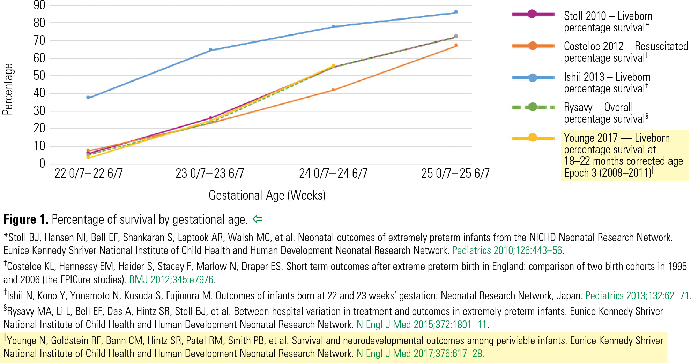

Slide 23
Jo is 34 weeks in her first pregnancy. She comes up to Day Assessment with 2 days of reduced fetal movements. The midwives ask you to help assess her.

Slide 24
Tests of fetal wellbeing
Compare assessment of fetal size by palpation vs ultrasound.
What are the features of a normal CTG and how do these reassure us about fetal wellbeing?
What abnormal features on an antenatal CTG might cause concern about fetal wellbeing?
How do we assess fetal wellbeing on USS?

Slide 25
http://eknygos.lsmuni.lt/akuserijaen/Obstetrics/4%20CTG%20engl.html

Slide 26
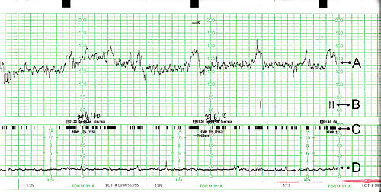

Slide 27
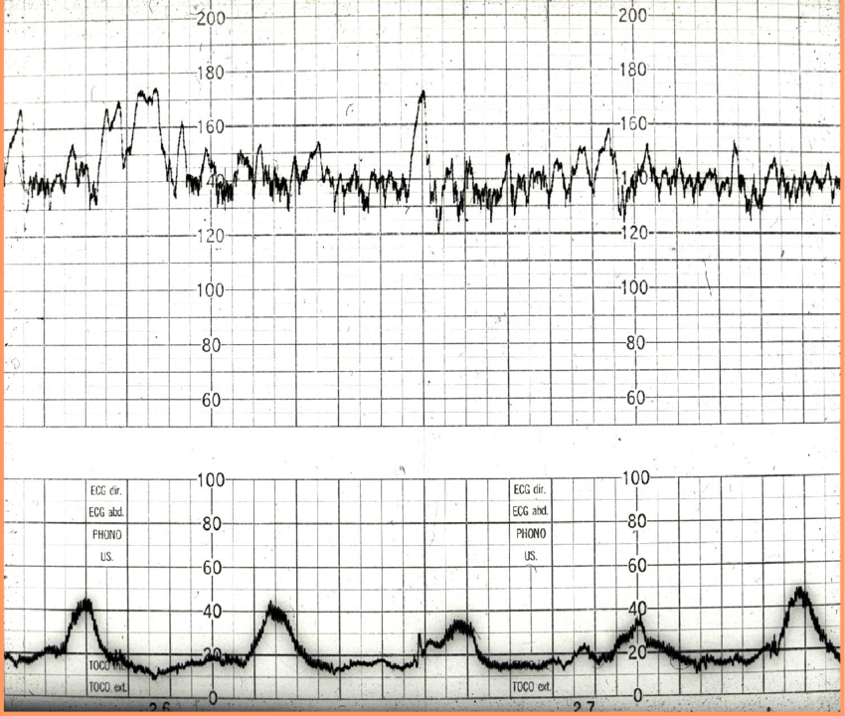

Slide 28
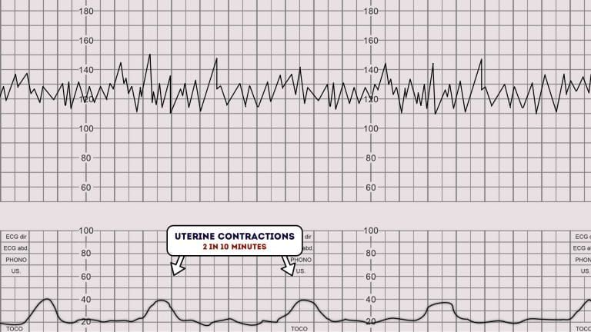

Slide 29
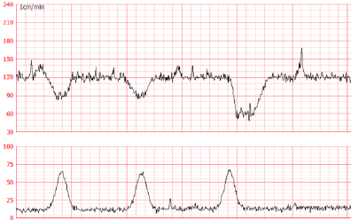

Slide 30
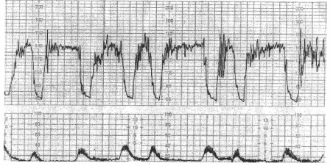

Slide 31
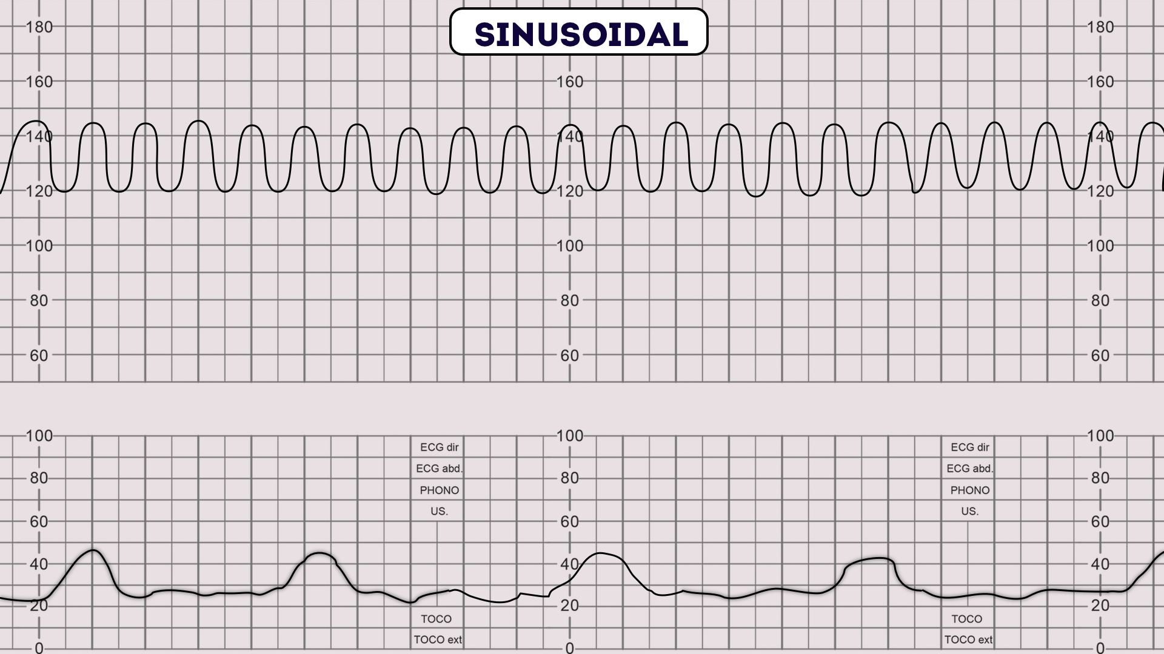

Slide 32
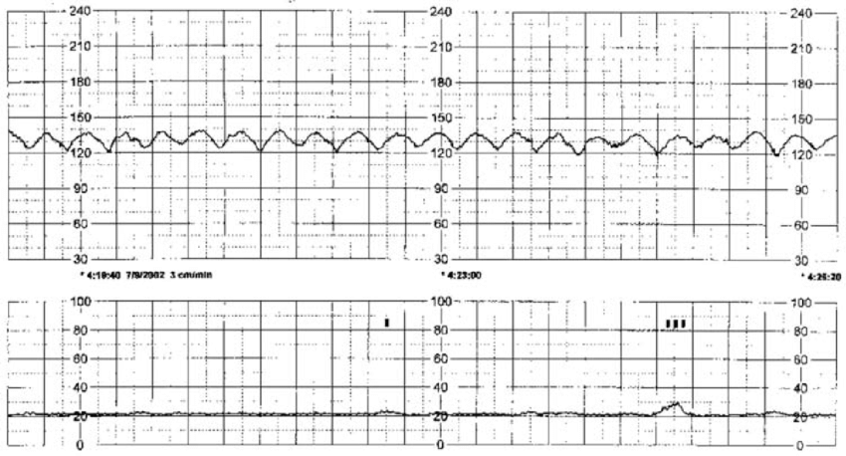

Slide 33
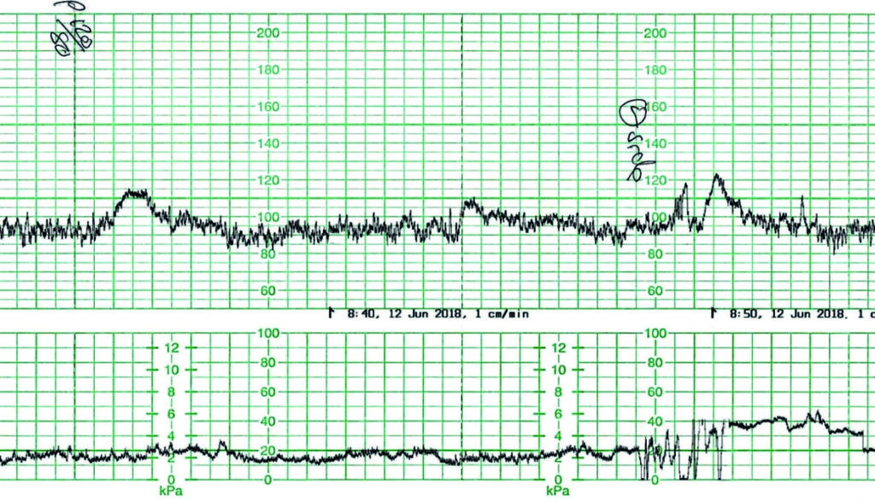

Slide 34
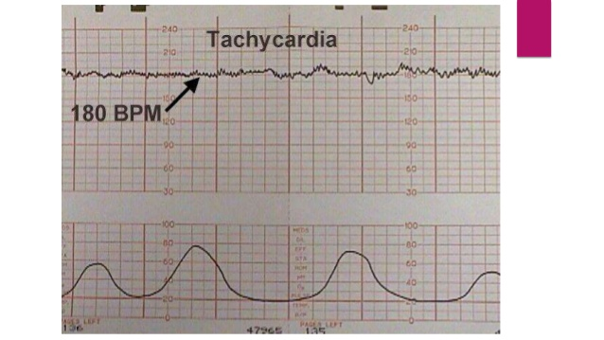

Slide 35
The midwives are unable to locate the fetal heart and an Ultrasound sadly diagnoses fetal demise.
What is the definition of a stillbirth?
Discuss the emotional impact a stillbirth has and what measures are available to support women in these circumstances.

